Slide 1
Telepsychiatry for C-L Psychiatrists – Hits and Near Misses
Andrew R. Alkis, MD
Clinical Assistant Professor
Department of Psychiatry & Behavioral Sciences

Slide 2
Acknowledgement
This presentation is supported by the Health Resources and Services Administration (HRSA) of the U.S. Department of Health and Human Services (HHS) as part of Grant Number U66RH31458 totaling $4,250,000 with 100 percent funded by the Office for the Advancement of Telehealth at HRSA/HHS. The contents are those of the author(s) and do not necessarily represent the official views of, nor an endorsement, by HRSA/HHS, or the U.S. Government.

Slide 3
Learning Objectives
Understand one institutions framework for telehealth care delivery
Describe a model for Telehealth-enabled Collaborative Care Management (Tele-CoCM)
Describe a direct-to-consumer model for primary care behavioral health integration leveraging Telehealth technology
Discuss success and challenges related to each telehealth-enabled program

Slide 4



MUSC Telehealth Infrastructure
Telehealth for efficient, effective care
MUSC Center for Telehealth
Center of Excellence
Healthcare Redesign
State of South Carolina telehealth investment. MUSC Center for Telehealth founded
Designated by Health Resources & Services Administration (HRSA) as a national Telehealth Center of Excellence
Integration of telehealth into existing healthcare delivery models and culture
2002- 2009
2020
2014
2013
2017
2023
Early Years
Telehealth Expansion
Telestroke, TeleICU, TelePsych, Maternal Fetal Telemedicine
SCTA Founded
South Carolina Telehealth Alliance founded. Headquartered at MUSC
Explosive growth of telehealth in ambulatory space due to COVID-19

Slide 5
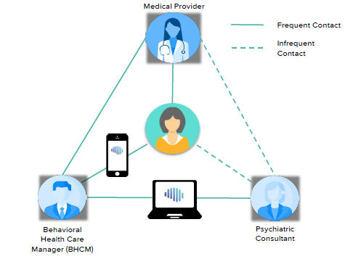
Telehealth-enabled Collaborative Care Management (Tele-CoCM)
CoCM OVERVIEW
Care delivery to MUSC Regional Health Network (RHN) Primary Care
Blends synchronous visits with asynchronous remote monitoring of patient progress
Ideal ratio for Behavioral Health Care Managers (BHCM) is 1:90 patients
Systematic Caseload review allows for Psychiatry oversight and recommendations at scale
Supported by NeuroFlow® – a digital engagement platform that serves as a patient registry and leverages AI-Enabled features to improve outcomes, overall wellness, and decrease costs of care
University of Washington AIMS Center – www.aims.uw.edu
www.neuroflow.com

Slide 6
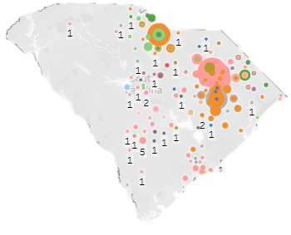
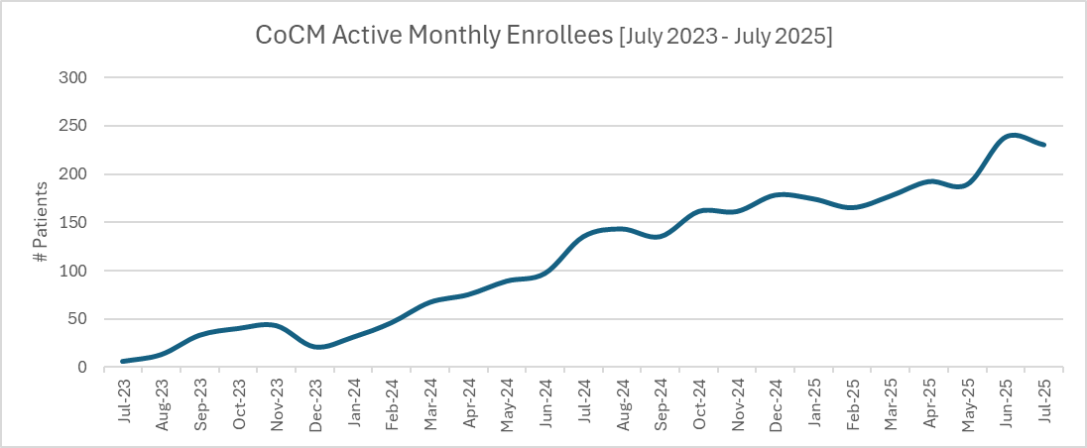
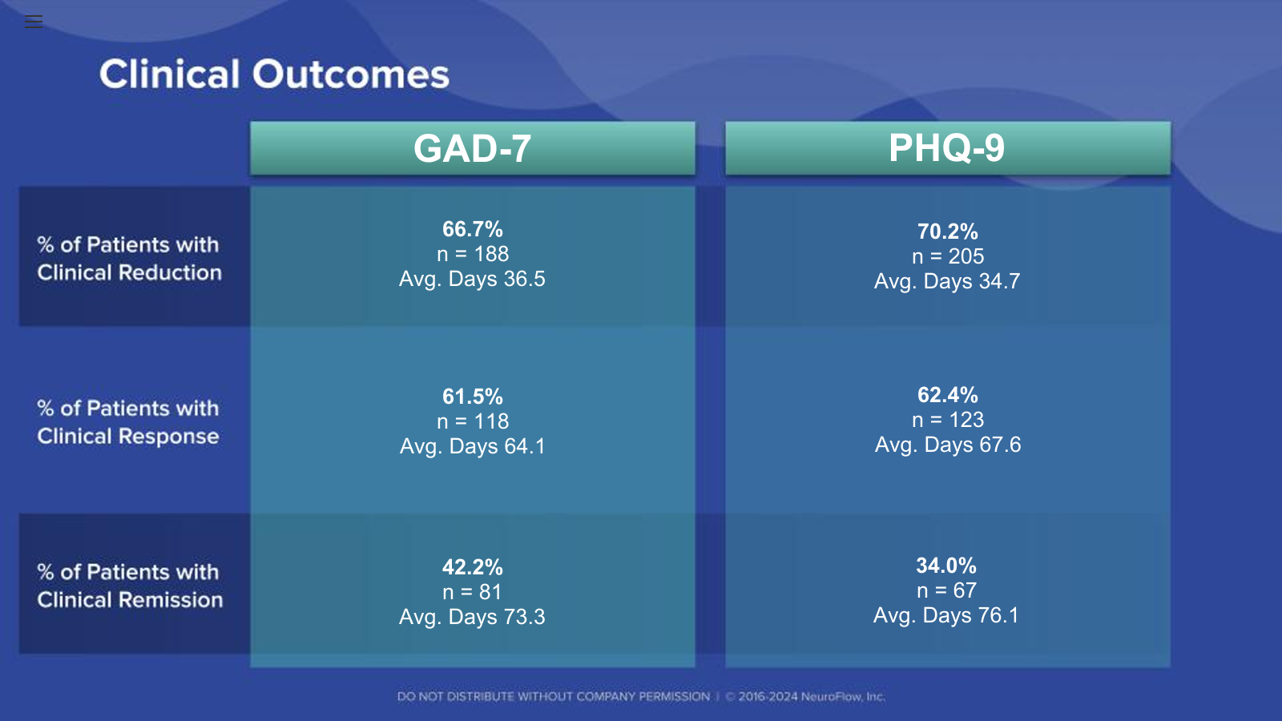
Tele-CoCM
Supporting Primary Care throughout
Rural South Carolina
Over 1/3rd
of patients had a clinical reduction in PHQ9/GAD7 in
35 days
Over 2/3rd
of patients had a clinical remission in PHQ9/GAD7 in
74 days

Slide 7
Tele-CoCM Successes
We are now enterprise wide and are starting to discuss movement into specialty care
Development of a resident longitudinal rotation
Primary care provider satisfaction has been consistently high
4 Behavioral Health Care Managers
Annual South Carolina Collaborative Care Summit

Slide 8
Tele-CoCM Challenage
A Change in Paradigm
  “Can you just see and manage my patient?”
Acceptance to Change
  Hesitancy from partners given newly activated CPT codes
A Crowded Market
  E-Consult, Competing internal specialty consultation, Competing external referrals
Trouble-shooting to Minimize Confusion
  Working with EPIC builders and other services to make ordering as simple as possible……………….may not be so simple

Slide 9
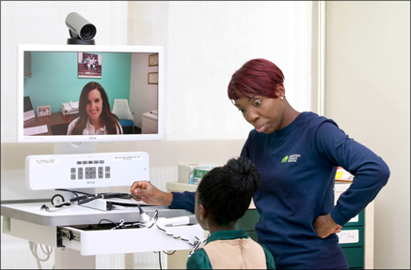
Outpatient Telehealth Psychiatry Consultation (OT Psych)
OT Psych OVERVIEW
Non-MUSC Primary Care Provider requests consultation
Psychiatry specialist performs real-time (synchronous), direct-to-consumer visits
Ideal number of visits is 3 – 5
Management recommendations are delivered to Primary Care Provider via secure, direct messaging – PCP places orders
Psychiatry specialists are physicians or PMH-NP (psychiatric mental health nurse practitioners)

Slide 10

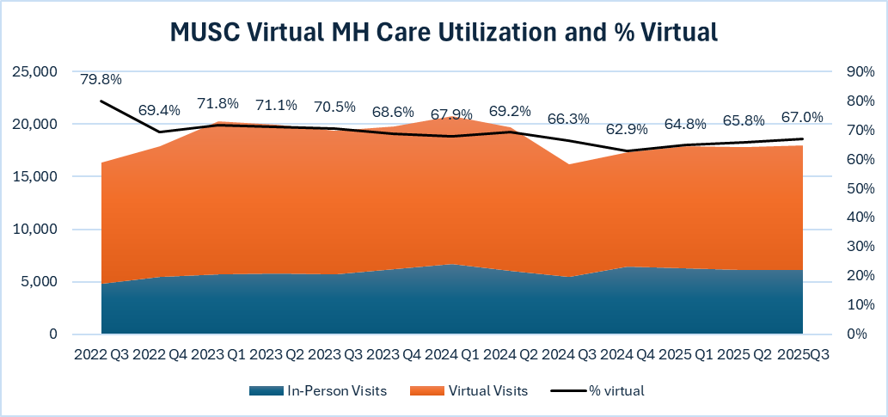

OT Psych
50,000
68%
DTC Behavioral Health Video Visits in the last 12 months
Of all ambulatory Behavioral Health video visits are virtual

Slide 11
OT Psych Successes
Exponential growth
Interprofessional partnership with College of Nursing (CON)
  PARTNER PMH-NP fellows help with care delivery with physician oversight
Consistent reimbursement using traditional CPT codes
Direct-to-consumer allows patients to be seen anywhere across the state
Fosters partnership and collaboration with non-MUSC primary care providers

Slide 12
OT Psych Challenges
Reaching non-MUSC Primary Care Providers
Recommendations not being implemented
Limited ability to evaluate certain mental health presentations
  Acutely suicidal patients, acutely psychotic patients, evaluations for neurodevelopmental disorders
Capping a number of consultation visits
  What if there is no long-term psychiatric option available?
  What if there is considerable rapport development?
Disagreements on management

Slide 13
Case Illustration
34-year-old female G4P3 with a psychiatric history pertinent for Major Depressive Disorder, Posttraumatic Stress Disorder, and Panic Disorder who presents to CoCM for evaluation. There is a history of post-partum depression.
Home medications include:
  Venlafaxine extended-release 150 mg by mouth daily
  Mirtazapine 15 mg by mouth at bedtime
  Alprazolam 1 mg by mouth three times daily (taking for ~ 2 years)
During follow-up with her Behavioral Health Care Manager, we learn she is 7-weeks pregnant.
OB/GYN has encouraged her to stop all psychotropic medicines
PCP does not feel comfortable with CoCM recommendations to continue medications given OB/GYN’s concerns

Slide 14
Case Illustration – continued
Collaboration Breakdown
  What if a provider is not reachable?
Ryan Haight and Post-Pandemic Era
  Can this patient receive a controlled substance if not seen by a prescriber face-to-face?
Creativity & Flexibility
  Can we blend programs (i.e., Tele-CoCM with OT Psych) to help bridge challenging cases?
Outcome
  Patient seen virtually by psychiatric provider to provide prescriptions to bridge them to our Women’s Perinatal Psychiatry clinic

Slide 15
Future Considerations
Strengthening partnership with Primary Care institutionally
Working with EPIC builders to simplify the referral process
Partnering with a Federally Qualified Health Center (FQHC)
Extending CoCM outside the MUSC RHN
Comparing Telehealth-enabled CoCM delivered virtually versus in-person
Reconceptualizing how all outpatient behavioral health care delivery can best co-exist

Slide 16
The Telehealth Centers of Excellence(COEs) develop resources for telehealth organizations, researchers, providers, and staff based on their experience, research, and innovation.
TelehealthCOE.org

