Slide 1


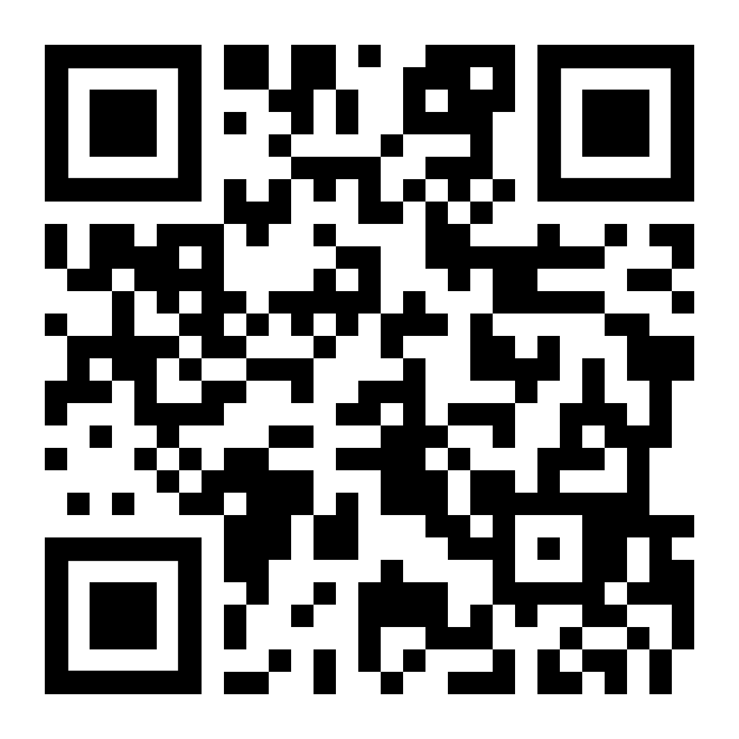
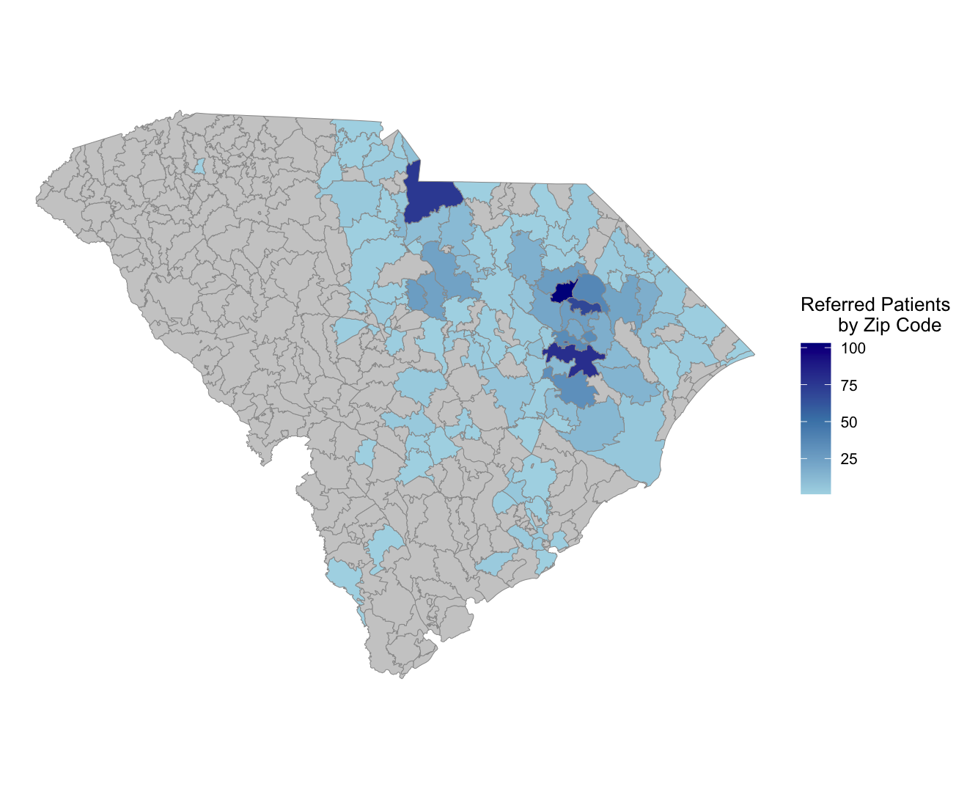
Evaluating a telehealth-enabled collaborative care program for behavioral health in rural primary care:
Leveraging patient-reported experiences to improve enrollment process
Caitlin Koob, PhD^{1,2}, Emily Johnson, PhD^{2,3}, Andrew Alkis, MD^{2,4}, Candace Sprouse-McClam, PhD²,
Katie Kirchoff, MSHI², & Jennifer Dahne, PhD^{2,4}
¹Department of Healthcare Leadership and Management, Medical University of South Carolina (MUSC), Charleston, SC; ²Center for Telehealth, MUSC, Charleston, SC;
³College of Nursing, MUSC, Charleston, SC; ⁴College of Medicine, MUSC, Charleston, SC
BACKGROUND
All 46 SC counties are considered to have a healthcare provider shortage
Collaborative care management addresses behavioral health in primary care
Uptake in rural communities remains challenging
Our telehealth-enabled Collaborative Care Management (CoCM) program was designed to improve access and quality of behavioral health services
Study Purpose: To describe the barriers and facilitators to CoCM enrollment among referred patients.
RESULTS
Reach:
  CoCM has grown from serving 18 to 44 primary care clinics statewide
  1,065 Patients were Referred to CoCM from 06/01/2023 – 06/30/2025 (Fig. 1)
  608 patients referred ultimately enrolled into the program and completed an index assessment and intake visit with a behavioral health manager
Effectiveness:
  Of patients who enrolled and discharged (N=465), 45% successfully graduated
  Enrollees reported improvements in their mental health (60%)
  71% of enrollees reported “always” or ”most of the time” feeling comfortable discussing their mental health concerns with their care manager
Adoption:
  Referred patients who did not enroll often did not remember receiving the information from their primary care provider (38.2%)
  Enrollees (80%) and non-enrollees (53%) reported information was easy to understand
Implementation:
  Enrollees participated in a mean of 124.9 days (SD = 92.5, IQR = 66.0-171.0)
  Enrollees (31%) and non-enrollees (31%) reported “flyers” as the best way to reach patients
Maintenance:
  Over half of enrollees (58%) reported being “confident” or “very confident” that they could maintain their progress after CoCM
  62% of enrollees reported they would recommend the CoCM program to others in need of mental or behavioral health support
Read more about CoCM’s pilot implementation here
(Kruis et al., 2025).
METHODS
RE-AIM guides real-time evaluation to inform program quality improvement and data-driven decision-making
Data sources:
  Electronic health records (N=1,065 patients)
  Neuroflow platform data for enrolled patients (N = 608)
  Electronic surveys from patients who did and did not enroll in CoCM (N=120)
  In-depth interviews with patients who did and did not enroll in CoCM (N=15)
Quantitative data were analyzed using descriptive statistics
Qualitative data were analyzed via deductive thematic analysis
Exemplar Quotes
“It has completely turned my whole life around …They really hit the nail on the head. They got personal quick…And they did so good guiding me, helping me through all that and opening me up.” - Enrollee “I have thought about it, but I lost the information on it, so I let it go.” - Non-enrollee
Figure 1. Patients referred to CoCM by zip code from 06/01/2023 – 06/30/2025.
CONCLUSIONS & NEXT STEPS
Feedback to improve program quality, patient outcomes, and guide scalability
Transitioned from grant funding to standard billing practices
Next steps include robust analyses of patient-reported data (i.e., screeners, mood trackers) and clinical outcomes, such as acute care utilization
This poster is supported by the Health Resources and Services Administration (HRSA) of the U.S. Department of Health and Human Services (HHS) as part of the National Telehealth Center of Excellence Award (U66RH31458) totaling $4,250,000 with 100 percent funded by HRSA/HHS. The contents are those of the author(s) and do not necessarily represent the official views of, nor an endorsement, by HRSA/HHS, or the U.S. Government.
Questions? Please reach out to Caitlin Koob at cak240@musc.edu.
Notes:
Notes:
In Powerpoint, click View > Guides
Keep text within gutter guides.
Author list: Don’t split names onto two lines (e.g., “Jimmy [break] Smith”). If that happens, use a new line, unless you need the space. Bold the first names of anybody who’s presenting in person.
Intro/methods/result: Do not drop below font size 28, but if you have extra space, jack up the font size until the space is full.
Do not use color in the sidebars except in graphs/figures. It’ll pull attention from the center and slow interpretation for passersby.

