Slide 1
Evaluation of School-based Telehealth Behavioral
Programs
Claire MacGeorge, MD, MSCR; Medical University of South Carolina
Emily Johnson, PhD; Medical University of South Carolina

Slide 2

Claire MacGeorge, MD, MSCR
MUSC Associate Professor of Pediatrics
Medical Director of School-based Telehealth at MUSC
Co-Investigator for MUSC’s Telehealth Center of Excellence through HRSA

Slide 3
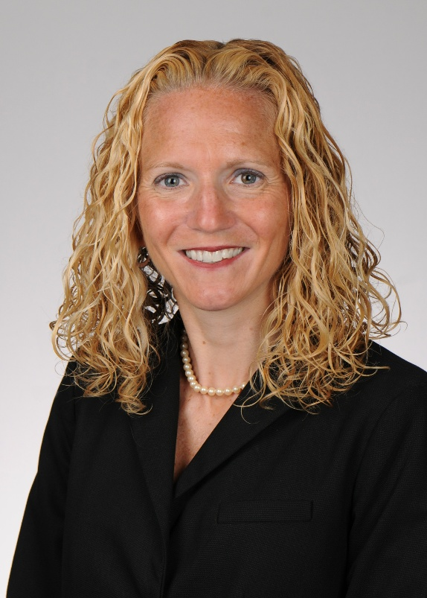
Emily Johnson, PhD
MUSC Professor, College of Nursing
Research Expertise-
  Implementation Scientist HRSA Telehealth Center of Excellence
  Member of MUSC Dissemination and Implementation (D&I) Science Collaborative (DISC)

Slide 4
The Telehealth Centers of Excellence(COEs) develop resources for telehealth organizations, researchers, providers, and staff based on their experience, research, and innovation.
TelehealthCOE.org

Slide 5
Objectives
1. Describe an overview of School-based telehealth (SBTH) behavioral programs including need, scope and advantages
2. Summarize an implementation-science focused evaluation of a robust state-wide SBTH behavioral program
3. Identify key strategies for a health system incorporating a new SBTH behavioral program

Slide 6
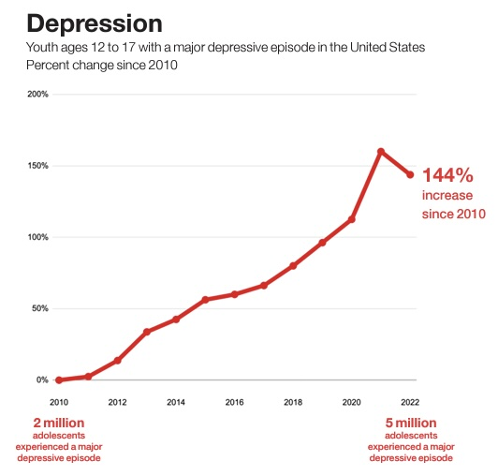
Mental Health Crisis
Background
20% of youth aged 12-17 in US reported at least one major depressive episode in the last year
60% of children in US with major depression do not receive any behavioral health treatment
Sowa NA, Gaffney K, Sanders A, Murrell C. School-Based Tele-Behavioral Health: A Scoping Review of the Literature. J Sch Health. 2024 Jun;94(6):571-580. doi: 10.1111/josh.13435. Epub 2024 Jan 23. PMID: 38263701.

Slide 7
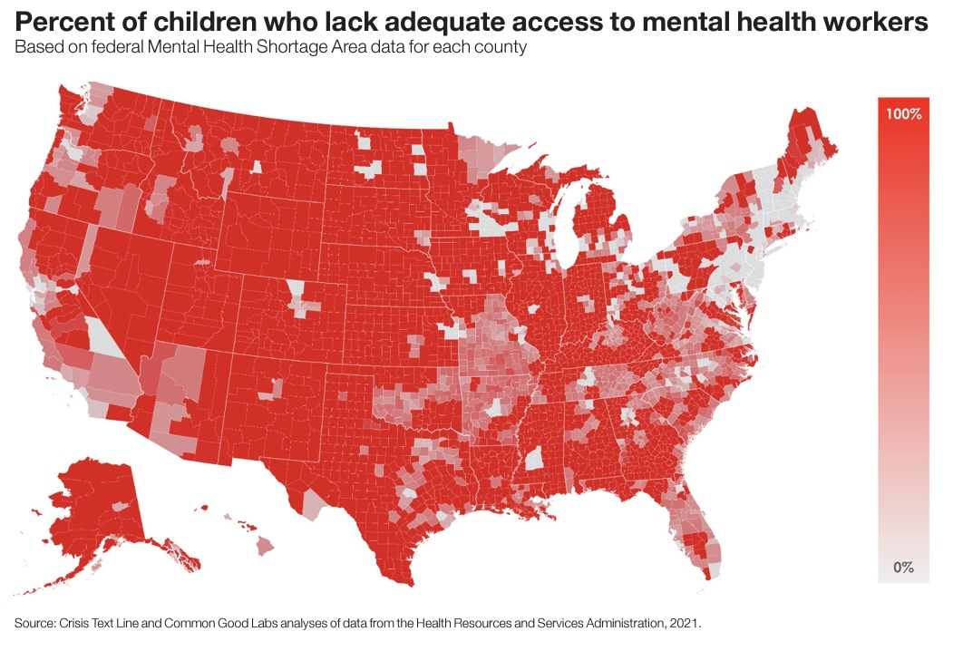
Background

Slide 8
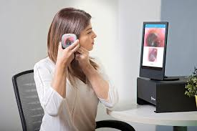
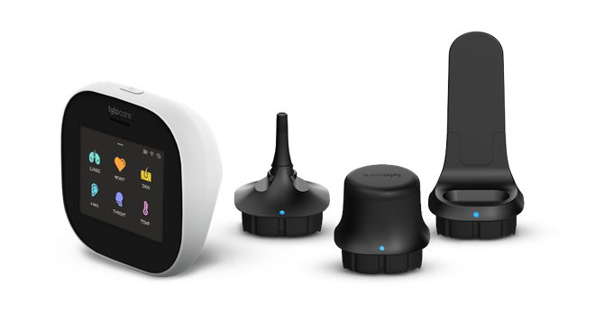
School-based telehealth (SBTH)
Background
Provision of high-quality healthcare for children in the school setting using telehealth technologies
3,900 school-based health center sites operating across the United States
Over 9.8 million students are served each year
Improve access by decreasing financial, geographic, age and cultural barriers
Soleimanpour S, Cushing K, Christensen J, Ng S, Yang J, Saphir M, Geierstanger S, Even M, Brey L. (2023). Findings from the 2022 National Census of School-Based Health Centers. Washington, DC: School-Based Health Alliance.
Kjolhede, C., Lee, A., De Pinto, C., O’Leary, S., Baum, M., Beers, N., Bode, S., Gibson, E., Gorski, P., Jacob, V., Larkin, M., Christopher, R., Schumacher, S. Council on school health, school-based health centers and pediatric practice. Pediatrics October 2021; 148 (4): e2021053758. 10.1542/peds.2021-053758

Slide 9
SBTH Behavioral Health - Scope
Background
Wide rage of conditions treated: ADHD, anxiety, depression
Targeted age groups: elementary through high school, teachers, parents
Variety of target audiences: Universal program vs selective, disease-specific
Richter, A.; Sjunnestrand, M.; Romare Strandh, M.; Hasson, H. Implementing school-based mental health services: A scoping review of the literature summarizing the factors that affect implementation. Int. J. Environ. Res. Public Health 2022, 19, 3489. https://doi.org/10.3390/ ijerph19063489

Slide 10
SBTH - Advantages
Background
All SBTH:
  Improve access to care
  Improve health outcomes
  Reduce health disparities
SBTH behavioral health:
  Address substance use, bullying, violence and suicide prevention
  Reduction in reported depressive episodes and suicidal ideation
Kjolhede, C., Lee, A., De Pinto, C., O’Leary, S., Baum, M., Beers, N., Bode, S., Gibson, E., Gorski, P., Jacob, V., Larkin, M., Christopher, R., Schumacher, S. Council on school health, school-based health centers and pediatric practice. Pediatrics October 2021; 148 (4): e2021053758. 10.1542/peds.2021-053758

Slide 11
Objectives
1. Describe an overview of School-based Telehealth (SBTH) Behavioral Programs including need, scope and advantages
2. Summarize an implementation-science focused evaluation of a robust state-wide SBTH behavioral program
3. Identify key strategies for a health system incorporating a new SBTH behavioral program
Notes:
Webinar objectives

Slide 12
State-wide SBTH Behavioral Health Program Evaluation
School based program in existence since 2013
Currently present in over 200 school districts and over 800 schools
From 2013-26, nearly 15,000 referrals
Services offered:
  Therapy, trauma/grief focused care, medication management and coping skills
  Completed via telehealth at school by licensed mental health clinician, psychologist, child and adolescent psychiatrist
Most common referrals-anxiety, depression, anger, attention problems, disruptive behaviors

Slide 13
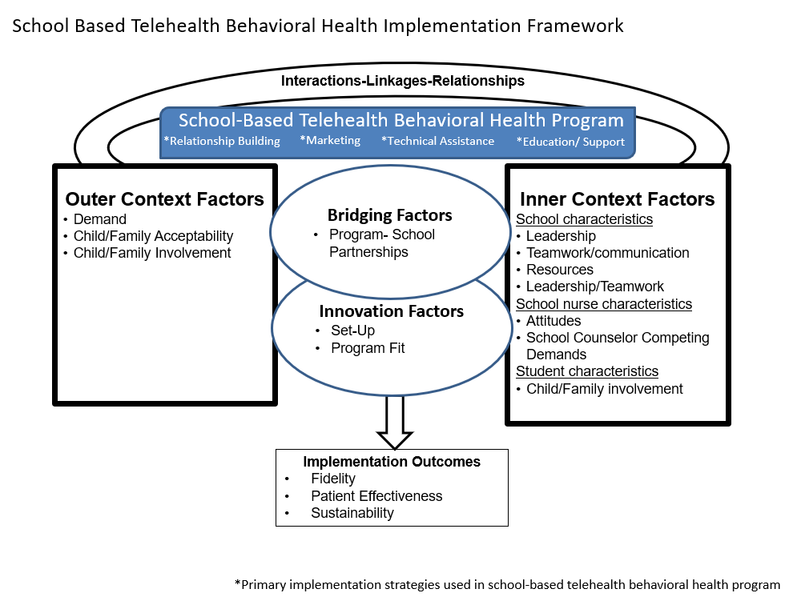
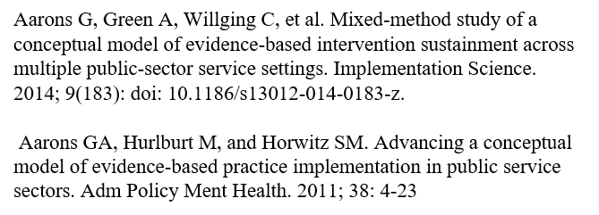
Exploration, Preparation, Implementation, Sustainment (EPIS) Framework

Slide 14
Study Methods
School Counselor Survey (n=79)
  Services offered at school
  Perceived barriers to SBTH behavioral health program
  Attitudes toward SBTH behavioral health program
Key Informant Interviews (n=18)
  In-depth exploration of barriers and facilitators to implementation and sustainability of SBTH behavioral health program
  5 SBTH behavioral health program staff
  7 SBTH behavioral health program therapists
  6 school counselors

Slide 15
Study Key Results-Outer
Demand
  Limited alternatives for behavioral health care (specifically rural areas)
  SBTH program is free, school-based, convenient
Child/Family Acceptability
  Parents appreciated convenience, free cost; students appreciate appointments
  Barriers-stigma toward behavioral health care, privacy concerns, confusion on logistics
Child/Family Involvement
  Strength and Challenge
  Parents decide if child participates, sign consent, join session virtually or in person
Notes:
To say
Acceptability-highest in parents when they clearly understood program; well informed, respected, protected by confidentiality, able to access support with minimal burden
Involvement-Several interviewees felt this involvement improves communication, supports continuity of care, and can build trust when families understand that the program is supportive, free, school-based, and not punitive. At the same time, school counselors in particular noted parent availability, work schedules, transportation, technology, language barriers and consent paperwork often affect access and appointment attendance. Younger children create additional demands because caregivers need to be physically present for each appointment.

Slide 16
Outer Results-Quotations
Demand
  “I've seen a lot of people who have been over the moon grateful because there was no other option for them…And just thinking about how there are more rural places or there are situations with disabilities and things like that where families cannot go to therapy at all...there’s no way for them to get there.” (Therapist)
Child/Family Acceptability
  “I would say probably more receptive than I anticipated… obviously there's so many variances like cultural and … perception around mental health… but this is free… And that's enough of a foot in the door to them.” (Therapist)

Slide 17
Study Key Results-Inner
Leadership
  District level (superintendent); school level (school counselor)
  Leadership buy-in at school level
Teamwork/Communication
  Between health science university, program therapists, school counselors, school administrative team
Attitudes
  Misperceptions regarding additional workload required by program
  Appreciation of program benefits
Competing Demands
Resources
  Space, staff/turn-over challenges

Slide 18
Inner Results-Quotations
Leadership
  “Most often, yes, it's going to be the school counselor who has little to no time to do the things they need to do to care for the mental health of their students, but also knows they have limited, if any, resources at all. And so, the school counselors really are the champions.” (Program Staff)
Teamwork/Communication
  “I try to encourage communication with the school counselor to make sure I'm not missing anything on my end when I'm trying to get the best possible care….if I notice something's not going right, or we're missing something, or if I have trouble getting hold of the parent, we use the school counselor for those that help in those things because they are there daily and they get to see the students. And any concerns that I have with school or schoolwork or any kind of crisis that's going on, we build more of a relationship.” (Therapist)

Slide 19
Study Key Results-Bridging and Innovation
Bridging
Partner
  Initial and ongoing collaborative relationship between program staff and schools; schools and program therapists
Innovation
Set-up
Program Fit
  Aligned with student and community needs
  Larger schools (more program familiarity, workflow/workforce) vs smaller schools (demand but fewer resources, workforce)
Notes:
Partner notes-Program staff, counselors and therapists all emphasized the importance of ongoing communication and collaboration for successful program implementation and sustainability. Program staff described ongoing collaboration they foster with participating school districts and campuses, beginning with initial program walkthroughs and continued training refresher sessions. Staff described their commitment to ensuring all counselors remain informed about program procedures and updates. Program staff members also noted schools have access to designated points of contact via email and phone, allowing counselors to ask questions and receive timely support when needed.
Counselors-some received insufficient information when starting role/turnover challenging; but always had contact information of program staff; emphasized importance of initial and ongoing training, recommended tip sheet
Therapists-ongoing communication with school counselors important; talked about patient service specialists (scheduling, sending zoom links to schools communication with parents)

Slide 20
Bridging Results-Quotation
Partner
  “I can certainly find answers if I need them. I think [program staff] have always been very accommodating in that way, I can reach out for help. I have had some challenges with some of the things, but we've worked out some kinks here and there.[Program staff] are available for sure.” (Counselor)

Slide 21
Study Key Results-Outcomes
Fidelity
  Referral process (dependent on school’s understanding, communication pathways, technology)
  Standardized timelines
Effectiveness
  Improved student functioning, improved grades, reduced acute mental health crises
  Need for long term analysis of improved clinical indicators (depression symptoms, etc)
Sustainability
  Concerns-financial support, clinician capacity, program demand
Notes:
Fidelity-program staff and therapists described the basic referral process as straightforward with one universal platform for counselor referrals reducing the risk of missing referrals and improving tracking of referral status. A few counselors reported confusion with the referral process initially which was resolved after program training.
Fidelity is also supported by standardized timelines, especially expectations that students receive intake within roughly three weeks post- referral, and by centralized documentation systems that help teams track referrals, assessments, session information, and care plans. Challenges occurred in the setting of last-minute scheduling, parent-student-school coordination, staff turnover, summer referrals, and technology glitches. Therapists noted occasional challenges with referrals (outside of scope and missing details) as well as care planning (treatment and follow-up scheduling). Suggestions to improve fidelity included optimization of initial program orientation within each school setting and ongoing training refreshers, clear communication channels and consistent scheduling practices.

Slide 22
Implementation Outcomes -Quotation
Effectiveness
“We’ve done a really good job of things like reach and how many patients we're serving and how many of each type of session we're providing…that's really well done. I think an area for growth is actual clinical change… for example, changes in depression symptoms over time based on the type of service they're getting or how many sessions they had.” (Staff)

Slide 23
Exploration, Preparation, Implementation, Sustainment (EPIS) Framework

Slide 24
Implementation and Sustainability Strategies
Initial and ongoing training
Clearly defined program roles
Building relationships/Marketing
Technical assistance
Powell, B.J., et al., A refined compilation of implementation strategies: results from the Expert Recommendations for Implementing Change (ERIC) project. Implementation Science, 2015. 10: p. 21.
Waltz, T.J., et al., Use of concept mapping to characterize relationships among implementation strategies and assess their feasibility and importance: results from the Expert Recommendations for Implementing Change (ERIC) study. Implementation Science, 2015.
Notes:
Notes
Initial and ongoing comprehensive training and collaborative interaction between the schools and program staff are vital for counselors to ensure their understanding of program processes, workflows, and technical details. Training is especially important when a new counselor joins a school, as turnover was described as a barrier to program knowledge. A quick reference guide that could be maintained at each school campus was suggested by counselors as a potential beneficial resource. Training and educating stakeholders, including collaborative dynamic training methods, was identified as a key implementation strategy in the Expert Recommendations for Implementing Change (ERIC) study [23, 24]
Counselors also described the need for clearly defined roles and processes for referrals and appointments to ensure a smooth, efficient clinical process and avoid overlap of appointment times. Sufficient school staff members to manage appointments was continually discussed as a barrier especially for smaller schools that include grades kindergarten through 12th grade who are often understaffed and stretched thin. Lastly, counselors and therapists discussed the need for heightened interaction with parents to improve their engagement, trust, and participation in the program.
building relationships and marketing the program with key stakeholders. Engaging consumers, including involving patients, family members and interventionists, was also described as a key implementation strategy in the ERIC study [23, 24].
program staff described going to schools and school/community events to make personal face-to-face connections with school district leaders, counselors, students and parents to distribute information about the virtual, school-based mental health care program and personally improve receptivity to the program. The staff also made an intentional effort to visit schools with low referral rates to answer questions and try to overcome hesitations to program participation. Program staff described the positive impact of word-of-mouth feedback as it was noted that often times, non-participating schools and families heard about the SBTH program through a friend or colleague and subsequently requested the services at their schools.

Slide 25
Future Directions
Discussion
Parent and child perspectives
Cost-effectiveness
Disease-specific outcome measurements
Continued implementation evaluations

Slide 26
Conclusions
Discussion
SBTH behavioral health programs are a potential solution to addressing behavioral health needs of children.
Implementation evaluations of large-scale programs may guide the initiation or optimization of other SBTH programs

Slide 27
References
Aarons G, Green A, Willging C, et al. Mixed-method study of a conceptual model of evidence-based intervention sustainment across multiple public-sector service settings. Implementation Science. 2014; 9(183): doi: 10.1186/s13012-014-0183-z.
Aarons GA, Hurlburt M, and Horwitz SM. Advancing a conceptual model of evidence-based practice implementation in public service sectors. Adm Policy Ment Health. 2011; 38: 4-23.
Health Resources and Services Administration. Crisis text line and common good labs: Analyses of data. 2021
Kjolhede, C. Lee, A., De Pinto, C., O’Leary, S., Baum, M. Beers, N., Bode, S., Gibson, E., Gorski, P., Jacob, V., Larkin, M., Christopher, R. Schumacher, H. Council on school health, School-based health centers and pediatric practice. Pediatrics. October 2021; 148 (4): e2021053758. 10.1542/peds.2021-053758
Powell, B.J., et al., A refined compilation of implementation strategies: results from the Expert Recommendations for Implementing Change (ERIC) project. Implement Science. 2015. 10: p. 21.
Richter, A.; Sjunnestrand, M.; Romare Strandh, M.; Hasson, H. Implementing school-based mental health services: A scoping review of the literature summarizing the factors that affect implementation. Int. J. Environ. Res. Public Health. 2022, 19, 3489. https://doi.org/10.3390/ ijerph19063489
Soleimanpour S, Cushing K, Christensen J, Ng S, Yang J, Saphir M, Geierstanger S, Even M, Brey L. (2023). Findings from the 2022 National Census of School-Based Health Centers. Washington, DC: School-Based Health Alliance.
Sowa NA, Gaffney K, Sanders A, Murrell C. School-based tele-behavioral health: A scoping review of the literature. J Sch Health. 2024 Jun;94(6):571-580. doi: 10.1111/josh.13435. Epub 2024 Jan 23. PMID: 38263701
Waltz, T.J., et al., Use of concept mapping to characterize relationships among implementation strategies and assess their feasibility and importance: results from the Expert Recommendations for Implementing Change (ERIC) study. Implement Science 2015.

Slide 28
Questions and Contact Information
Claire MacGeorge
  macgeorg@musc.edu
Emily Johnson
  johnsoem@musc.edu

