Slide 1
Program Evaluation and a Telehealth Learning Health System: Lessons from Virtual Specialty Care and Tele-Palliative Care
Jillian Harvey, PhD, MPH

Slide 2

Acknowledgement
This presentation was supported by the Health Resources and Services Administration (HRSA) of the U.S. Department of Health and Human Services (HHS) under the Medical University of South Carolina Telehealth Center of Excellence cooperative agreement (U66RH31458), which has a total award amount of $4,250,000 for the approved project period. The contents are those of the author(s) and do not necessarily represent the official views of, nor an endorsement, by HRSA, HHS, or the U.S. Government.

Slide 3
Agenda
Introduction/Background
Overview of Telehealth Center for Telehealth
Conceptual Framework of Mini Learning Health System
Examples
  Virtual Specialty
  Tele Palliative Care

Slide 4
MUSC Telehealth Background

Slide 5

Medical University of South Carolina (MUSC)
Patient care is provided at 16 hospitals (includes owned or governing interest)
Approximately 2,700 beds and four additional hospital locations in development
Nearly 750 care locations situated in all regions of South Carolina.
Center for Telehealth at MUSC
The Center for Telehealth has over 15 years of experience providing telehealth, offering over 100 unique telehealth services to over 280 sites across South Carolina.
Care settings include over 45 hospitals, over 90 schools, and over 100 community clinics and other facilities (all 46 SC counties).

Slide 6

MUSC Telehealth History
MUSC Center for Telehealth
Center of Excellence
MUSC Center for Telehealth founded
State of South Carolina telehealth investment.
Designated by Health Resources & Services Administration (HRSA) as a national Telehealth Center of Excellence
2005-
2009
2014
2020
2013
2017
Early Years
SCTA Founded
Telehealth Expansion
Telestroke, TeleICU, TelePsych, Maternal Fetal Telemedicine
South Carolina Telehealth Association founded. Headquartered at MUSC
Explosive growth of telehealth in ambulatory space due to COVID-19

Slide 7

Problem: Access challenge in SC
Problem: Patients in South Carolina often have difficulty accessing in-person care, which results in delays and poor health outcomes
  Context: South Carolina has 41 out of 46 counties designated as Health Professional Shortage Areas (HPSAs), leading to delays in accessing in-person specialty care.
  Average Wait times for in-person specialty visits could take 3-6 months.

Slide 8
The Telehealth Centers of Excellence (COEs) research and evaluate virtual care services to improve health access and outcomes.
What is a Telehealth Center of Excellence?
TelehealthCOE.org

Slide 9










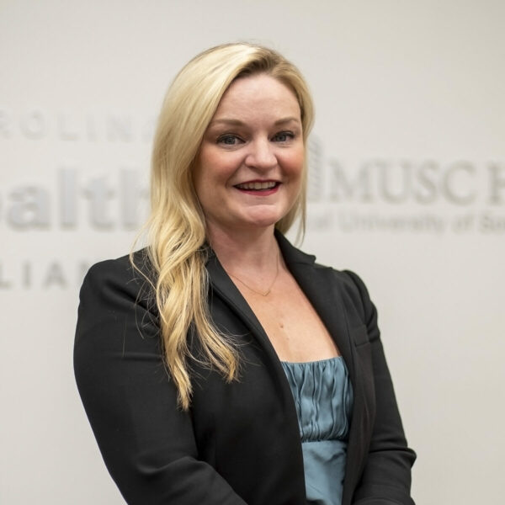




MUSC COE Team Health Services Research
Department of Healthcare Leadership & Management
Center for Telehealth
Jillian Harvey, PhD
Professor
Caitlin Koob, PhD
Assistant Professor
Kit Simpson, DrPH
Distinguished Professor
Dunc Williams, PhD
Associate Professor
Cortney Belton, MBA, RN
Clinical Manager
Peter Gardella, MBA, RN
Director Telehealth Operations & Nursing
James McElligott, MD
Medical Director
Emily Warr, MSN
Telehealth Administrator
Telehealth Center of Excellence
College of Nursing
Samantha D’Orio, MHA
COE Coordinator
Dee Ford, MD
PI
Division Chief Pulmonary, CC, Sleep
Kathryn King, MD
Co-PI
CMIO
Katie Kirchoff, MSCR
Data & Performance Manager
Rebecca Verdin, MHA
COE Manager
Edrin Williams, DHA
Executive Director Grants & Research
Christina McDaniel, DNP
Instructor

Slide 10

Learning Health Systems Defined
AHRQ defines a learning health system as a health system in which internal data and experience are systematically integrated with external evidence, and that knowledge is put into practice. As a result, patients get higher quality, safer, more efficient care, and health care delivery organizations become better places to work.
Source: AHRQ. (2019). About Learning Health Systems. Available at: https://www.ahrq.gov/learning-health-systems/about.html

Slide 11


MUSC Telehealth Center of Excellence: A Mini Learning Health System
Integrating telehealth operations and research to generate evidence, drive improvements, and enhance telehealth services.
1
DATA WE UTILIZE
ALIGN PRIORITIES,
QUESTIONS & DATA
(Ideas & Methods)
1. CLINICAL & TELEHEALTH
Identify telehealth priorities and operational challenges
Develop evaluation and research questions
Select study designs, measures, and data sources
2
OUTCOMES
Epic EHR data
Telehealth platform data: utilization, logs, connection quality, performance
Scheduling, access, no-shows, cancellations
Claims Data (state & national)
5
LEARN, ADAPT &
DISSEMINATE
Better Patient
Outcomes
ANALYZE & GENERATE
KNOWLEDGE
Share insights with operational and research stakeholders
Disseminate findings internally and externally
Scale what works
Generate new questions and priorities
2. QUALITATIVE
Descriptive and comparative analyses
Implementation science
Economic evaluation
Qualitative analysis
Literature Reviews
Enhanced Provider
Experience and Satisfaction
Interviews
Focus groups
Open-ended feedback
High-Quality
Telehealth Services
3. HEALTH SYSTEM FINANCIAL
Costs
Revenue
Staffing and resource utilization
Budget and operational performance data
3
More Efficient
Operations
Center for Telehealth
MUSC University
Health Services Researchers
Healthcare Operations
& Service Center
APPLY FINDINGS
TO IMPROVE
MEASURE OUTCOMES
& EVALUATE
4. PATIENT & PROVIDER ENGAGEMENT
Refine telehealth workflows and clinical protocols
Staff training and change management
Program and policy improvements
3
Stronger Financial
Performance
Surveys
Experience scores
Engagement metrics
Partnership between telehealth operations and research to continuously improve telehealth care through evidence generation, implementation, evaluation, and dissemination.
Monitor quality, safety, utilization, and financial outcomes
Track patient and provider experience
Assess implementation success
Compare with goals and benchmarks
Improved Access to
Telehealth Services
5. QUALITY & SAFETY METRICS
4
Clinical quality measures
Patient safety metrics
Service performance indicators
A CONTINUOUS CYCLE
Adapted from: Easterling, D., Perry, A. C., Woodside, R., Patel, T., & Gesell, S. B. (2022). Clarifying the concept of a learning health system for healthcare delivery organizations: Implications from a qualitative analysis of the scientific literature. Learning Health Systems, 6(2), e10287
Shared priorities → Knowledge → Action → Evaluation → Learning
FOUNDATIONS THAT ENABLE OUR MINI LEARNING HEALTH SYSTEM
Leadership
Commitment
Robust Data
Infrastructure
Analytics & Research
Expertise
Patient & Provider
Engagement
Culture of Learning
& Collaboration
Privacy, Security &
Ethical Use of Data

Slide 12
Example #1: Virtual Specialty Program Background and Implementation

Slide 13
Example #1
A Virtual Specialty Service Line was developed to increase access to specialty providers, reduce wait times, and improve patient outcomes.

Slide 14
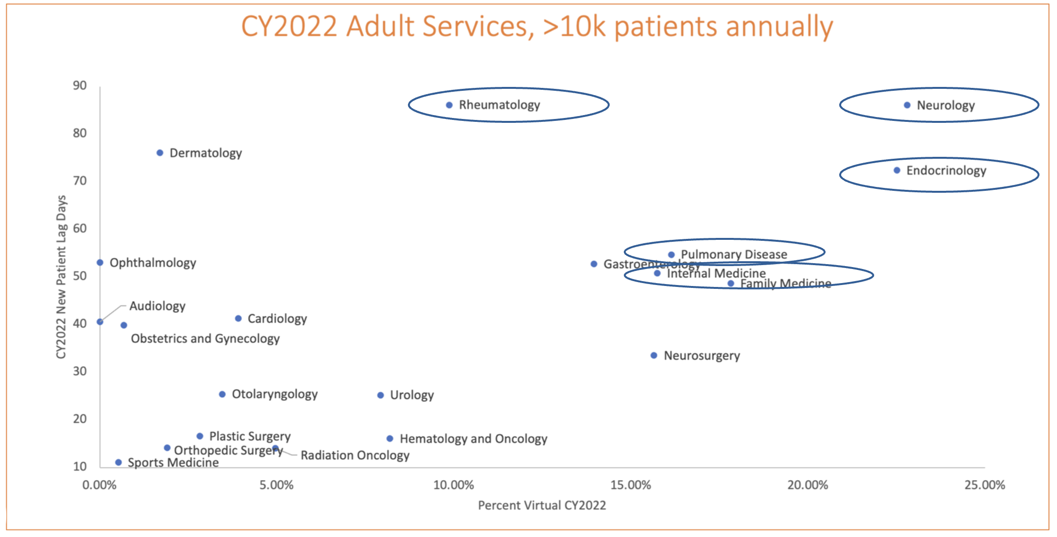
Why did we build the Virtual Specialty Practice?
How did we decide where to start?
To address patient demand and MUSC access issues
To reduce wait times
To grow specialty market share statewide
To meet patients where they are and start treatment plans
To successfully recruit specialists for our growing system and state needs
New patient lag days
% virtual = historical amenability

Slide 15

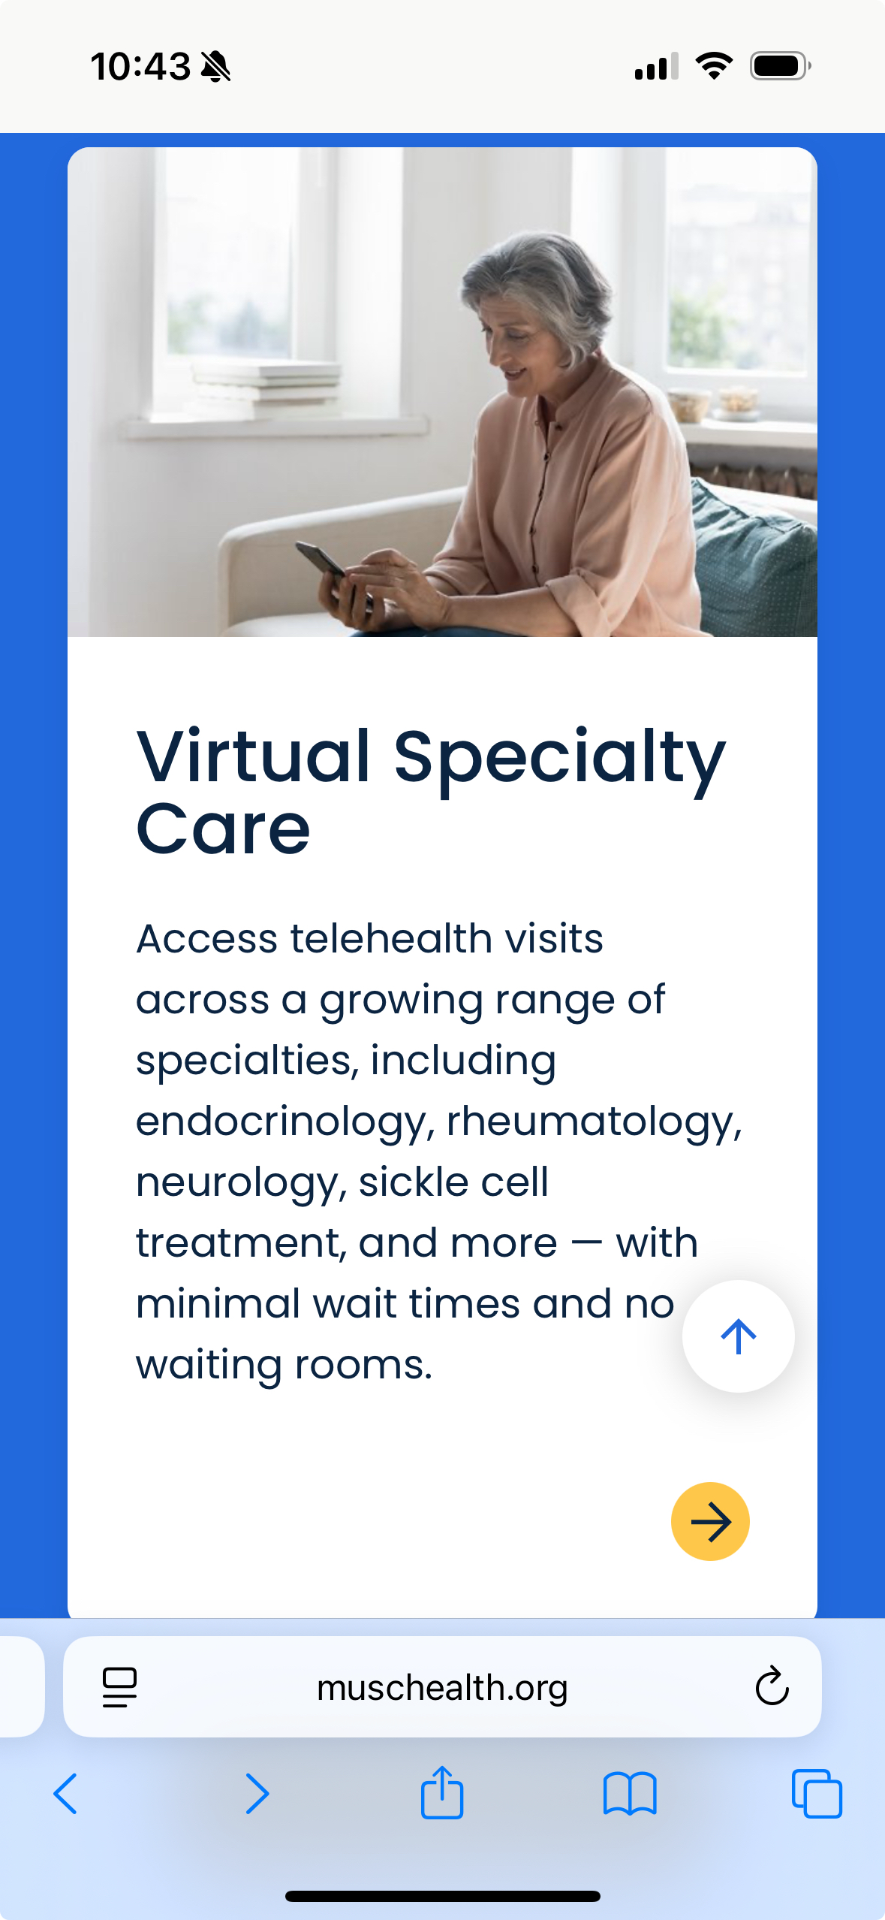
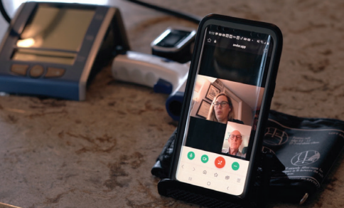
What is the Virtual Specialty Practice?
Innovative care model implemented in July 2022
100% virtual practice.
Fully staffed virtual ‘clinic’ with dedicated RNs, LPNs, and registration supporting pre-visit and post-visit experience, follow-ups, and ancillary service referrals
  Providers and support staff with SC licenses living in multiple states
Low barrier online scheduling with or without a referral
Timely access as soon as same-day for most specialties
9 specialties:
Endocrinology
Rheumatology
Benign Hematology
Neurology
Pulmonary
Sleep Medicine
Infectious Disease
Psychiatry
Dermatology

Slide 16

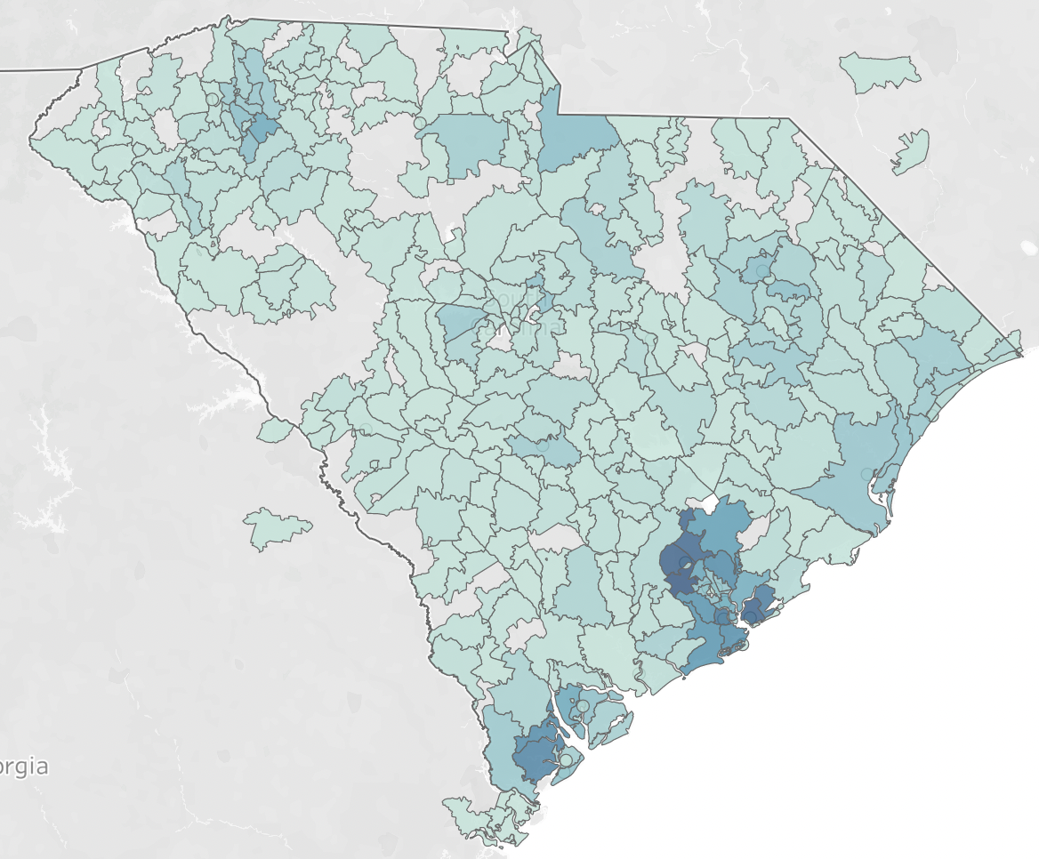
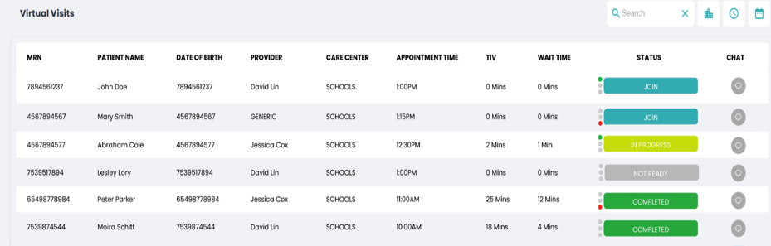
How does the Virtual Specialty Practice function?
Fully staffed virtual ‘clinic’ with dedicated RNs, LPNs, and registration supporting pre-visit and post-visit experience, follow-ups, and ancillary service referrals
Pre-visit support for clinical triage needs and tech support
My Chart messages with Virtual Practice panel patients
Coordination follow-up with ancillary service network, results management, escalation support
Affiliate ancillary service partnerships for imaging, labs, infusions, etc.
Notes:
How does the Virtual Specialty Practice Function
Also include: Staffing model, and use of APN
Patients have a choice to wait for in-person
Local Resources for: Lab, Imaging, Infusion
Specialty Pharmacy

Slide 17
Program Evaluation

Slide 18
Evaluation Methods: Virtual Care
We employed the RE-AIM framework to assess key program elements and outcomes. RE-AIM is a popular framework for guiding evaluations, RE-AIM enhances the sustainable adoption and implementation of interventions and services.
We selected outcomes in the following RE-AIM dimensions
  Reach: the number of participants & their characteristics
  Effectiveness: impact of the program
  Adoption: the providers and service lines who adopt the program
  Implementation: consistency and adaptions made to the program
  Maintenance/sustainment: extent the program becomes routine and institutionalized
Data: EPIC electronic medical record data and Andor telehealth virtual visit platform data
Methods:
  Descriptive Program Evaluation
  Data are aggregated and trended over time
  Business intelligence dashboards are developed/implemented to enable leadership real-time access to key metrics by provider, and program.
Source: https://re-aim.org/learn/what-is-re-aim/

Slide 19
Program Outcomes

Slide 20
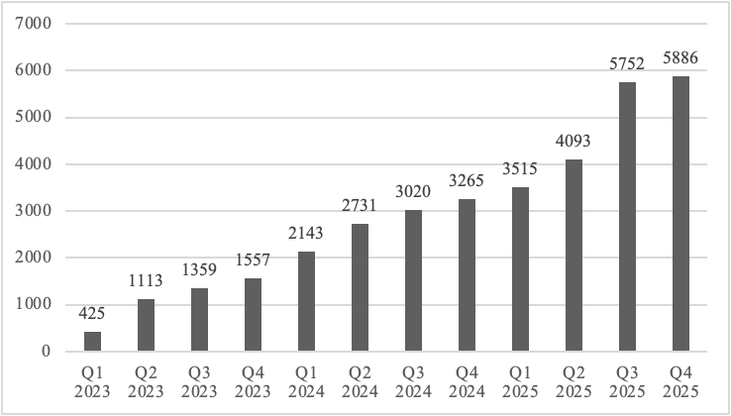
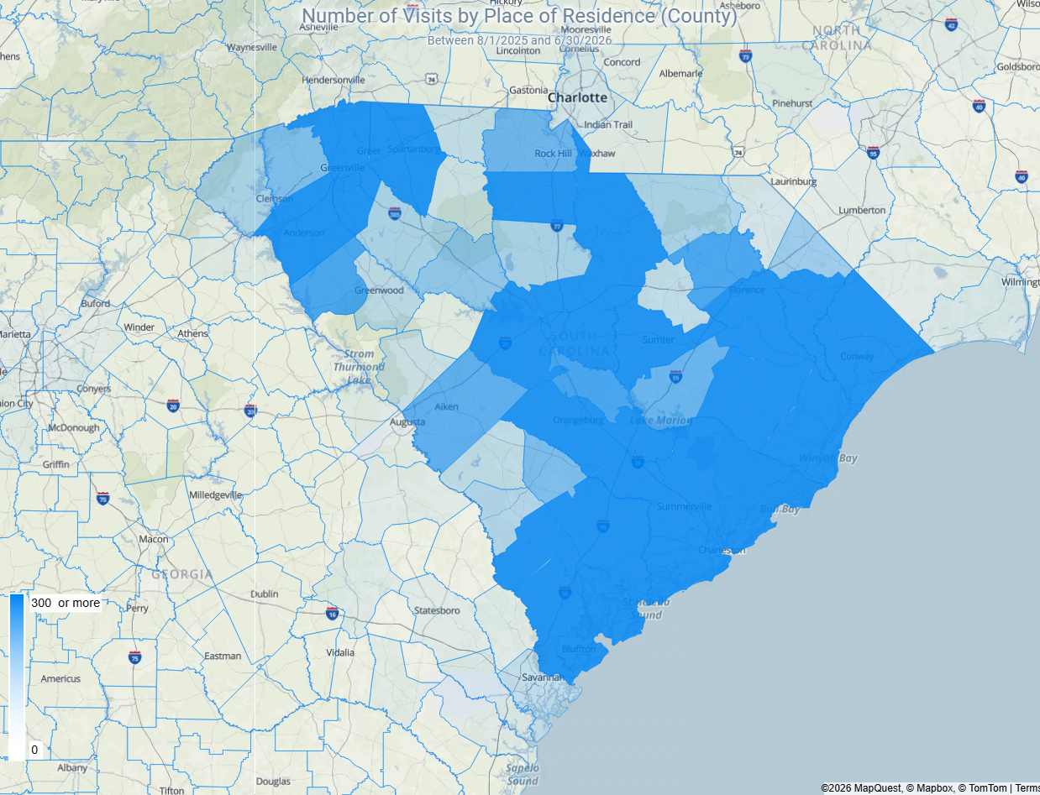
Reach:
Virtual Specialty Visit Utilization FY 2023-2025
Patient Home Location
Total Virtual Specialty Visits: 34,859
*Based on Patient Home Zip Code and Not Place of Service

Slide 21
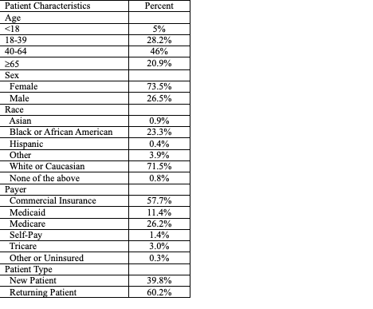
Reach: Patient Characteristics FY 2023-2025

Slide 22
Effectiveness: Expanding Access
Average # of Days to Specialty Appointment |  | Percent of New Patients Seen within 7 days
CY 2024 | CY 2025 | CY 2024 | CY 2025
23.8 | 24.6 | 38.4% | 49.4%

Slide 23
Effectiveness: Virtual Specialty Cancellation and No-Show Rates
Metric | CY 2024 | CY 2025
No Show Rate | 14.8% | 12.6%
Patient Same Day Cancellation Rate | 15.6% | 16.4%

Slide 24
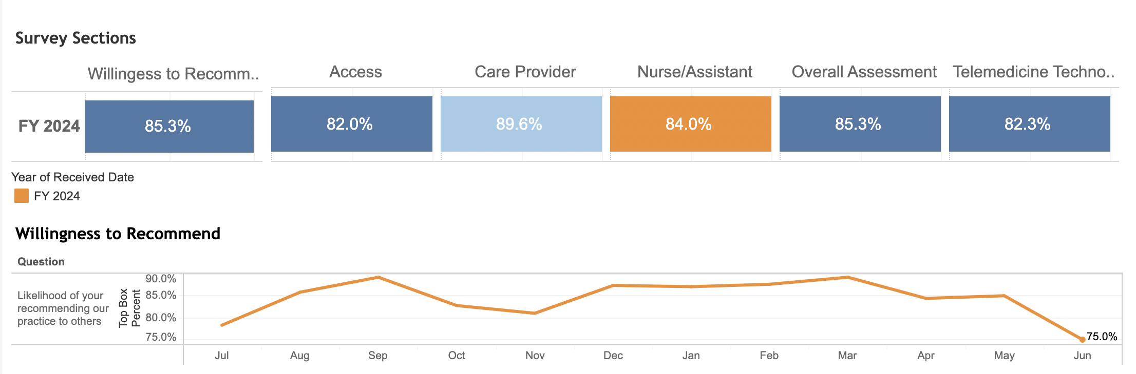
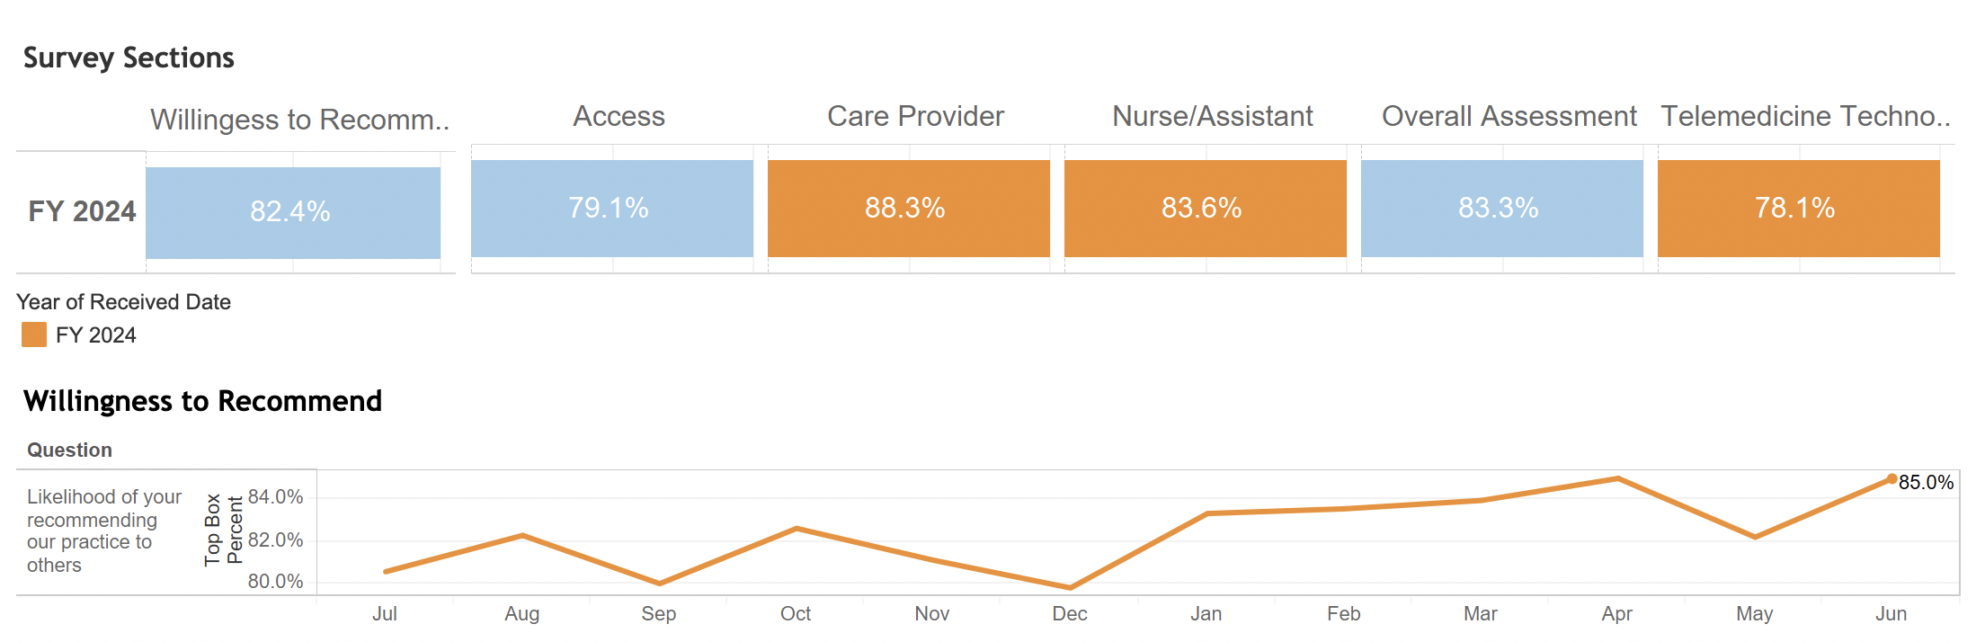
Effectiveness: Patient Experience
+2.9%
+2.9%
+2.0%
+4.2%
100% virtual practice
Hybrid in-person / virtual practice

Slide 25
Adoption: Volume by Specialty
July 2022 Lauch
  Rheumatology & Endocrinology highest volumes (11,708 & 10,103 total visits to date)
Late FY 2023
  Hematology & Neurology Launch
Early FY 2024
  Sleep Medicine
Late FY 2024
  Gastroenterology & Pediatric Endocrinology

Slide 26
Implementation
Additional providers are added per specialty based on access metrics
Additional specialties are added based on system access needs
Examination of provider capacity vs tendency to overbook to account for no-show appointments

Slide 27
Maintenance
Benchmarking for sustainability
Assessing relative effectiveness in quality to in-person
Context for organizational decision making
Access evaluation

Slide 28
Future Direction
Health System
  Continue to grow multi-specialty model and improve access metrics
  Continue to advance ancillary services to support specialty access across the state
    Example: Biopsy locations for dermatology, ultrasound for OBGyn
Health Services Research Team-Mixed Methods Deep Dive
  Explanatory sequential mixed methods
    Year 1: Describe the access and productivity trends of virtual specialty rheumatology program from July 2022-Decmber 2026.
    Year 1: Identify stakeholder perspectives on factors that facilitate or hinder virtual specialty program growth and sustainability.

Slide 29
Example #2
MUSC Health Palliative Telehealth Program
  Systemwide tele palliative care model within MUSC Health
  Delivers specialty palliative care across hospital settings

Slide 30
Background: Use of timely and effective Consultations for Palliative Care (CPC) may reduce patient suffering, decrease family distress, improve provider communication and reduce cost of futile intervention to hospitals and insurers.
Problem: CPCs are underused and often used too late even though Medicare and most other insurers cover CPCs (including telehealth consults) for people with serious or terminal conditions.
What Tele palliative Consults Address:
  Symptom management
  Goals-of-care discussions
  Advance care planning
  Decision support for patients, families, and care teams
  Alignment of treatment with patient values and preferences

Slide 31
Program Structure
How the Model Works
  3 palliative-trained Advanced Practice Providers (APPs)
  Serve 14 Regional Health Network hospitals
    MUSC Health hospitals (4)
    Affiliated system hospitals (10)
  Virtual integration with local care teams at the bedside
    Scheduled telehealth visit: bedside team, family and caregivers can attend
  Emphasis on early inpatient involvement & goals
  Education with local teams on value of early involvement

Slide 32
Clinical Team was interested in:
  The team was interested in using data to inform program expansion.
  Data to support outreach to the regional hospitals
    Current service offered: M-F 9-5
    Typically, long length of stays before referral is made
  Identify Key Performance Indicators
    How to turn measurement into improvement
“Data to help us to translate what we felt we knew into hard numbers, to share with leadership & the sites”.
-APP

Slide 33
Multi-Methods Evaluation Approach
Access
Populations Reached
Hospital & Geographic Spread
Timeliness
Three days referral to consult is meaningful in in-person
Clinical & Utilization Outcomes
LOS, ICU Use, Discharge Location, Readmissions
Patient and Family Experience (qualitative)
Patient Characteristics
Economics
Cost per Admission
Costs Avoided
Descriptive Analysis: Access & Utilization
  Epic Data
  Develop KPI
Use of propensity score matching (age, race, sex, DRG)
    Comparison of early palliative consult vs. >3 days
    Costs are calculated from discharge record charges, assuming a 27% cost-to-charge ratio
  Exclusion: Transfer patients
Regression estimates controlling for age, race, married, veteran, and insurer.
  Qualitative Analysis of Patient & Provider Key Informant Interviews

Slide 34
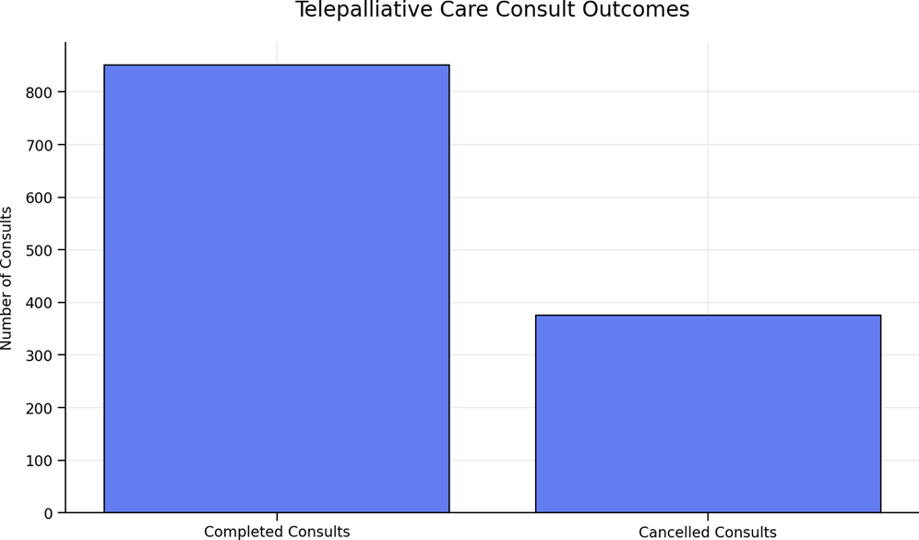
Consult Volume and Outcomes
Key Findings (Sept 2025-March 2026)
1,227 total consults ordered
851 consults completed (69%)
376 consults cancelled (31%)
Cancellations driven by clinical timing and care transitions:
  Family not available
  Patient death
  Patient discharge
Indicates late referral

Slide 35
Results: Patient Demographics for MUSC Telehealth Palliative Care Consults (2024)
Variable | N=1169 | Age Range
Age Mean(SD) | 73.6 (13.6) | 29-101
Female N(%) | 614 (52%)
Married N (%) | 422 (36%)
Race N(%)
White | 603 (52%)
Black | 552 (47%)
Other | 14 (1%)
Insurer N(%):
Medicare | 837 (72%)
Private | 156 (13%)
Medicaid | 74 (6%)
Other | 102 (9%)

Slide 36
Subgroup Comparisons:
PC Consult <= 3 days of Admit vs >3 days
40% (N=480) of patients had consult within 3 days of admissions
  Of These 90% were discharged alive
  Mean days to discharge from PC consult= 4.8 (SD 8.7)
  Mean overall LOS = 6.9 (SD 8.7)
  52.5% had a DH death record file within the observation time
60% of patents has PC consult => 4 days after admission
  Of these 85% were discharges alive (p=.0153)
  Mean days to discharge from PC consult= 8.3 (SD 15.9) (p<.0001)
  Mean overall LOS = 21.8 (SD 41.2) (<.0001)
  62.2% had a DH death record file within the observation time (p=.0008)

Slide 37
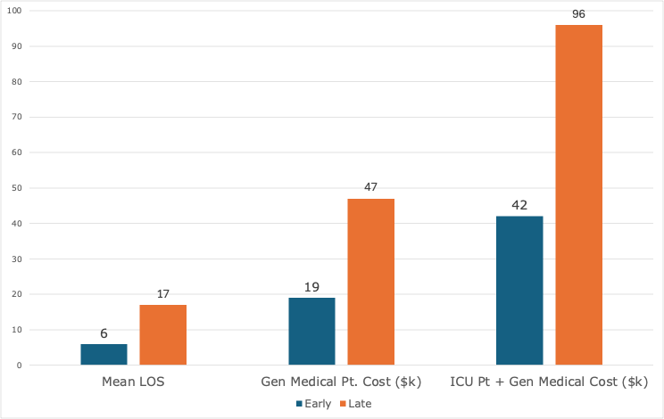
Propensity Score Matched Results
10.5 Days
Adjusted Mean LOS Difference
$27,755
General Medicine Cost Difference
$54,186
ICU + General Medicine Cost Difference
Match Sample
278 Early Consults
278 Late Consults

Slide 38
Mean LOS, General Medicine Cost and ICU Cost for Matched Groups Controlling for Demographics
 | PC Consult <= 3 Days N=278 | PC Consult >3 Days N=278 | Difference (B-A) | Statistic
Mean LOS [median] (95% CI) | 6.3 [4] (4.8 – 8.2) | 16.8 [7] (12.8 – 22.1) | 10.5 (8.0 – 13.9) | P<.0001
General Medicine Stay Mean Total Cost per Admission (95% CI) | $19,413 ($15,207 - $24,782) | $47,168 ($36,787 - $60,477) | $27,755 ($21,580 - $35,695) | p<.0001
Stay with ICU Mean Total Cost per Admission (95% CI) | $42,305 ($33,351 - $53,665) | $96,491 ($75,760 - $122,896) | $54,186 ($42,409 - $69,231) | p<.0001

Slide 39
Qualitative Feedback: Patients & Providers
  Patients and providers consistently describe tele palliative care as compassionate, high‑value, and essential. Expressing strong demand for expanded availability & follow‑up.
Patient & Family Voices
  “The video was perfect solution for those of us out of town to be a part in discussion.”
  “Feel very fortunate to have had the service of the palliative consult.”
Provider Voices
  “Especially helpful in resolving provider and family conflict over appropriate care.”
  “Important service for patient care given high acuity and complexity of patients with limited palliative services in the area.”
  “Consistently been pleased with the added value and grateful for the extensive time spent.”
  “An invaluable service. I wish they were available 7 days a week.”
  “I wish we had follow-up on patients and not only the option of new consults.”

Slide 40
Next Steps Tele Palliative Care
Monitor KPIs
Sustainability & Capacity
Earlier identification of patients who are most likely to benefit

Slide 41
Mini Learning Health System Lessons Learned
1. The most important step is agreeing on the questions
2. Operational and research timelines do not always align
3. Mixed-methods approaches generate the most actionable insights
4. Evaluation should be embedded, not added later
5. Stakeholder engagement improves both science and implementation
6. Dissemination should occur throughout the process
National Academy of Medicine A learning health system is one in which science, informatics, incentives, and culture are aligned for continuous improvement, with new knowledge generated as a by-product of care delivery
Friedman CP, Rubin J, Brown J, et al. (2015) Toward a Science of Learning Systems: A Research Agenda for the High-Functioning Learning Health System. Journal of the American Medical Informatics Association, 22(1), 43-50.

Slide 42
Questions ?

