Slide 1
Sustainability Strategies for Rural Telehealth Programs
Panelists:
Dr. Andrew Wilhelm – Division Director, Pulmonary Critical Care, UMMC
Kyle Brewer – Administrator, Center for Telehealth and Emerging Technologies (CTET), UMMC
Christina Wright – Director of School Based Telehealth Program, CTET, UMMC
Param Narain - MBA Candidate at Millsaps College, Intern, CTET, UMMC
Moderator:
Dr. Saurabh Chandra – Chief Telehealth Officer, Project Director, Telehealth Center of Excellence, CTET, UMMC
This presentation was supported by the Health Resources and Services Administration (HRSA) of the U.S. Department of Health and Human Services (HHS) under the National Telehealth Center of Excellence cooperative agreement U66RH31459, which has a total award amount of $4,250,000 for the approved project period. The contents are those of the author(s) and do not necessarily represent the official views of, nor an endorsement by, HRSA, HHS, or the U.S. Government.

Slide 2
SCHOOL-BASED TELEHEALTH PROGRAM

Slide 3

Telehealth Centers of Excellence
School-Based Telehealth
PHASE 1 — MISSISSIPPI DEPARTMENT OF EDUCATION(MDE) RAPID IMPLEMENTATION
August 2022 – September 2024
PHASE 2 — UMMC CENTER OF EXCELLENCE REIMBURSEMENT PILOT
October 2024 – June 2026
JUL 2022
DEC 2022
OCT 2023
SEP 2024
OCT 2024
SEP 2025
JUN 2026
4 districts, 21 schools go live
51 districts, 294 schools live
Peak reach: 74 districts, 421 schools
MDE grant ends — 5,198 visits delivered
COE pilot begins: 32 districts contracted
Year 1 complete: 1,036 visits, 547 students
693 encounters; SBTH named in MS's RHTP plan
6,927
74 → 32
THE SHIFT
FREE CARE
→
SUSTAINABLE MODEL
visits delivered across 74 districts served statewide since program inception (2022–2026)
74 districts — peak (MDE)
32 — COE pilot
Grant-funded universal access evolving into a reimbursement-tested, financially sustainable model.
5,198 under the MDE grant (2022–2024) · 1,729 in the COE pilot (2024–2026)
districts (205 schools, 79,189 students) in the reimbursement-focused pilot

Slide 4
Telehealth Centers of Excellence
School-Based Telehealth
1,729
VISITS · 769 UNIQUE STUDENTS
COE REIMBURSEMENT PILOT
October 2024 – June 2026
Financial specifics: Param & Kyle
REIMBURSEMENT PILOT
CLINICAL CAPACITY
GRANT-FUNDED SUPPORT
Verifying insurance and securing consent to bill for every encounter — that administrative build, not clinical demand, is where the pilot's work is happening now.
An academic medical center's established telehealth teams mean a school nurse can get a child in front of a provider the same day, not weeks later.
Grants still cover what reimbursement never will — point-of-care testing supplies, and the marketing and outreach that keeps districts engaged.

Slide 5
School-Based Telehealth - Financial Summary
NOV 2024 – SEP 2025 | 11 months | 32 Districts | 79,189 Students Population
997
CONSULTS
469
UC
528
BH
URGENT CARE
BEHAVIORAL HEALTH
NURSE PRACTITIONER
LICENSED PROFESSIONAL COUNSELLOR
469
57
471
CONSULTS
CONSULTS
CONSULTS
53%
47%
2%
16%
REVENUE
46%
36%
$8,239
$1,857
$7,434
NP’s service Cost
$ 12,965
$ 3,151
$ 15,851
Administrative Cost
$ 21,078**
$ 1,069
$ 6,793
EXPENSES
$34,043
$4,220
$22,644
NET MARGIN
-$25,804
-$2,363
-$15,210
* Self Pay comprises of students who may not have insurance, their consent forms were incomplete, or the parents chose to pay regardless
** Admin Cost in UC comprise of:
Scheduler Fees
POC test
Marketing Cost
Internal Administrative Cost

Slide 6
School-Based Telehealth - Challenges
1
We used an existing care team rather than dedicated staff
7
2
Every visit required a school nurse or facilitator on-site
3
Time sensitivity made insurance & consent capture harder for Urgent Care
operational challenges
surfaced across the school-based telehealth pilot
4
Reimbursement was low due to missing insurance & incomplete consent
5
Visit workflows are difficult to run in a school setting
Each shaped how we redesign staffing, consent capture, and workflow going forward.
6
Point-of-care testing required the school to obtain a Clinical Laboratory Improvement Amendments (CLIA) waiver
7
Visit volume depended on the school nurse or facilitator

Slide 7
School-Based Telehealth - Lessons Learned
1
2
3
Lead with Behavioral Health
Explore a membership model
Capture consent & insurance early
Anchor the model on the LPC-delivered behavioral health service, where demand and reimbursement are strongest.
Test a predictable per-student membership structure to stabilize revenue against variable visit volume.
Collect insurance and consent at the start of the school year, before time-sensitive visits occur.

Slide 8
School-Based Telehealth - Annual Projections
URGENT CARE
BEHAVIORAL HEALTH
NURSE PRACTITIONER
LICENSED PROFESSIONAL COUNSELLOR
1000
1000
1000
CONSULTS
CONSULTS
CONSULTS
Primary CPT Code
99213
Primary CPT Code
99214
Primary CPT Code
90832
Medicaid Rate (@ $54)
Medicaid Rate (@ $79)
Medicaid Rate (@ $112)
REVENUE
$31,320*
$45,820*
$70,760*
NP’s Service Cost
$ 18,429
$ 27,644
$ 16,827
Administrative Cost
$ 11,378
$ 13,221
$ 11,058
EXPENSES
$29,808
$40,865
$27,885
NET MARGIN
$1,512
$4,955
$42,875
*42% Denial Rate Accounted

Slide 9
TELE-CRITICAL CARE PROGRAM

Slide 10
Tele-Critical Care-Financial Summary
May 2025 - Feb2026 | 9 months | 22 Patient Accounts | Cost Provider : Grant Funded
96
69
38
55%
Total Tele-Critical Care (TCC) Consults
Unique Patients
Retained Patients
Retained Patient Rate
solely attributable to TCC
PROGRAM TOTALS · 9 MONTHS
PER-PATIENT UNIT ECONOMICS
Total revenue after consult
$135,301
$6,150
$4,653
$1,497
Total hospital cost after consult
($1512 /day/bed pulled from cost report)
Revenue
Cost
Net margin
$102,360
+$32,941
TOTAL NET MARGIN
per patient · based on 22 accounts analysed

Slide 11
Tele-Critical Care - Annual Projections – (Volume Growth Scenarios)
Based on 9-month run rate || Includes TCC Service Cost: $9000/month
Annual Revenue vs. Cost by Scenario
128
Estimated TCC consults
over 12 months
92
Estimated unique patients
over 12 months
51
Estimated retained patients
solely attributable to TCC
BREAKEVEN
The program turns profitable at approximately 13 consults per month

Slide 12
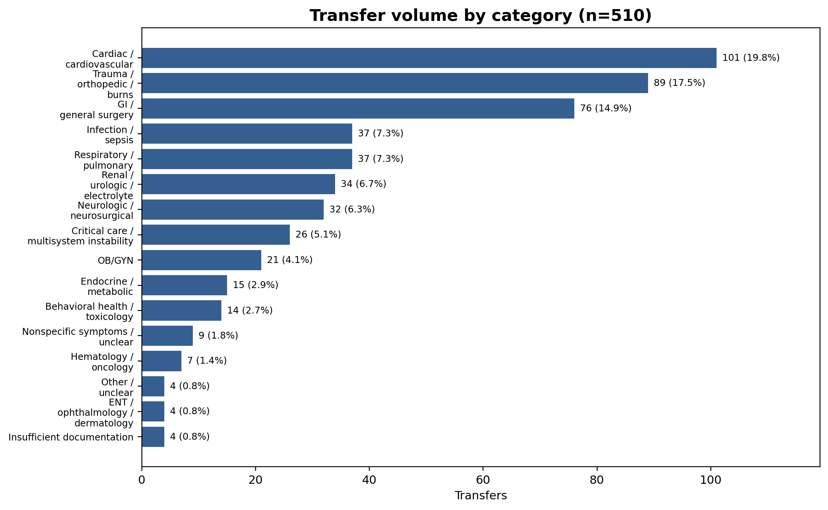
Telehealth Centers of Excellence
Tele-Critical Care – 2024 Transfer Analysis
510 documented transfer reasons reviewed across 16 primary categories
510
Transfers Reviewed
16
Primary Categories
52%
In Top 3 Categories

Slide 13
Telehealth Centers of Excellence
Tele-Critical Care – 12 Month Projection + 20% Transfer Retention
CURRENT TRAJECTORY
WITH 20% TRANSFER RETENTION
Retained Patients
51
Retained Patients
153
Total revenue after consult
$326,928
Total revenue after consult
$954,228
Total hospital cost after consult
$343,701
Total hospital cost after consult
$818,307
-$16,773
+$135,921
TOTAL NET MARGIN
TOTAL NET MARGIN

Slide 14
Telehealth Centers of Excellence
Tele-Critical Care – Lessons Learned
1
Retain patients locally
2
Get billing codes right
The local physician must identify which patients can be retained at the hospital because of this program.
The hospital has to have the appropriate billing codes in place to capture revenue for the service.
3
Invest in physician engagement
4
Standardize the call process
Physician training and sustained engagement are critical to consistent utilization and outcomes.
A streamlined and stable call process must be established so consults happen reliably.

Slide 15






Follow us!

Slide 16



Contact Information
tcoe@umc.edu

Slide 17

This presentation was supported by the Health Resources and Services Administration (HRSA) of the U.S. Department of Health and Human Services (HHS) under the National Telehealth Center of Excellence cooperative agreement U66RH31459, which has a total award amount of $4,250,000 for the approved project period. The contents are those of the author(s) and do not necessarily represent the official views of, nor an endorsement by, HRSA, HHS, or the U.S. Government.

