Slide 1


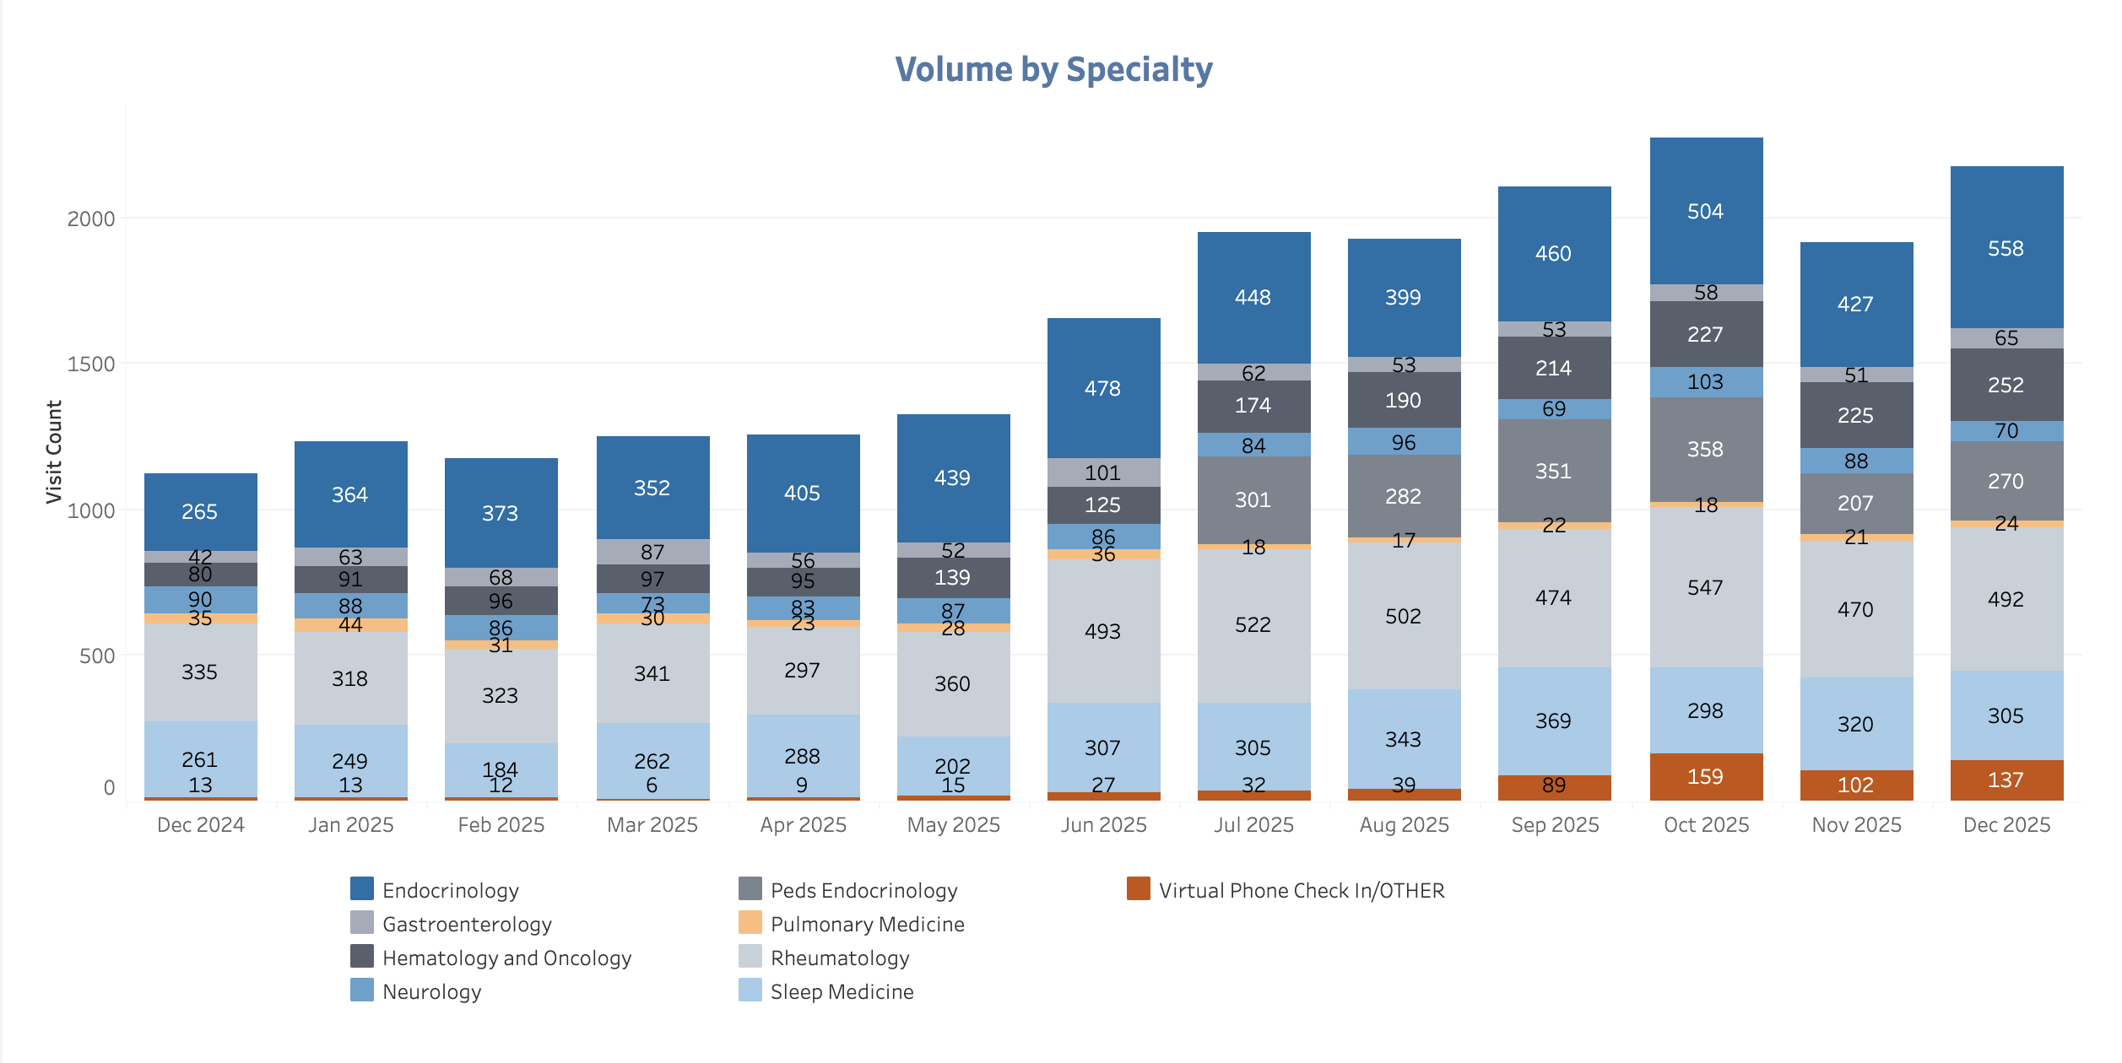

Redesigning Access: A Virtual Approach to Specialty Care Delivery
Dunc Williams, PhD¹, Caitlin Koob, PhD¹, Jillian Harvey, PhD¹,
Jimmy McElligott, MD², Emily Warr, MSN, RN², & Dee Ford, MD²
¹Department of Healthcare Leadership and Management, Medical University of South Carolina, Charleston, SC
²Center for Telehealth, Medical University of South Carolina, Charleston, SC
OVERVIEW
RESULTS
IMPLICATIONS
BACKGROUND
South Carolina has 41 out of 46 counties designated as Health Professional Shortage Areas (HPSAs), leading to delays in accessing in-person specialty care
Traditional, in-person specialty care averages a 3- to 6-month wait time for new patients
The Virtual Specialty Care Program was developed to increase access to high-demand specialty care services
“No barrier,” 100% virtual services
Coordinate referrals for in-person lab work, imaging, and pharmaceuticals based on patient’s location
STUDY DESIGN
RE-AIM guides real-time evaluation to inform program quality improvement and data-driven decision-making
Data sources: program tracking data, REDCap, electronic health records, and qualitative data from patients
Quantitative data are analyzed using descriptive statistics, and qualitative content analysis is utilized to identify themes
SETTING
‘Virtual clinics’ are fully staffed with specialized physicians, registered nurses, and registration staff to support patients through pre- and post-visit experience, follow-ups, and ancillary service referrals
Virtual Specialties were identified through the intersection of high-demand and historical amenability to virtual services systemwide
Reach: 35,588 Virtual Specialty visits occurred from 1/2023-12/2025.
Effectiveness:
Patient experience ratings are consistently higher for the 100% virtual practice compared to hybrid care
Average new patients with appointments within 7 days: 38.4% (2024) & 49.4% (2025)
Patients report immediate impacts for increased access to specialty care services, and the ability to initiate treatments faster than they would have with the first-available in-person visit
Compared to in-person, virtual patients were younger and visits were of lower complexity.
Patients save considerable time and costs required to travel for medical care
Adoption: Endocrinology is consistently the highest volume service each month, followed by Rheumatology
Implementation: Virtual Specialty Programs underwent a four-phase implementation process
Maintenance:
60% of virtual visits are from returning patients
IMPLICATIONS FOR POLICY & PRACTICE
To date, this Virtual Specialty program has increased access to care across SC, improved patient satisfaction, and reduced no-show rates relative to national benchmarks
Virtual clinics increased access to care, while simultaneously improving patient satisfaction and adherence to scheduled visits
Policy efforts are needed to sustain reimbursement of virtual specialty services
Figure 1. Virtual Only Volume by Specialty
Figure 2. Virtual vs In-Person Patient Characteristics
FUNDING ACKNOWLEDGEMENT
This research is supported by the Health Resources and Services Administration (HRSA) of the U.S. Department of Health and Human Services (HHS) as part of the National Telehealth Center of Excellence Award (U66RH31458) totaling $4,250,000 with 100 percent funded by HRSA/HHS. The contents are those of the author(s) and do not necessarily represent the official views of, nor an endorsement, by HRSA/HHS, or the U.S. Government.
QUESTIONS
Please reach out to Dunc Williams at wiljd@musc.edu.

