Slide 1


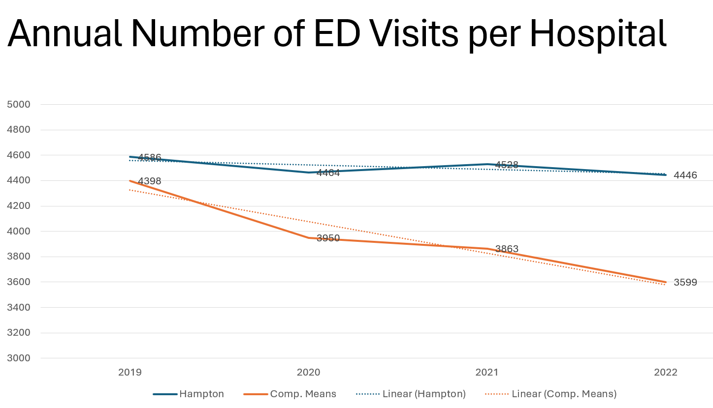
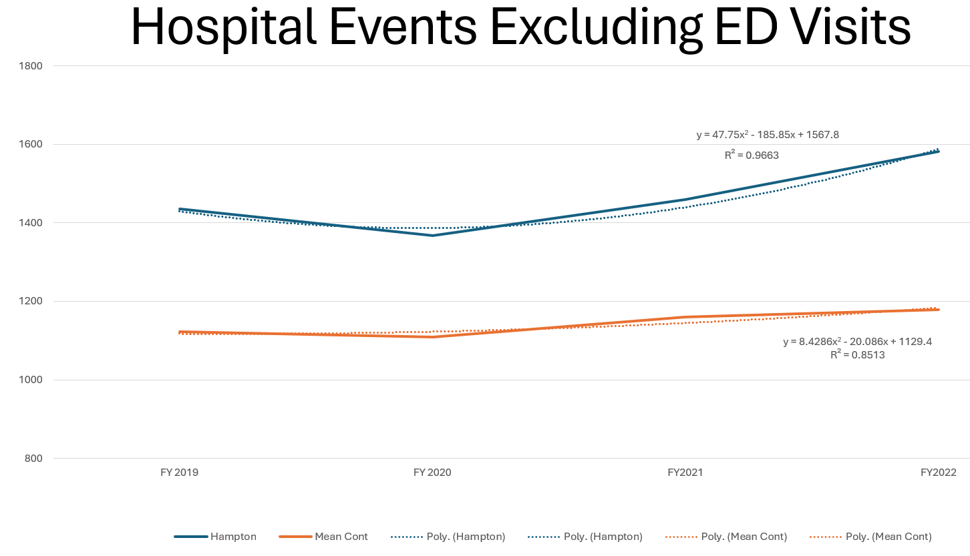
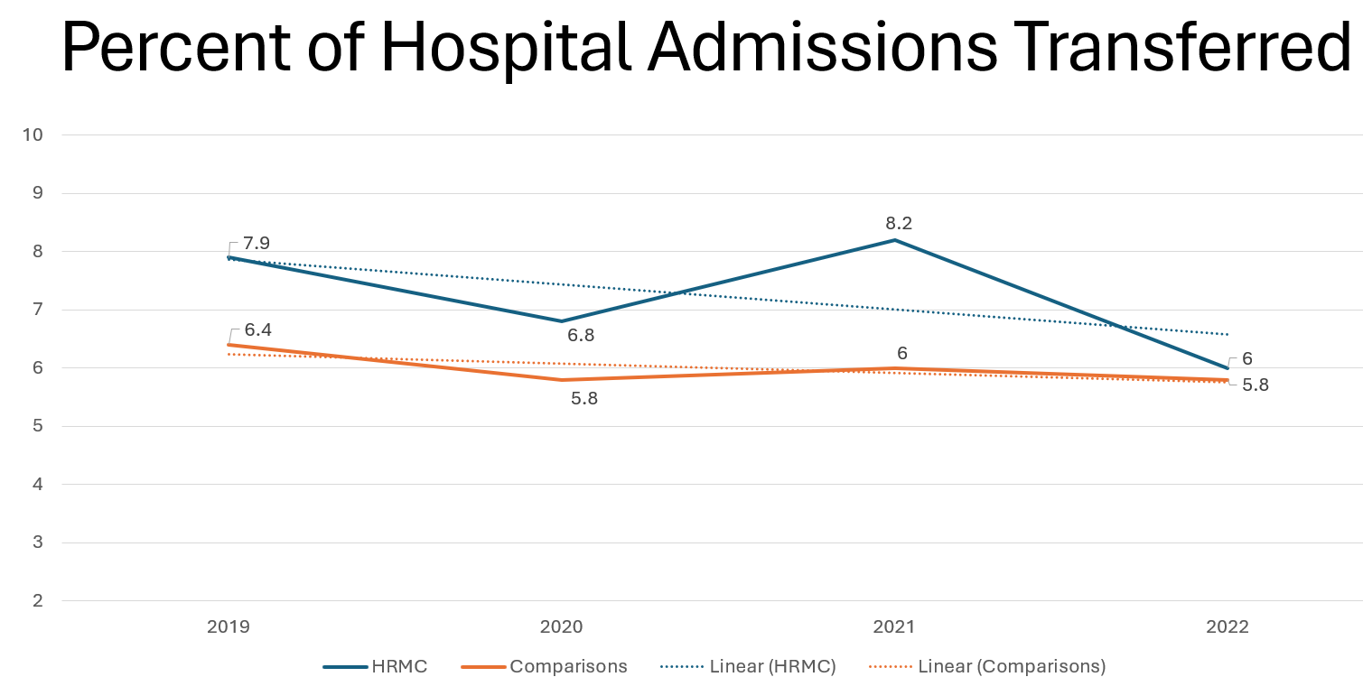
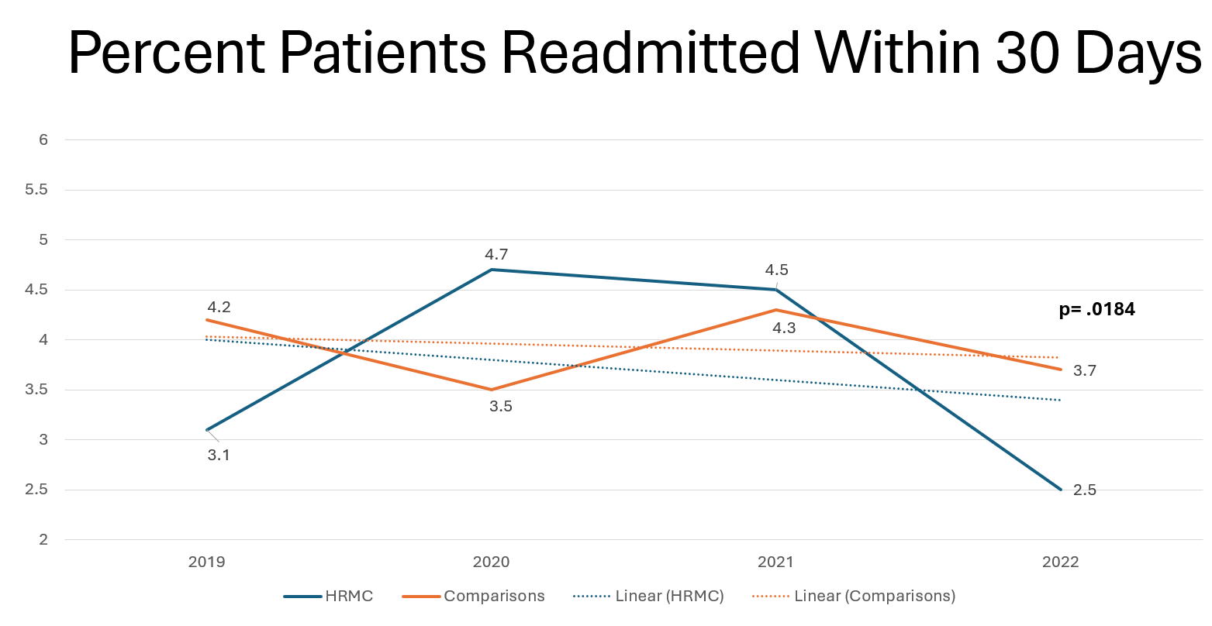
Outcomes of a Rural Hospital Tele-Hospitalist Model: A Case-Control Design
Jillian Harvey, PhD, Yotam Papo, MD, Kit Simpson, DrPH, Dee Ford, MD
Dunc Williams, PhD, Marc Heincelman, MD, MPH
Background
Methods
Discussion
-Rural hospitals continue to close across the US due to high fixed costs, low patient volume, and the rural healthcare workforce shortage
-Telehealth coverage is one solution -Hampton Regional Medical Center (Hampton): 32-bed not-for-profit rural hospital serving patients in counties ranked 43rd and 46th out of 46 counties in South Carolina Health Outcomes
-Study Type: case-control design from 2019-2022
-Case: HRMC (telemedicine services)
-Control: 7 comparison hospitals in SC
-Data Source: SC All-payor Hospital Discharge Dataset
-Outcome Measures: Emergency Department visits, hospital events (inpatient admissions, observations, outpatient surgery admissions), inpatient hospital transfers, 30-day hospital readmissions
-As ~300 rural hospitals in the US are facing immediate risk of closure due to high fixed costs and low inpatient volumes, our innovative tele-hospitalist partnership offers a promising approach to sustaining rural healthcare delivery
-Through this partnership, Hampton experienced an increase in total hospital events, decrease in inpatient transfers, and decrease in 30-day readmission rate
-Hampton is performing as well, and in some measures better than, the 7 comparison hospitals
HRMC Tele-Hospitalist Model
Results
-Staffing: Onsite APPs partnering with MUSC tele-hospitalist physicians to provide coverage of all admitted patients
-In-person consults: Surgery, cardiology orthopedic surgery
-Tele-consults: Infectious Disease, Neurology, Critical Care
-Technology:
-Videoconferencing Platform: Andor
-Videoconferencing Vehicle: Telehealth cart
-Electronic Health Record: Meditech
Next Steps
-Expansion of our tele-hospitalist program to three additional rural hospitals in South Carolina
Funding Acknowledgement
Study Objective
-Evaluate Hampton’s performance measures since implementation of a tele-hospitalist program versus a comparison group of 7 similar-sized rural hospitals in SC
This project is supported by the Health Resources and Services Administration (HRSA) of the U.S. Department of Health and Human Services (HHS) as part of the National Telehealth Center of Excellence Award (U66RH31458) totaling $4,250,000 with 100 percent funded by HRSA/HHS. The contents are those of the author(s) and do not necessarily represent the official views of, nor an endorsement, by HRSA/HHS, or the U.S. Government.

