Slide 1

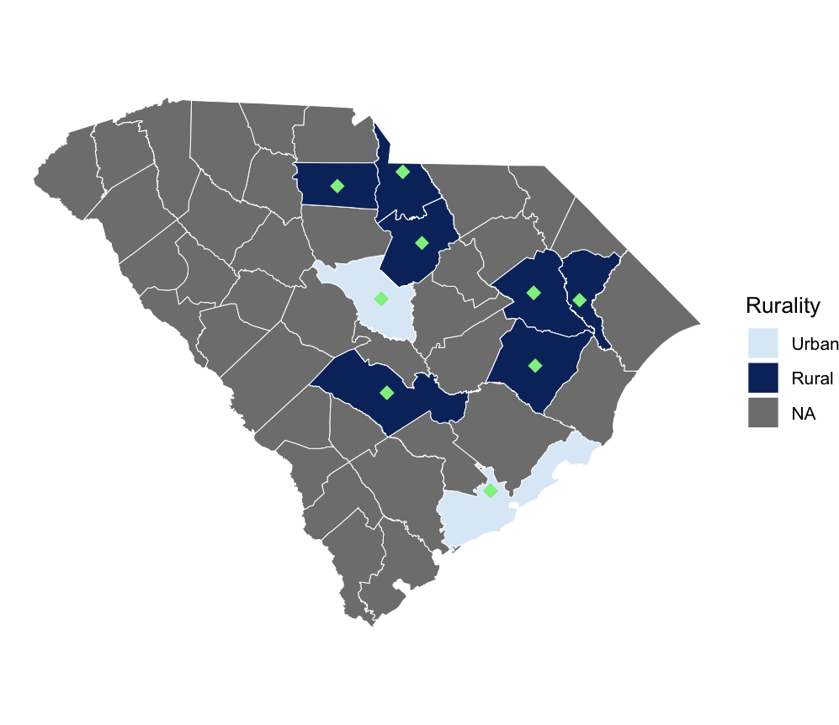

Impact of Virtual Nursing on Care Delivery in Rural Hospitals
Caitlin Koob, PhD^{1,2}, Kit N. Simpson, DrPH^{1,2}, Jillian Harvey, PhD^{1,2}, Dunc Williams, PhD^{1,2}, Katie Kirchoff, MSHI²,
Peter Gardella, MBA², Emily Warr, MSN², & Dee Ford, MD^{2,3}
¹Department of Healthcare Leadership and Management, Medical University of South Carolina (MUSC), Charleston, SC; ²Center for Telehealth, MUSC, Charleston, SC;
³College of Medicine, MUSC, Charleston, SC
BACKGROUND
Virtual nursing programs (VRN) are evolving
  Offering an innovative care delivery model to support retention and alleviate workload burden for bedside nurses
Prior research has focused on single-site implementation
  Little understanding of provider-level outcomes or operational management of such programs
In a large health system in South Carolina, a VRN model was rapidly implemented in 32 units in 2024
Study Purpose: To evaluate the impact of VRN on care delivery, particularly in rural hospitals
RESULTS: Operational Findings Systemwide
From January through June 2025, VRN supported 23,516 admissions, including 58,793 tasks, systemwide VRN supported 60.2% of hospital admissions: Primarily for Admissions (65%) Followed by: Quality of Care (18%) and Discharges (17%), and often provided multiple services within one visit
Time spent across service types | Overall (M = 36.8 minutes per visit, SD = 27.0) Longer visits for admissions alone (M = 34.6 minutes, SD = 26.9) Visit for admission support, combined with care planning or education: M = 44.7 minutes
Quality of care | Visit length for quality of care alone: M = 9.3 minutes (SD = 6.5) Combined with education: M = 23.8 minutes
Discharge | Visit length for discharge alone: M = 25.5 minutes (SD = 12.3) Combined with education: M = 23.0 (SD = 11.4) Nearly two-thirds (61.8%) of discharges occurred in <3 hours from time of order with VRN support
RESULTS: Rural Impact
Over half (51.2%, n=21) VRN units were implemented in rural hospitals Bedside nurses in rural hospitals reported more clinical experience, compared to those in urban hospitals M=16.17 years (SD=11.62) vs. M=9.87 years (SD=10.07), p = 0.003 The majority of bedside nurses in rural (78.0%) and urban (76.4%) hospitals reported being “satisfied” or “very satisfied” with the VRN program, compared to 100% of virtual nurses Most bedside nurses also reported a “slight” or “significant decrease” in workload with VRN support (Rural: 88.1%, Urban: 80%)
Exemplar Quotes | Bedside nurses in rural hospitals reported: Receiving most support for time-consuming admission tasks Described VRN as “a great asset,” “makes the workday so much better,” and “has restored faith in bedside nursing” Virtual nurses echoed that this “team” approach to nursing “is the future” This role allowed them to “stay in the field that [they love]"
METHODS & STUDY DESIGN
We retrospectively analyzed VRN data across 32 units
Data were triangulated from:
  Program tracking within REDCap (from January to June 2025)
  A REDCap survey distributed among bedside and virtual nurses (from May to September 2025; N=142)
Outcomes: VRN utilization, VRN service unit types, time spent per task
Service unit types: admission, discharge, care plan, education, quality-of-care, and documentation compliance
Descriptive statistics were used to understand patterns of VRN support across service types, estimate time spent on each type of task, and nurses’ perceptions of the VRN program
Sub analyses were conducted to examine rural impact
MUSC’s Virtual Nursing Units
By Rurality
CONCLUSIONS & NEXT STEPS
Situated within a larger, multi-level evaluation of VRN’s multi-level impact
Further investigation is needed to understand the financial return on VRN investments in rural hospitals, including improved throughput and/or decreased turnover rates
Green diamonds indicate VRN units.
Note: Some counties have > 1 VRN unit.
This poster is supported by the Health Resources and Services Administration (HRSA) of the U.S. Department of Health and Human Services (HHS) as part of the Telehealth Center of Excellence Award (U66RH31458) totaling $4,250,000 with 100 percent funded by HRSA/HHS. The contents are those of the author(s) and do not necessarily represent the official views of, nor an endorsement, by HRSA/HHS, or the U.S. Government.
Questions? Please reach out to Caitlin Koob at cak240@musc.edu.
Notes:
Notes:
In Powerpoint, click View > Guides
Keep text within gutter guides.
Author list: Don’t split names onto two lines (e.g., “Jimmy [break] Smith”). If that happens, use a new line, unless you need the space. Bold the first names of anybody who’s presenting in person.
Intro/methods/result: Do not drop below font size 28, but if you have extra space, jack up the font size until the space is full.
Do not use color in the sidebars except in graphs/figures. It’ll pull attention from the center and slow interpretation for passersby.

