Slide 1
Redesigning Access: A Virtual Approach to Specialty Care Delivery
Dunc Williams, PhD¹, Caitlin Koob, PhD¹, Jillian Harvey, PhD¹,
Jimmy McElligott, MD², Peter Gardella, MBA, RN²,
Emily Warr, MSN, RN², & Dee Ford, MD²
¹Department of Healthcare Leadership and Management, Medical University of South Carolina, Charleston, SC
²Center for Telehealth, Medical University of South Carolina, Charleston, SC

Slide 2
Faculty
Dunc Williams, PhD
  Associate Professor of Healthcare Financial Management, Medical University of South Carolina, Department of Healthcare Leadership & Management
Jillian Harvey, PhD
  Professor, Medical University of South Carolina, Department of Healthcare Leadership & Management
Emily Warr, MSN
  System Administrator, Medical University of South Carolina, Center for Telehealth
Caitlin Koob, PhD, OTR/L
  Research Associate Faculty, Medical University of South Carolina, Department of Healthcare Leadership & Management

Slide 3

Acknowledgement
The Health Resources and Services Administration (HRSA), Department of Health and Human Services (HHS) as part of the National Telehealth Center of Excellence Award (U66RH31458) provided financial support for this poster. The award provided 100% of total costs and totaled $4,250,000. The contents are those of the author. The views expressed in this publication are solely those of the authors and do not reflect the official views of the funders or the U.S. government.

Slide 4
Learning Objectives
Describe how to design and implement successful virtual programs that address the gaps in workforce, quality, access, and patient care needs.
Discuss lessons learned from program implementation that could inform the expansion and further scaling of future programs or initiatives.

Slide 5
Agenda
Agenda
Background
Virtual Specialty Program
Program Evaluation
Program Outcomes
  Part 1: Virtual Only (1/23 – 12/25)
  Part 2: Virtual vs In-Person (1/25 – 6/25)
Challenges & Lessons Learned
Future Directions and Conclusion
Questions

Slide 6
Background:
MUSC Telehealth

Slide 7
Medical University of South Carolina (MUSC)
Background
Provide patient care at 16 hospitals (includes owned or governing interest)
Approximately 2,700 beds and four additional hospital locations in development
Nearly 750 care locations situated in all regions of South Carolina.
Center for Telehealth at MUSC
The Center for Telehealth has over 15 years of experience providing telehealth, offering over 100 unique telehealth services to over 280 sites across South Carolina.
Care settings include over 45 hospitals, over 90 schools, and over 100 community clinics and other facilities.

Slide 8

Telehealth History at MUSC
Background
MUSC Center for Telehealth
Center of Excellence
State of South Carolina telehealth investment. MUSC Center for Telehealth founded
Designated by Health Resources & Services Administration (HRSA) as a national Telehealth Center of Excellence
2005-
2009
2014
2020
2013
2017
Early Years
SCTA Founded
Telehealth Expansion
Telestroke, TeleICU, TelePsych, Maternal Fetal Telemedicine
South Carolina Telehealth Association founded. Headquartered at MUSC
Explosive growth of telehealth in ambulatory space due to COVID-19

Slide 9
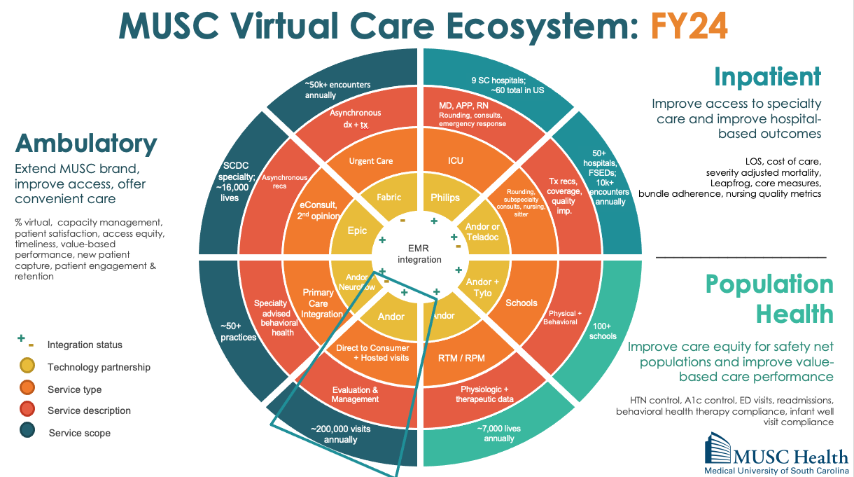
Background

Slide 10
Problem: Access challenge in SC
Background
Solution:
Problem: Patients in South Carolina Patients often have difficulty accessing in-person care, which results in delays and poor health outcomes
  Context: South Carolina has 41 out of 46 counties designated as Health Professional Shortage Areas (HPSAs), leading to delays in accessing in-person specialty care.
  Average Wait times for in-person specialty visits could take 3-6 months.
A Virtual Specialty Service Line was developed to increase access to specialty providers, reduce wait times, and improve patient outcomes.

Slide 11
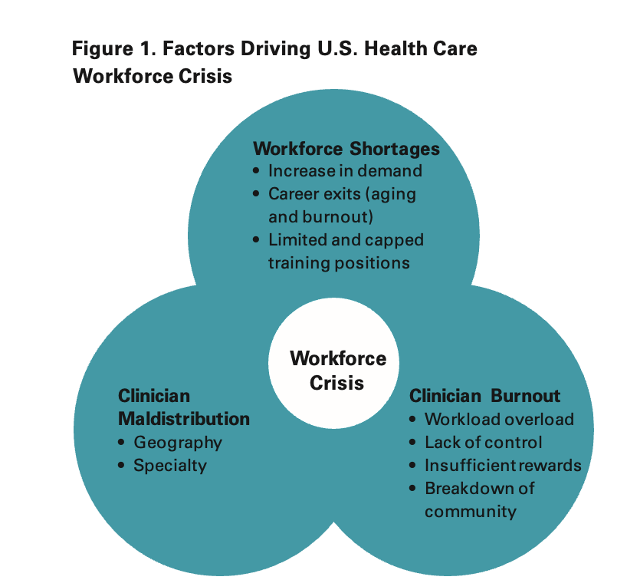
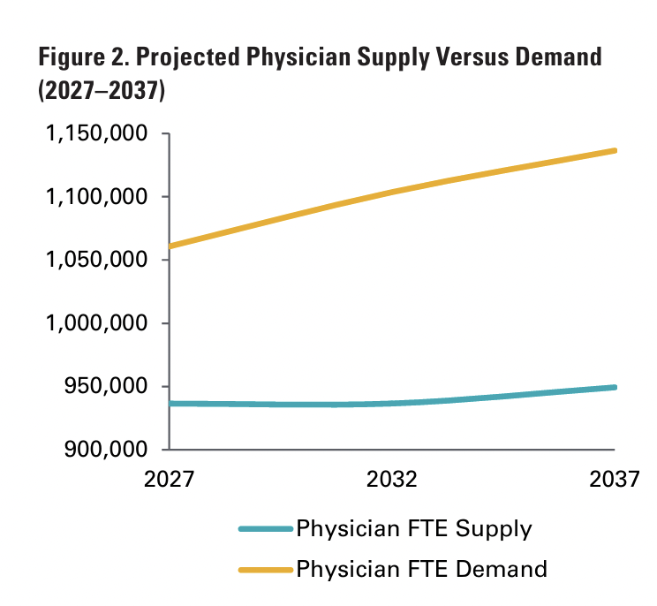
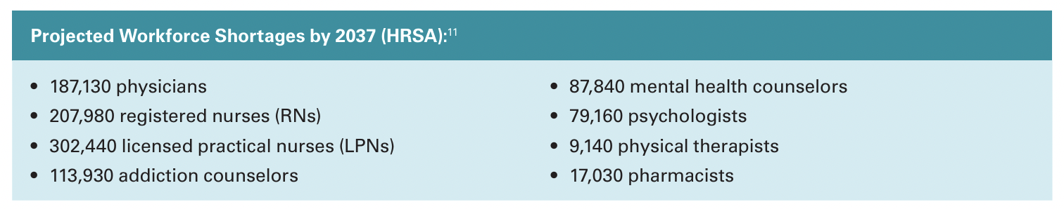
Access issues projected to worsen
Source: HRSA National Center for Health Workforce Analysis. (2025). Health workforce projections https://bhw.hrsa.gov/data-research/projecting-health-workforce-supply-demand
Notes:
Just keep content to say, appendix.

Slide 12
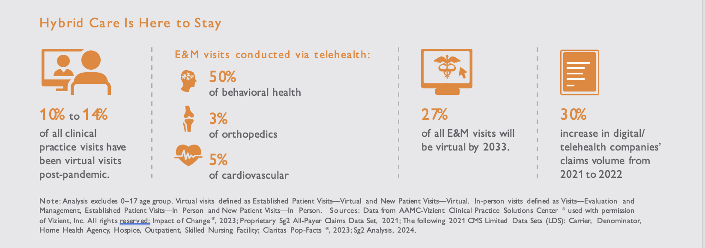
And telehealth projected to grow
Source: Vizient. (2024). Data on the Edge. Planning for future virtual visit growth. https://vizientinc-delivery.sitecorecontenthub.cloud/api/public/content/DataOnTheEdge_VirtualVisit
Notes:
Just keep content to say, appendix.

Slide 13
Virtual Specialty Program:
Background and Implementation

Slide 14
MUSC Health Virtual Care Ecosystem: 2026
~80k+ encounters
annually
5 SC hospitals;
~60 total in US
Inpatient
Ambulatory
Asynchronous
dx + tx
MD, APP, RN
Rounding, consults,
emergency response
SCDC
specialty; ~ ~16,000
lives
40+
hospitals,
FSEDs;
10k+
encounters
annually
Urgent Care
ICU
Improve access to specialty care and improve hospital-based outcomes
LOS, cost of care,
severity adjusted mortality,
Leapfrog, core measures,
bundle adherence, nursing quality metrics
Asynchronous
recs
Tx recs,
coverage,
quality
imp.
Extend MUSC brand, improve access, offer convenient care
% virtual, capacity management, patient satisfaction, access equity, timeliness, value-based performance, new patient capture, patient engagement & retention
eConsult,
2nd opinion
Fabric
Philips
Rounding, subspecialty consults, nursing,
sitter
Epic
-
Andor or Teladoc
+
+
+
EMR
integration
-
___________________
~50+
practices
Specialty
advised
behavioral
health
Primary
Care
Integration
Andor + Neuroflow
Andor + Tyto
Schools
Physical + Behavioral
+
+
150+
schools
-
Population Health
+
+
Andor
Andor
+
Direct to Consumer
+ Hosted visits
RTM / RPM
-
Bidirectional integration status
Technology partnership
Evaluation &
Management
Physiologic +
therapeutic data
Improve care equity for safety net populations and improve value-based care performance
HTN control, A1c control, ED visits, readmissions, behavioral health therapy compliance, infant well visit compliance
Service type
~240,000 visits
annually
~7,000 lives
annually
Service description
Service scope

Slide 15

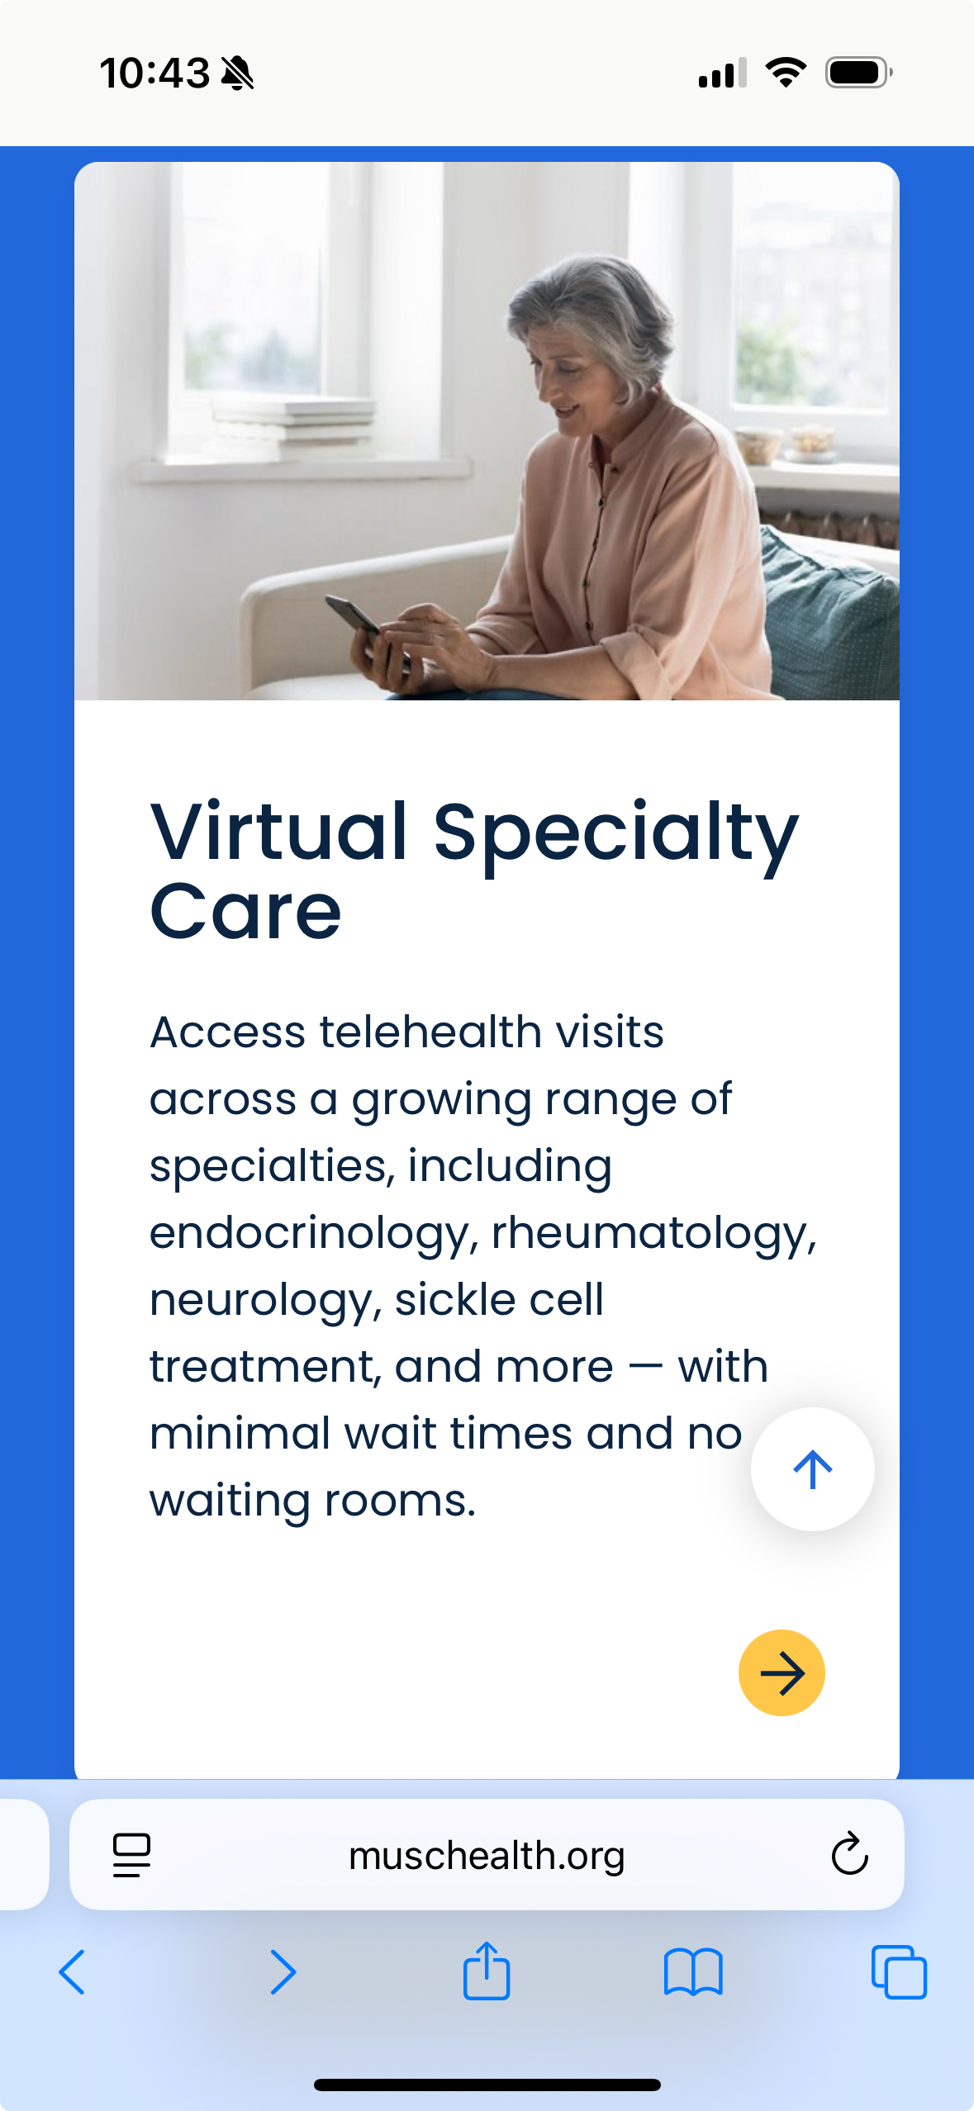
What is the Virtual Specialty Practice?
Virtual Specialty Program
9 Specialties:
Endocrinology
Rheumatology
Benign Hematology
Neurology
Pulmonary
Sleep Medicine
Infectious Disease
Psychiatry
Dermatology
Innovative care model implemented in January 2023
100% virtual practice seeing new and return patients in high demand specialties and primary care across the state
Low friction, no barrier online scheduling with or without a referral
Timely access as soon as same day for primary care and most specialties offered
Fully staffed virtual ‘clinic’ with dedicated RNs, LPNs, and registration supporting pre-visit and post-visit experience, follow-ups, and ancillary service referrals
Providers and support staff with SC licenses living in multiple states
Notes:
keep

Slide 16
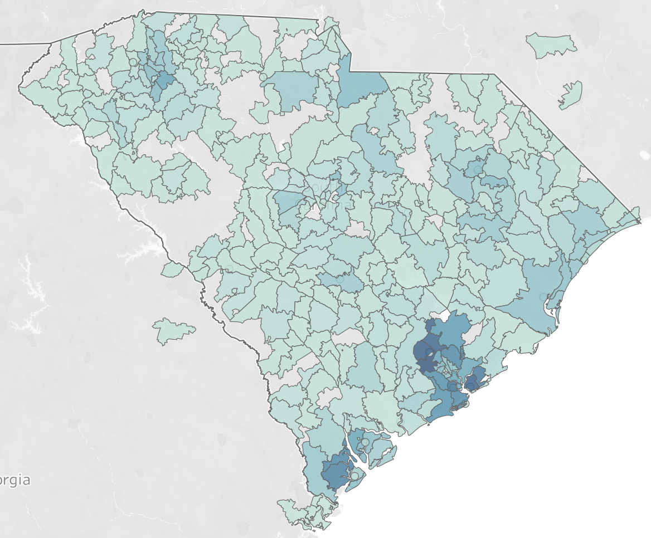
How does the Virtual Specialty Practice function?
Virtual Specialty Program
Pre-visit support for clinical triage needs and tech support
My Chart messages with Virtual Practice panel patients
Coordination follow-up with ancillary service network, results management, escalation support
Fully staffed virtual ‘clinic’ with dedicated RNs, LPNs, and registration supporting pre-visit and post-visit experience, follow-ups, and ancillary service referrals
Affiliate ancillary service partnerships for imaging, labs, infusions, etc.
Notes:
KEEP How does the Virtual Specialty Practice Function
Also include: Staffing model, and use of APN
Patients have a choice to wait for in-person
Local Resources for: Lab, Imaging, Infusion
Specialty Pharmacy

Slide 17
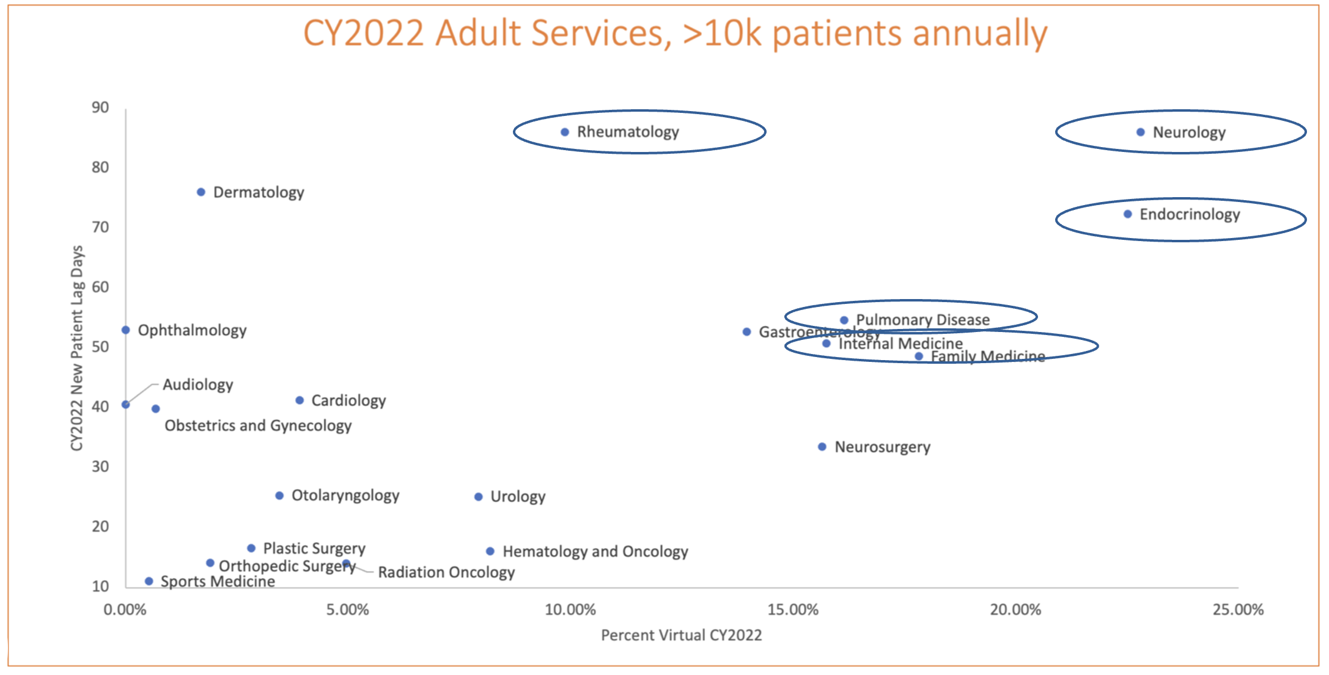
Goals:
Virtual Specialty Program
Reduce wait times for specialty care.
Increase access to care in rural and underserved areas.
Successfully recruit specialists for our growing system and state needs.
Address patient demand and MUSC access issues
Decrease new visit lag days
Grow our specialty market share statewide
Meet patients where they are and start treatment plans
Help affiliates and referring practices across the state serve their patient’s specialty needs
How did we decide where to start?
New Patient Lag Days
% Virtual = Historical Amenability
Notes:
The service lines were originally selected using a strategic population health approach. Using a ‘matrix’ methodology (Figure 1), the time to patient appointments and historical telehealth utilization were considered. This approach accounted for access needs, feasibility, and historical telehealth utilization . Based on this assessment, Rheumatology, Endocrinology, Neurology, and Pulmonology were selected as the initial virtual specialty services. More recently, in the context of program expansion, less emphasis has been placed on the ‘historical amenability’ axis, as access needs have shifted to more challenging specialties. For example, Dermatology is in the upper left-hand quadrant. It has not historically done much telehealth because it is procedure-based. But wait times to access Dermatology are significant. Therefore, we are addressing the access problem by establishing biopsy centers in brick-and-mortar facilities across the state, enabling virtual provider visits in rural areas.
these two sentences both say "historical tele util,." I like the divided sentence approach, with the first sentence emphasizing the two biggest factors and the second sentence including additional / secondary factors (i assume). could we cut the second "historical..." phrase?
could we define this here, or rephrase? not great, but something about "historical amenability to telehealth"?

Slide 18
Program Evaluation:

Slide 19
Evaluation Methods: Virtual Care
Program Evaluation
We employed the RE-AIM framework to assess key program elements and outcomes. RE-AIM is a popular framework for guiding evaluations, RE-AIM enhances the sustainable adoption and implementation of interventions and services.
We selected outcomes in the following RE-AIM dimensions
  Reach: the number of participants & their characteristics
  Effectiveness: impact of the program
  Adoption: the providers and service lines who adopt the program
  Implementation: consistency and adaptions made to the program
  Maintenance/sustainment: extent the program becomes routine and institutionalized
Data: EPIC electronic medical record data and Andor telehealth virtual visit platform data
Methods:
  Data are aggregated and trended over time
  Business intelligence dashboards are also used to enable leadership real-time access to key metrics by provider, program and compare new vs. returning patient types
Source: https://re-aim.org/learn/what-is-re-aim/
Notes:
keep

Slide 20
Evaluation: In-person Comparison Benchmark
Program Evaluation
Patient encounter data from Jan-June 2025
  In-person for four in-person specialty practices
  Virtual visits for virtual specialty providers
Comparison to better understand patient needs, utilization of services, and intensity of services.
Notes:
keep

Slide 21
Program Outcomes:
Part 1: Virtual Only (1/23–12/25)

Slide 22
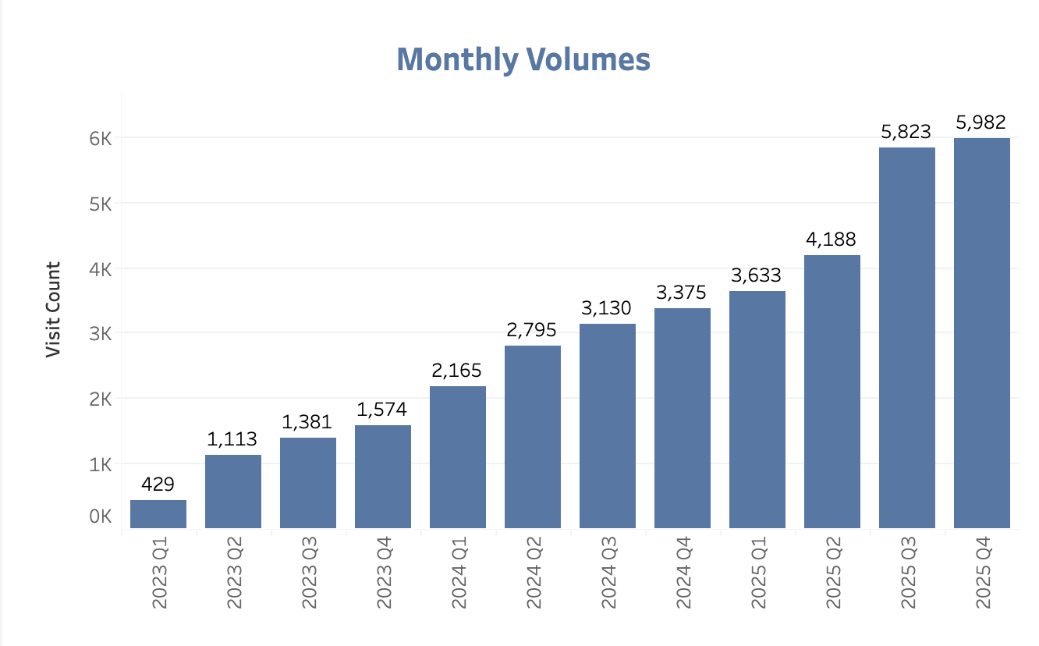
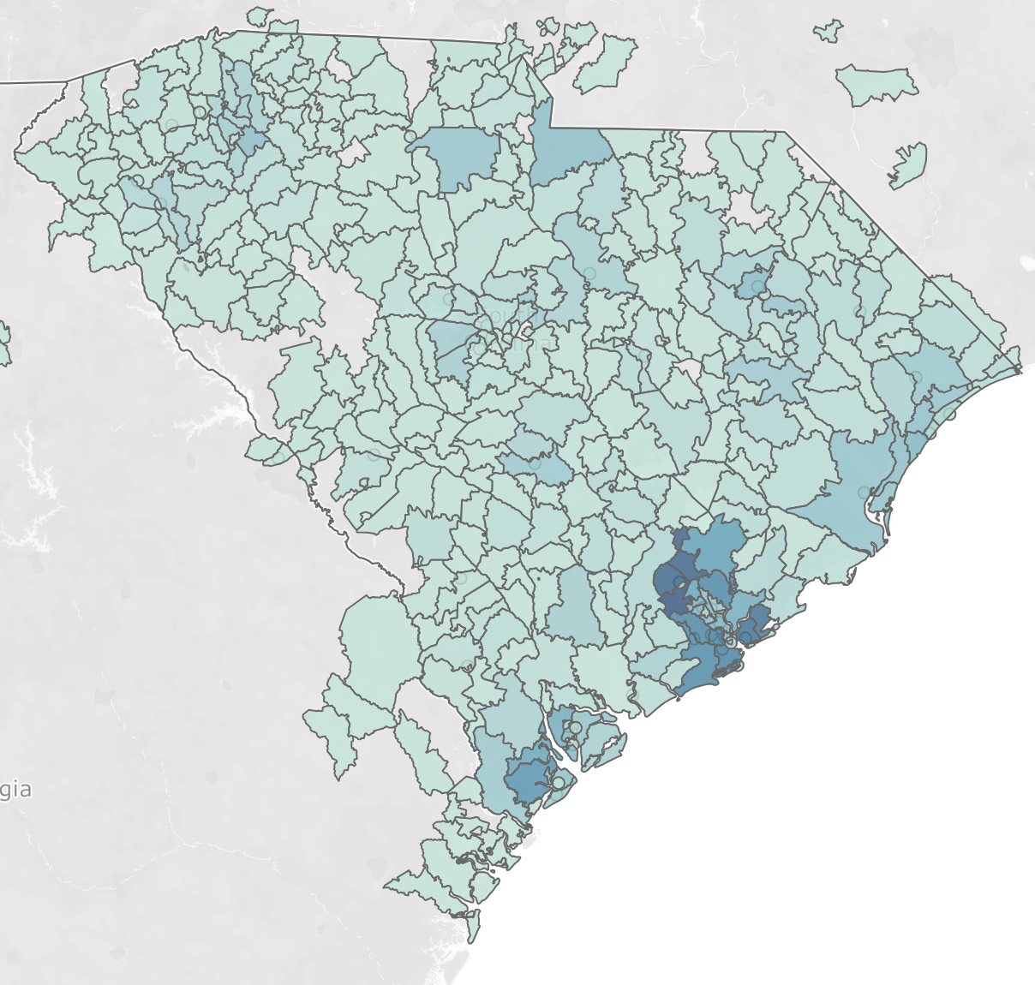
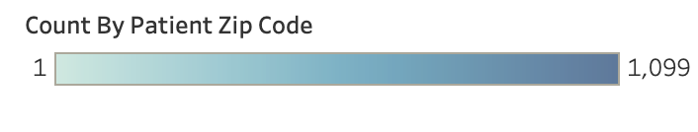
Reach: January 2023-December 2025
Program Outcomes: Part 1: Virtual Only (1/23-12/25)
Total Virtual Specialty Visits: 35,588
Notes:
RE-AIM

Slide 23
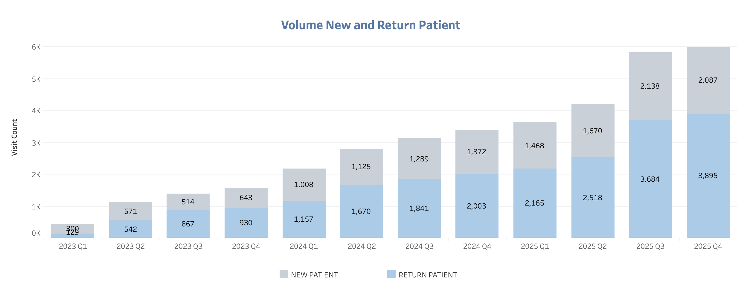
Effectiveness: Expanding Access
Program Outcomes: Part 1: Virtual Only (1/23-12/25)
Notes:
re-aim

Slide 24
Effectiveness: Capacity Management (July 2024-December 2025)
Program Outcomes: Part 1: Virtual Only (1/23-12/25)
Metric | 2024 | 2025
Average New Patients with Appointments w/in 7 days | 38.4% | 49.4%
Average New Patient Appointment Lag in Days | 23.8 | 24.6
Patient Same Day Cancellation Rate | 15.6% | 16.4%
Notes:
RE-AIM

Slide 25
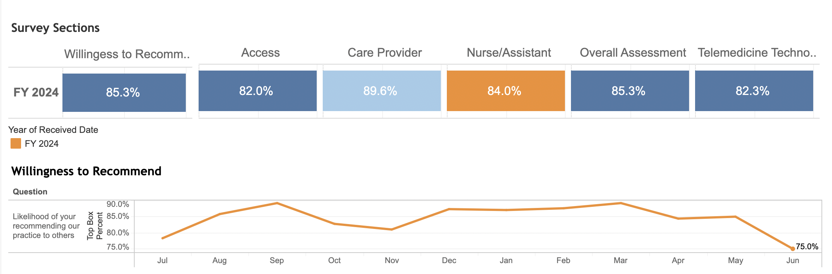
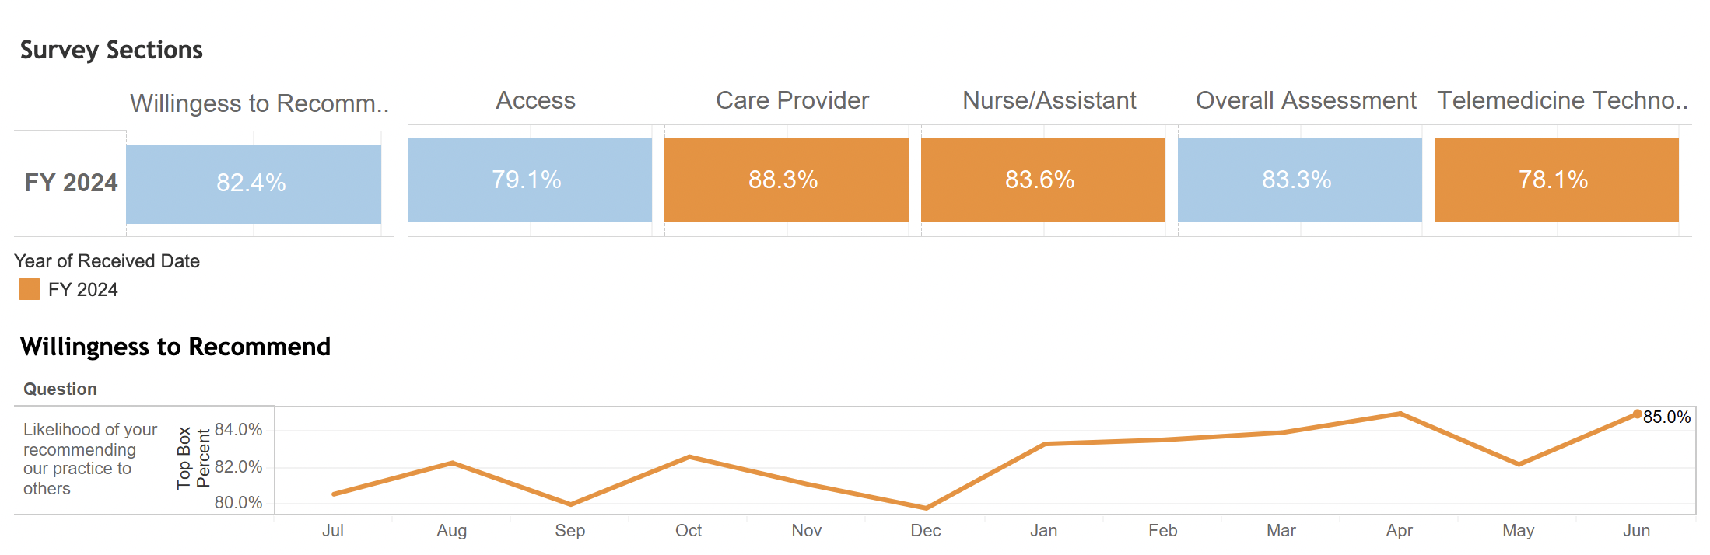
Patient Experience
Program Outcomes: Part 1: Virtual Only (1/23-12/25)
+2.9%
+2.9%
+2.0%
+4.2%
100% virtual practice
Hybrid in-person / virtual practice
Notes:
RE-AIM

Slide 26
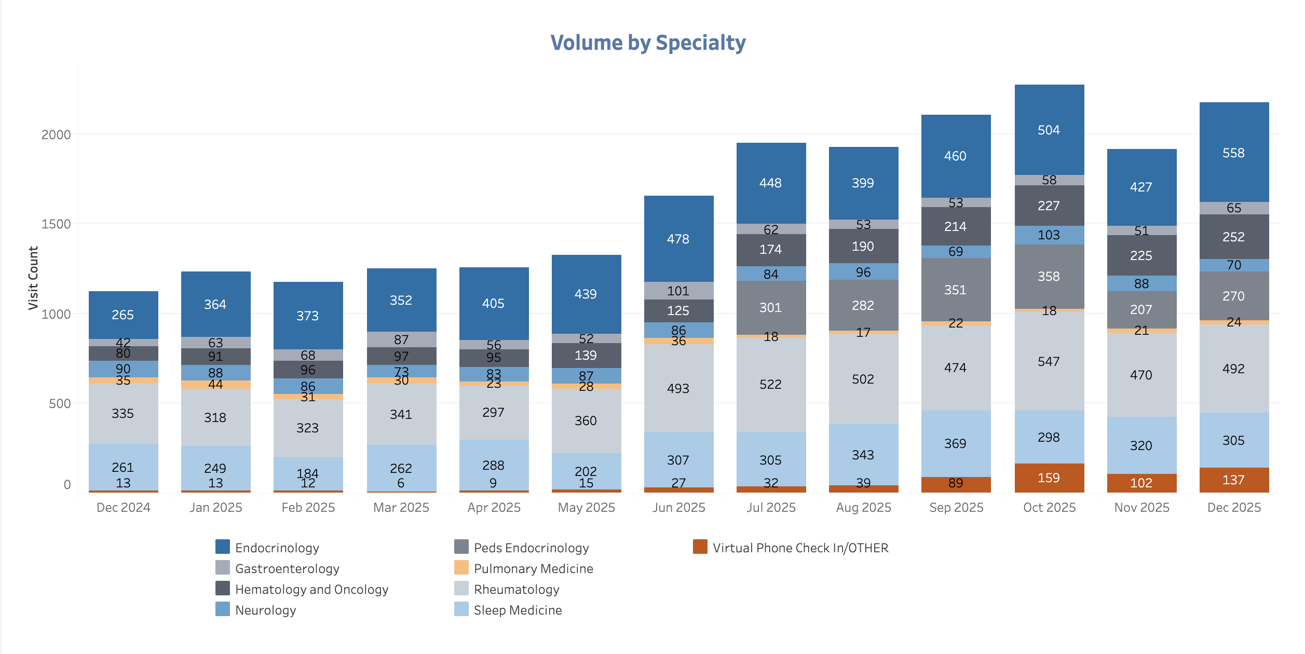
Adoption: Volume by Specialty
Program Outcomes: Part 1: Virtual Only (1/23-12/25)
Notes:
RE-AIM

Slide 27
Implementation
Program Outcomes: Part 1: Virtual Only (1/23-12/25)
Additional providers are added per specialty based on access metrics
Additional specialties are added based on system access needs
Examination of provider capacity vs tendency to overbook to account for no-show appointments
Notes:
RE-AIM

Slide 28
Program Outcomes:
Part 2: Virtual vs In-Person (1/25 – 6/25)

Slide 29
Maintenance
Benchmarking for sustainability
Assessing relative effectiveness
Context for organizational decision making
Access evaluation
Notes:
RE-AIM

Slide 30
Virtual vs In-Person Specialty Care Utilization Jan-June 2025
Program Outcomes: Part 2: Virtual vs In-Person (1/25-6/25
38,636 unique patients
56,120 total completed visits
  48,239 in-person competed visits
  7,881 virtual specialty completed visits
Notes:
RE-AIM

Slide 31
Completed Visits: Patient Demographics
Program Outcomes: Part 2: Virtual vs In-Person (1/25-6/25

Slide 32
Visits by Payer Type
Program Outcomes: Part 2: Virtual vs In-Person (1/25-6/25
New vs Returning Patients

Slide 33
Visit Intensity
Program Outcomes: Part 2: Virtual vs In-Person (1/25-6/25
The top 10 CPT codes included new and established office visits for both in-person & specialty
  In-person visits had higher rates of high complexity CPT codes
  In-person CPT codes included injections
  Virtual visits had higher rates of low or moderate CPT codes
Visit Time
Same Day Cancelation Rates

Slide 34
Challenges and Lessons Learned

Slide 35
Lessons learned
Challenges and Lessons Learned
Hiring out of state/fully remote providers.
Initial fears about quality, accountability & engagement
HR Issue with certain states
EHR/Scheduling interface with how appointments are scheduled for in person vs virtual
Different specialties have different needs (Sleep vs. Dermatology)
Pt acceptance and buy-in (Pulmonology vs Dermatology)
Provider buy-in

Slide 36
Future Direction & Conclusions

Slide 37
Future Direction
Future Direction & Conclusions
Continue to grow multi-specialty model
Grow specialty access to saturation, as referral patterns are changing
Continue to advance ancillary services to support specialty access across the state
  Example: Biopsy locations for dermatology, ultrasound for OBGyn
Notes:
Findings from this research associated with MUSC’s Virtual Specialty Program’s growth, robustness, access for rural populations, and patient satisfaction should be considered by policymakers, insurers, providers, and administrators considering viable, cost-effective solutions to access to care, particularly in high-need specialties. This research is relevant for telehealth reimbursement policy, provider cross-state privileges, APP colocation definitions, and other access to care policy discussions.
MUSC’s Virtual Specialty Program experienced significant growth between January 1, 2023 and December 31, 2025, providing 35,425 virtual specialty visits. The most common virtual specialty services were Gastrenterology and Endocrinology. Across all specialties supported, we exceed our Vizient consortium in percent virtual care provided to patients. The program continues to serve about 40% new patient visits. Wait times vary across specialties; we continuously monitor provider schedules and lag days to improve time to access care. This program provided visits to patients in nearly every zip code in the state of South Carolina. Rural access to specialty care improves through this model. Patient satisfaction was also high for virtual care; 100% virtual patients reported a higher “willingness to recommend” than hybrid or in-person patients.
The program provides virtual care predominantly to commercially insured patients. This could somewhat be associated with favorable commercial insurance reimbursement policies for telehealth visits, but it nevertheless has both positive and negative impacts. Financially, commercially insured patients yield higher profits, positively impacted the organizations bottom line and increasing opportunities to grow and reinvest in virtual care. An unintended consequence of serving a predominantly commercially insured virtual specialty population could be a reduction in access for non-commercially insured patients. Alternatively, if growth through virtual access exceeds prior supply, it is possible that non-commercial patient access is not stymied but even improved through the growing MUSC Virtual Specialty Program; future evaluation is needed on this area.
Jillian remaining notes:
The patient wait times, are considerably lower than the published literature.
Could tie in literature about volume being the biggest factor to quality outcomes
Conclusion
Offering a virtual-only specialty service can significantly improve access for patients, especially in underserved or rural areas with significant specialty provider shortages. Our data shows high utilization of virtual visits for specialties, suggesting strong demand. While specific procedures require in-person care, virtual specialty services may expand access to new patient populations, improve continuity, reduce wait times, and optimize resource allocation. Strategic implementation could lead to more effective healthcare delivery and better patient outcomes. Ongoing analysis will examine physician productivity, visit outcomes (e.g., cancellation, no-show rates), patient satisfaction, and provider satisfaction across virtual and in-person groups.
is this true? anecdotally, as a BCBS state employee, i think it's as cheap or cheaper for my copay for me to see my sleep doctor virtually.
Pulled this from Caitlin's SEARCH abstract. did not touch it.

Slide 38
Conclusions
Patient Impact:
Early results show-
Access & Integration:
Establishing a highly accessible digital front door remains a challenge, when integrating Electronic Health Record (EHR) tools.
Regulatory Barriers:
South Carolina regulations on Schedule II & III medication prescribing limit care options.
Program Growth:
Continued expansion will involve innovative partnerships, cross-specialty collaboration, and coordination with trusted affiliates.
Increased access to timely care
Improved patient experience
Lower no-show rates than national benchmarks
Geographic requirement for overseeing physicians regarding APPs

Slide 39
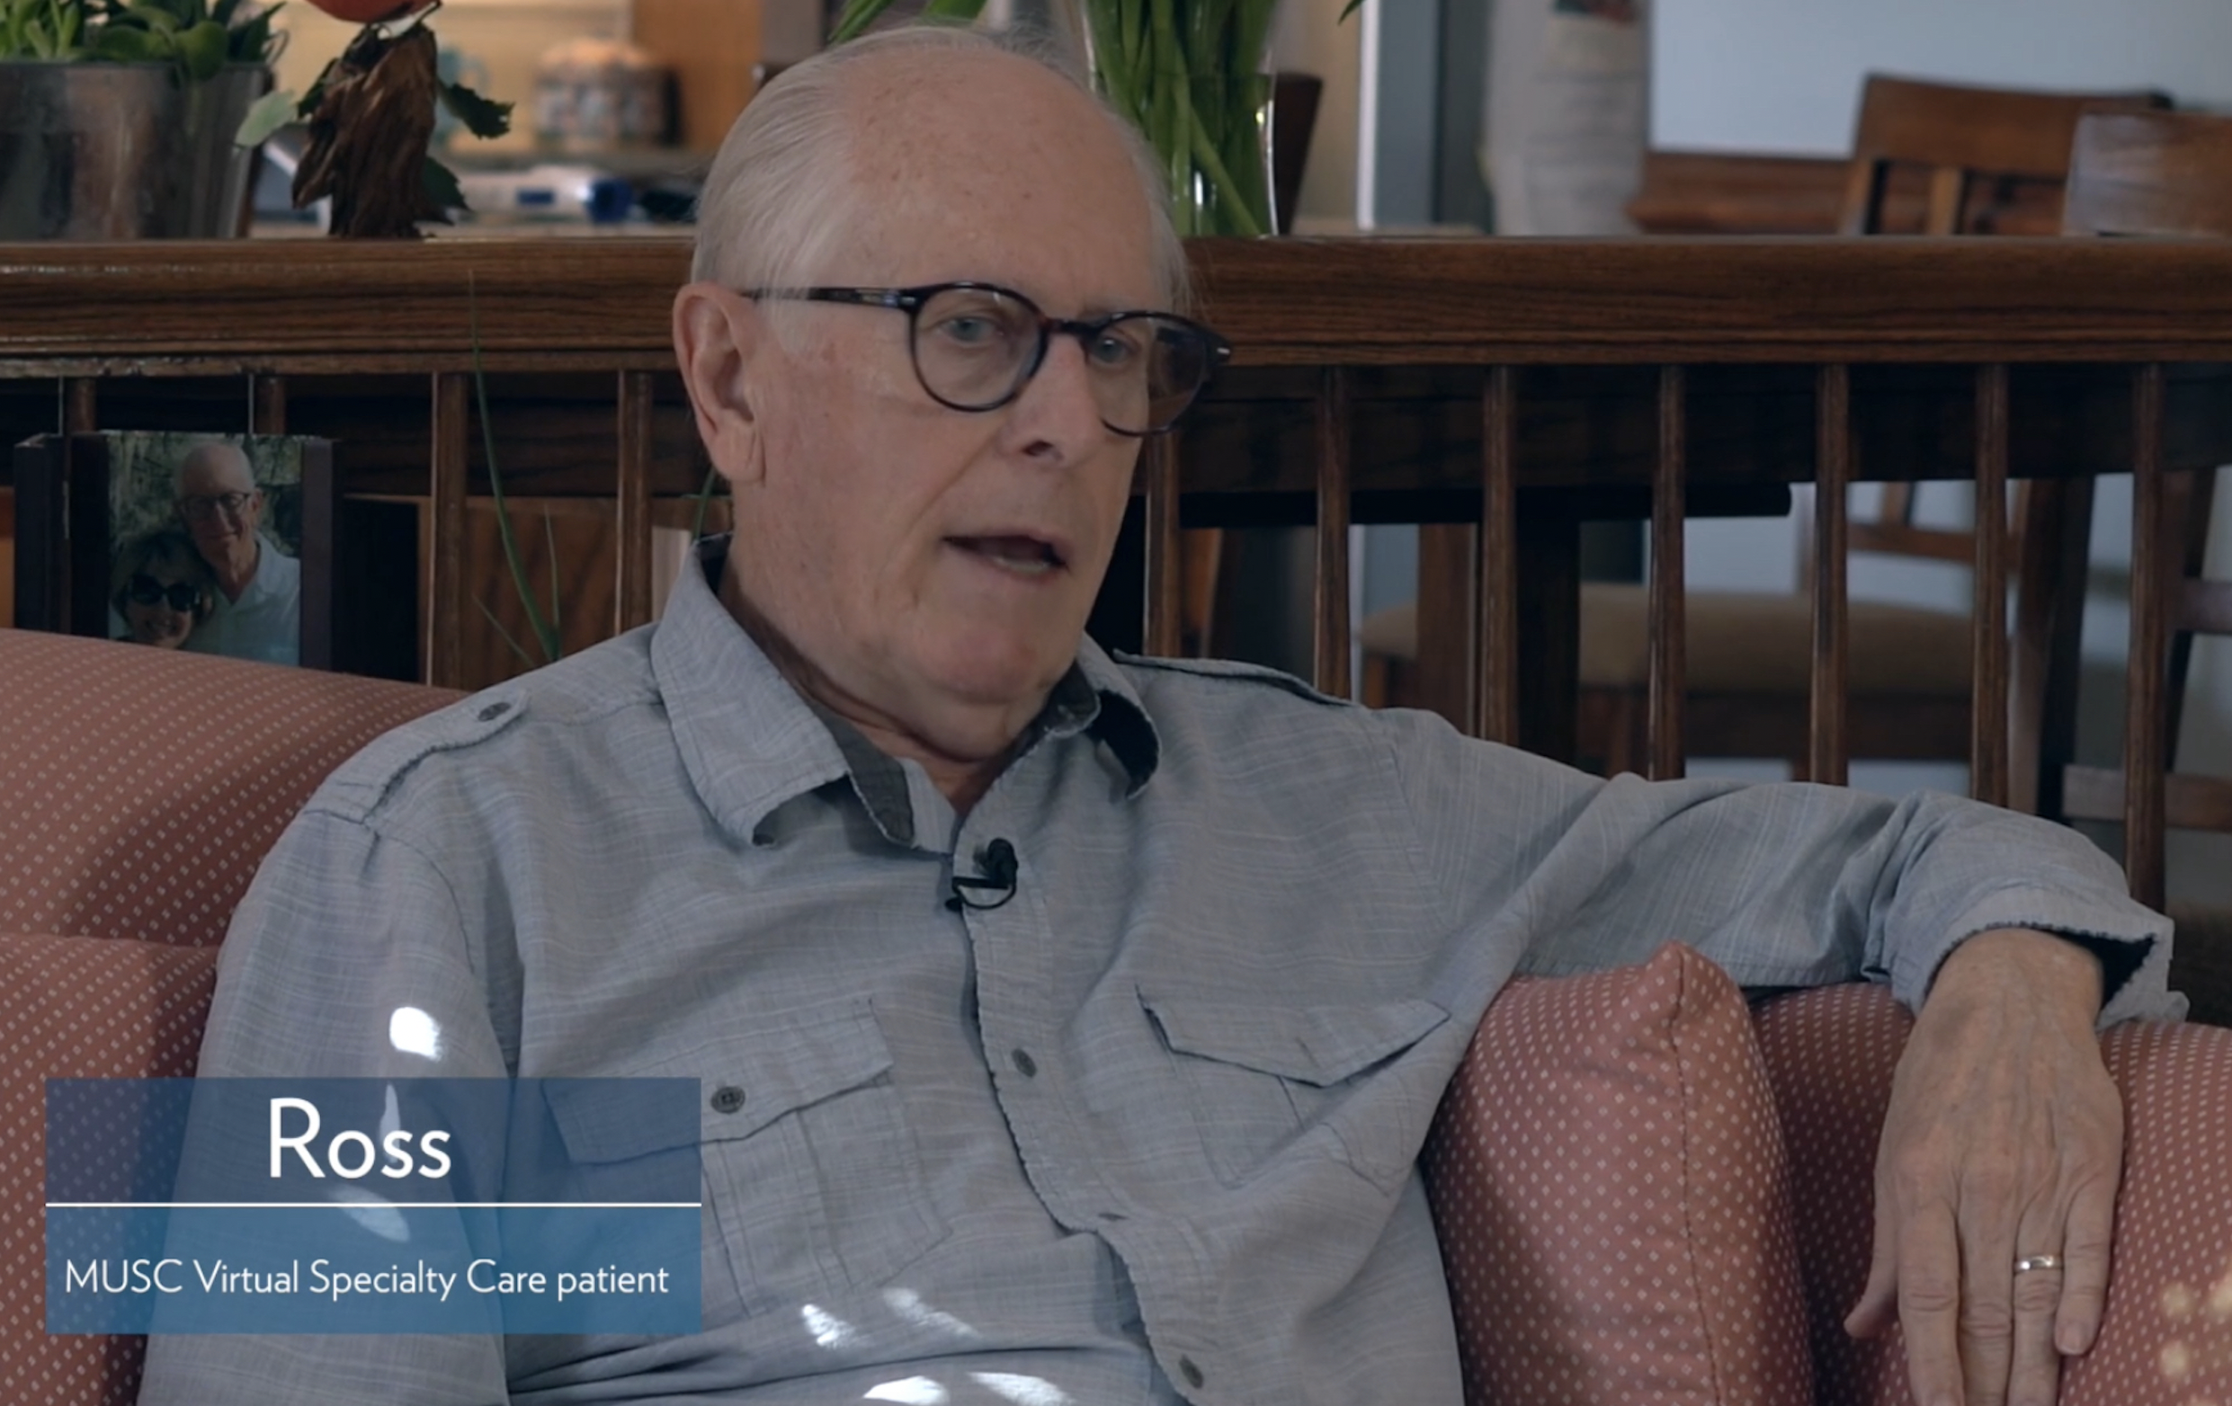

Conclusions
Ross’ story…
Early virtual practice patient seeking rheumatology care
Activities of daily living were impacted, and he needed to be seen to start treatment
Was seen via virtual specialty the next day and was immediately impacted, prescribed medications started
Ross’ story is not unique.
Notes:
appendix

Slide 40
Questions?
Please feel free to reach out to Dunc Williams at wiljd@musc.edu.
Thank you!

