Slide 1


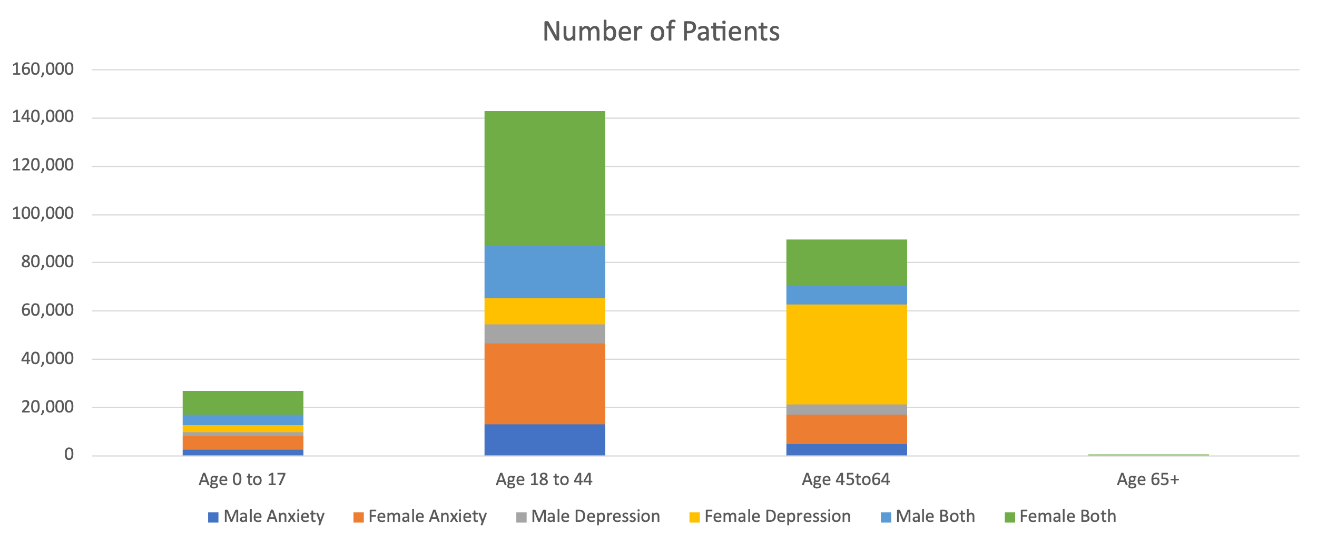
Telehealth Use in Behavioral Health Among Commercially Insured Patients
Kit Simpson, DrPH ¹, Caitlin Koob, PhD ¹, Emily Johnson, PhD², Dunc Williams, PhD¹
¹Medical University of South Carolina (MUSC) Telehealth Center of Excellence
¹MUSC College of Nursing
OVERVIEW
In this mixed-methods study, we combined national claims analysis with patient surveys and interviews. Quantitatively, we used 2022 MarketScan data to evaluate telehealth use among commercially insured individuals for which the primary or secondary diagnosis code was anxiety, depression or whether both were present. We quantified and identified utilization patterns across visit types, ages, and sex.
Qualitatively through our telehealth-enabled Collaborative Care Management (CoCM) program, we conducted a survey and interviews to understand patient perspectives on telehealth use to treat depression and anxiety.
RESULTS
Quantitative
Qualitative
From the IBM Marketscan Commercial Claims and Encounters Database, 2022, we identified 15,903,345 telehealth visits.
Of those visits, based on the AHRQ Clinical Classifications software (CCSR) for ICD-10-CM diagnoses, v2025.1, 6.6 million had a primary ICD-10 diagnosis code indicating a behavioral health condition
5,811,798 visits for 236,395 unique patients had a primary Dx of depression or anxiety.
Age, sex, and diagnosis distributions for telehealth services are shown in Figure 1 and Table 1.
MUSC’s telehealth-enabled Collaborative Care Management (CoCM) program was designed to improve access and quality of mental and behavioral health services to South Carolinans.
Between 6/1/23 – 6/30/25, 1,065 patients were referred to CoCM, 608 ultimately enrolled.
From those, we received electronic survey responses from 120 patients and we conducted 13 in-depth interviews of patients who did or did not enroll in telehealth-based mental/behavioral health services.
Patients Perspectives: Telehealth for Depression & Anxiety
(Electronic Survey Results, N=120)
The majority (60%) of enrollees reported improvements in their mental health after telehealth sessions
Over half of enrollees (58%) reported being “confident” or “very confident” that they could maintain their progress after telehealth therapy sessions
62% of enrollees reported they would recommend the telehealth program to others in need of mental or behavioral health support
Patient-Reported Benefit of Telehealth
(In-depth Interviews, N=13)
“Since the beginning, number one, why I stayed, especially number one is that it's telehealth and it's just super convenient. They were able to adjust their own times where I was available.”
“I knew it was someone I could talk to. I didn't feel judged. …I could openly talk to her because it was someone I had never met.”
“I most definitely will 100% continue. I feel like I couldn't function if I didn't have the program at this point.”
Figure 1. Visits by Age Group, Sex and Diagnosis for First Telehealth Record
Table 1. Days from Pre-Visit to 1st Telehealth Record (Mean, SD)
Age Group | Anxiety | Depression | Both | Overall Mean (SD)
0 to 17 | 4.8 (8.1) | 5.1 (8.4) | 2.0 (3.4) | 3.4 (6.4)
18 to 44 | 5.6 (10.0) | 5.9 (10.2) | 2.2 (4.3) | 3.9 (7.8)
45 to 64 | 5.6 (9.9) | 5.7 (10.0) | 2.1 (3.6) | 4.0 (7.9)
65+ | 3.6 (4.2) | 3.7 (4.9) | 1.7 (2.5) | 2.8 (4.0)
Overall Mean (SD) | 5.5 (9.8) | 5.7 (9.9) | 2.2 (4.1) | 3.8 (7.7)
FUNDING ACKNOWLEDGEMENT
This research is supported by the Health Resources and Services Administration (HRSA) of the U.S. Department of Health and Human Services (HHS) as part of the National Telehealth Center of Excellence Award (U66RH31458) totaling $4,250,000 with 100 percent funded by HRSA/HHS. The contents are those of the author(s) and do not necessarily represent the official views of, nor an endorsement, by HRSA/HHS, or the U.S. Government.
SUMMARY
Our findings illuminate utilization trends and patient-reported benefits of telehealth services for behavioral health diagnoses.
There was high utilization in 2022 (6.6mn visits) for 236,396 unique patients, of which 70% were female, more commonly between the ages of 18-44.
Mean telehealth visits per person were 9 for anxiety, 8 for depression, and 40 for both.
Days from Pre-visit to 1st telehealth record was under 6 across all categories.
Qualitative interviews highlight convenience, reduced stigma, and scheduling flexibility as key benefits.
Many patients report preferring telehealth services for mental and behavioral health needs, rather than in-person services.
Telehealth may increase access to high-quality mental and behavioral health services.
Notes:
Implications for Telehealth Programs
• Telehealth may reduce stigma barriers for behavioral health
• Flexible scheduling increases engagement
• Programs like CoCM can expand access in shortage areas

