Slide 1


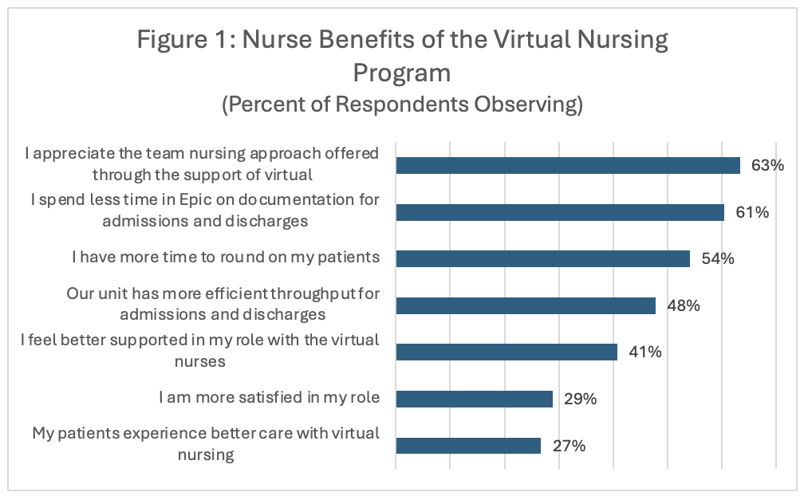
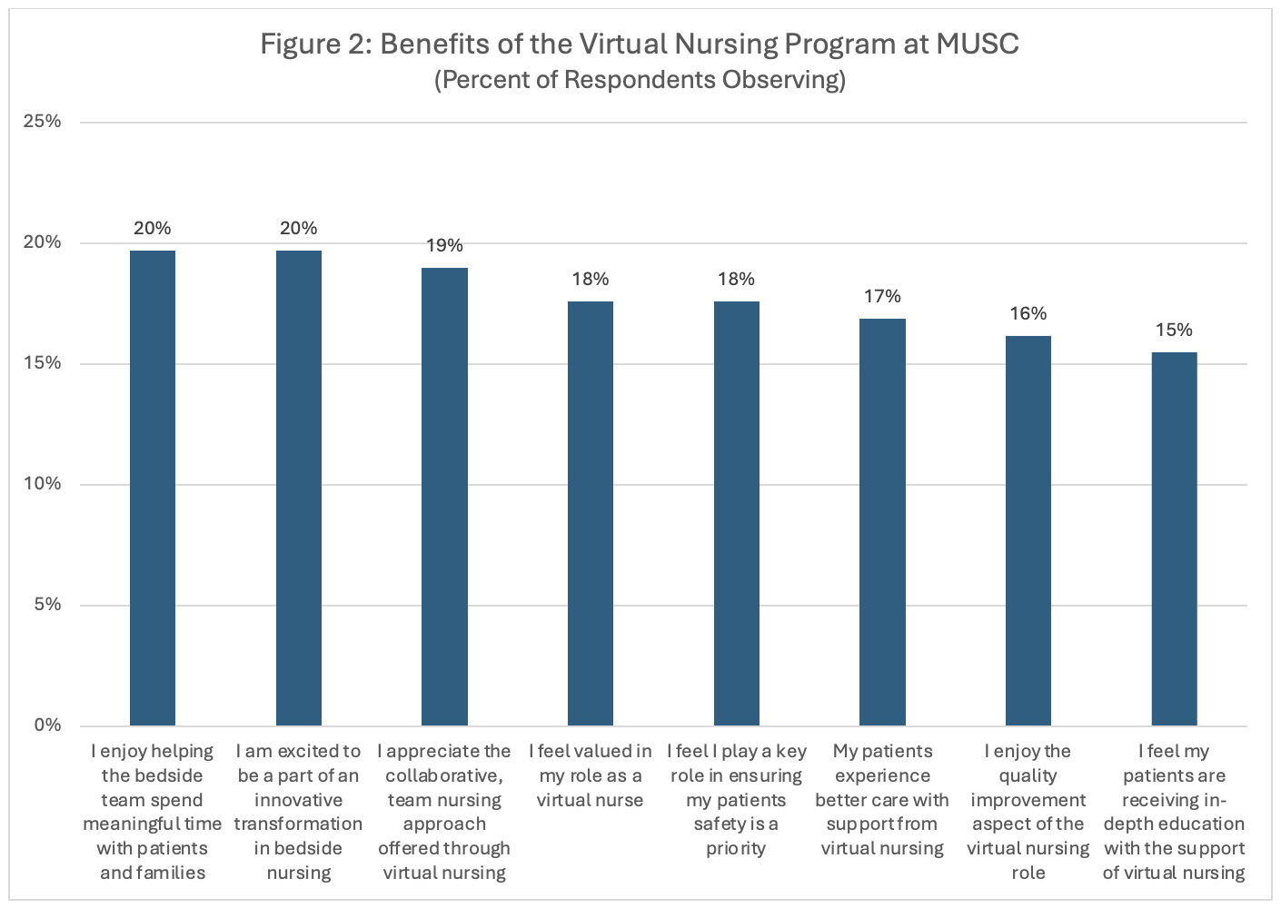
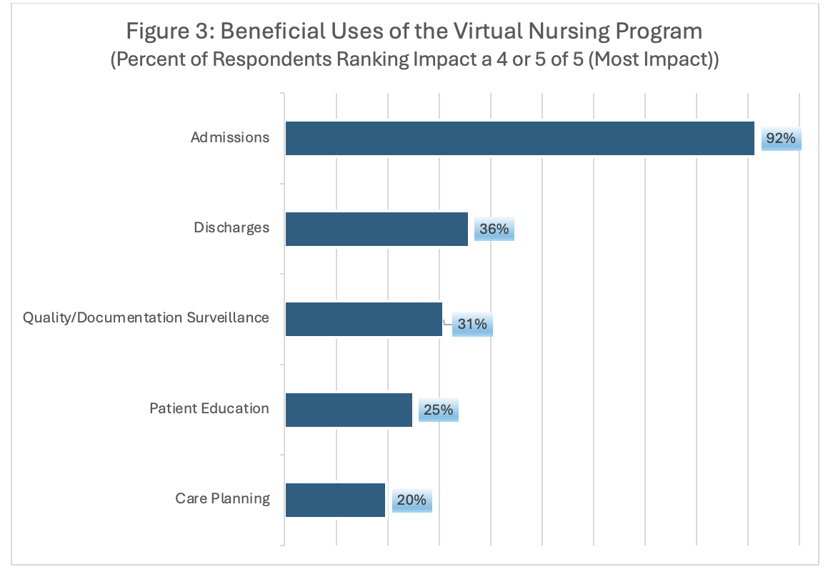
Evaluating the Impact of a Virtual Nursing Model on Providers within a Large Academic Medical Center: Incorporating Unit-Level Indicators and Nurse-Reported Outcomes
Caitlin Koob, PhD¹, Jillian Harvey, PhD¹, Jimmy McElligott, MD², Peter Gardella, MBA, RN², Emily Warr, MSN, RN², Dunc Williams, PhD¹, & Dee Ford, MD²
¹Medical University of South Carolina (MUSC) ²Telehealth Center of Excellence
OVERVIEW
A Virtual Nursing Model (VRN) was implemented across an academic medical center as an innovative care delivery model to address patient access and healthcare workforce shortages, leveraging teams of remote nurses to offset time-consuming tasks. We surveyed bedside and virtual nurses (N=132) to assess their perceived value of the VRN model. Overall, nurses provided favorable perceptions of VRN.
METHODS
This study retrospectively analyzed VRN data from January to June 2025 across 36 units systemwide, following rapid expansion. Data were triangulated from patients’ electronic health records, program tracking within the Research Electronic Data Capture System (REDCap), and a REDCap survey distributed among bedside and virtual nurses from May to September 2025 (N=142 completed; 17.3% and 69% response rates for bedside and virtual nurses, respectively).
Outcomes include VRN utilization, VRN service unit types, and time spent per task. Service unit types describe VRN support, including tasks related to admission, discharge, care plan, education, quality-of-care, and documentation compliance. Descriptive statistics were used to understand patterns of VRN support across service types, estimate the mean number of minutes spent performing each type of task, and nurses’ perceptions of the VRN program. Analyses were conducted using SAS,v.9.3 and R, v.4.4.1.
RESULTS
From January through June 2025, VRN provided support for 23,516 admissions, including 58,793 specific tasks, systemwide. VRN supported 60.2% of total hospital admissions, primarily supporting admissions (65%), quality-of-care (18%), and discharges (17%), and often provided multiple services within one visit.
Across service types, visits lasted a mean of 36.8 minutes (SD=27.0) with longer visits time for admissions alone (M=34.6, SD=26.9), or 44.7 minutes when combined with care planning or education.
Over half (51.2%; n=21) of VRN units were implemented in rural hospitals.
RESULTS
Overall, most nurses reported benefits of a team-based approach to care (63%) and time saved, particularly related to admission documentation (61%) and more time to spend on rounding (54%). Additionally, 29% of nurses reported improved satisfaction and 27% felt the patient experience improved since VRN implementation (Figure 1).
When asked how VRN impacted workload, 87% of bedside nurses said it slightly or significantly decreased workload. Nurses ranked various uses of virtual nursing as a 4 or 5 on a 1-5 scale (with 5 being the most impactful), including admissions (92%), discharges (36%), quality documentation/surveillance (31%), patient education (25%), and care planning (20%) (Figure 3). Overall, nurses reported being very satisfied with the virtual nursing program 61% of the time.
Comments from nurses in two free-text questions on the survey were generally favorable, supporting quantified results presented in this study. Nurses reported receiving the most support for time-consuming admission tasks, and described VRN as a “great asset,” “makes the workday so much better,” and “has restored faith in bedside nursing.” Virtual nurses echoed that this “team” approach to nursing “is the future,” and that this role has allowed them to “stay in the field that [they love].”
DISCUSSION
VRN may be one mechanism to alleviate ongoing patient access and healthcare workforce shortage gaps. Growing VRN volumes across services and favorable patient and nurse responses support continued growth of VRN.
This study is situated within a larger, multi-level evaluation of the VRN model’s impact on patient, provider, and systemic outcomes. Favorable perceptions of the VRN model from bedside and virtual nurses indicate feasibility of continued VRN expansion across innovative use-cases, including high-touch departments such as emergency departments and intensive care units. Further investigation is needed to understand the financial return on investments to hospitals, including improved throughput and/or decreased turnover rates across VRN units.
Funding Acknowledgement
This research is supported by the Health Resources and Services Administration (HRSA) of the U.S. Department of Health and Human Services (HHS) as part of the National Telehealth Center of Excellence Award (U66RH31458) totaling $4,250,000 with 100 percent funded by HRSA/HHS. The contents are those of the author(s) and do not necessarily represent the official views of, nor an endorsement, by HRSA/HHS, or the U.S. Government.
Notes:
Systemic gaps in U.S. healthcare delivery have created workforce issues that impact patient outcomes and costs. As a result, there is growing concern for an estimated deficit of 3.2 million healthcare workers by 2026 nationwide; in one state, 39% of surveyed nurses reported intentions of leaving their job within one-year.
To address these concerns, a Virtual Nursing model (VRN) was developed as an innovative care delivery model, leveraging teams of remote, virtual nurses to support bedside nurses in providing care via technology. This study evaluates bedside and virtual nurses’ perceived value and attitudes towards a implemented VRN model, following its pilot implementation.
From 5/22/25 through 9/9/25, we surveyed 692 nurses (650 bedside nurses, 42 virtual only contract nurses) from MUSC’s 41 VRN units. Of the 692 nurses surveyed, 132 completed the survey, 10 completed most of the survey but did not submit it (all 10 bedside), totaling 142 surveys eligible for evaluation.
Overall, the majority of nurses’ reported benefits of a team-based approach to care (63%) and time saved, particularly related to admission documentation (61%) and more time to spend on rounding (54%). Additionally, 29% of nurses reported improved satisfaction and 27% felt the patient experience improved since VRN implementation.
Research Method: Survey/Qualitative
Research Classification: Clinician Experience
Research Results (100 word limit):
When asked how VRN impacted workload, 87% of bedside nurses said it slightly or significantly decreased workload. Nurses ranked various uses of virtual nursing as a 4 or 5 on a 1-5 scale (with 5 being the most impactful), including admissions (92%), discharges (36%), quality documentation/surveillance (31%), patient education (25%), and care planning (20%). Overall, nurses reported being very satisfied with the virtual nursing program 61% of the time. Comments from nurses in two free-text questions on the survey were generally favorable, supporting quantified results presented in this study.
Research Conclusions (100 word limit):
This study is situated within a larger, multi-level evaluation of the VRN model’s impact on patient, provider, and systemic outcomes. Favorable perceptions of the VRN model from bedside and virtual nurses’ indicate feasibility of continued VRN expansion across innovative use-cases, including high-touch departments such as emergency departments and intensive care units.
…
Caitlin’s results:
From January through June 2025, VRN provided support for 23,516 admissions, including 58,793 specific tasks, systemwide. VRN supported 60.2% of total hospital admissions, primarily supporting admissions (65%), quality-of-care (18%), and discharges (17%), and often provided multiple services within one visit.
Across service types, visits lasted a mean of 36.8 minutes (SD=27.0) with longer visits time for admissions alone (M=34.6, SD=26.9), or 44.7 minutes when combined with care planning or education.
NOT ON POSTER, MAY COMBO WITH ABOVE IN A TABLE: Quality-of-care visits lasted a mean of 9.3 minutes (SD=6.5), or 23.8 minutes with education. Discharge visits lasted a mean of 25.5 minutes (SD=12.3), or 23.0 minutes (SD=11.4) with education. Further, 61.8% of discharges occurred in <3 hours from time of order with VRN support.
Over half (51.2%; n=21) of VRN units were implemented in rural hospitals. Bedside nurses in rural hospitals reported significantly more experience (in years), compared to those in urban hospitals (M=16.17, SD=11.62 vs. M=9.873, SD=10.07; p=0.003).
NOT ON POSTER: The majority of bedside nurses in rural (78.0%) and urban (76.4%) hospitals reported being “satisfied” or “very satisfied” with the VRN program, compared to 100% of virtual nurses. Most bedside nurses also reported a “slight” or “significant decrease” in workload with VRN support (Rural: 88.1%, Urban: 80%).
Reflecting quantitative findings, bedside nurses in rural hospitals reported receiving most support for time-consuming admission tasks, and described VRN as a “great asset,” “makes the workday so much better,” and “has restored faith in bedside nursing.” Virtual nurses echoed that this “team” approach to nursing “is the future,” and that this role has allowed them to “stay in the field that [they love].”

