Slide 1

Digital Specialty Access: Evaluating a Virtual-Only Specialty Care Program
Katie Kirchoff, MSHI
Center for Telehealth, MUSC

Slide 2

Acknowledgement
10,000+
Professional Staff
This presentation is supported by the Health Resources and Services Administration (HRSA) of the U.S. Department of Health and Human Services (HHS) as part of the Telehealth Center of Excellence Award (U66RH31458) totaling $4,250,000 with 100 percent funded by HRSA/HHS. The contents are those of the author(s) and do not necessarily represent the official views of, nor an endorsement, by HRSA/HHS, or the U.S. Government.

Slide 3
Learning Objectives
Describe the development and implementation of a completely virtual specialty service line aimed at addressing the significant delays and challenges patients encounter in accessing in-person specialty care.
Examine how a fully dedicated remote clinical support team leverages technology to coordinate pre-visit and post-visit activities, including appointment scheduling, clinical screenings, and patient connectivity.
Evaluate a virtual specialty program by monitoring outcomes related to workforce, quality care, access, benchmarking against in-person care, patient satisfaction, and patient care needs.
10,000+
Professional Staff

Slide 4

About MUSC & Need for Virtual Specialty

Slide 5
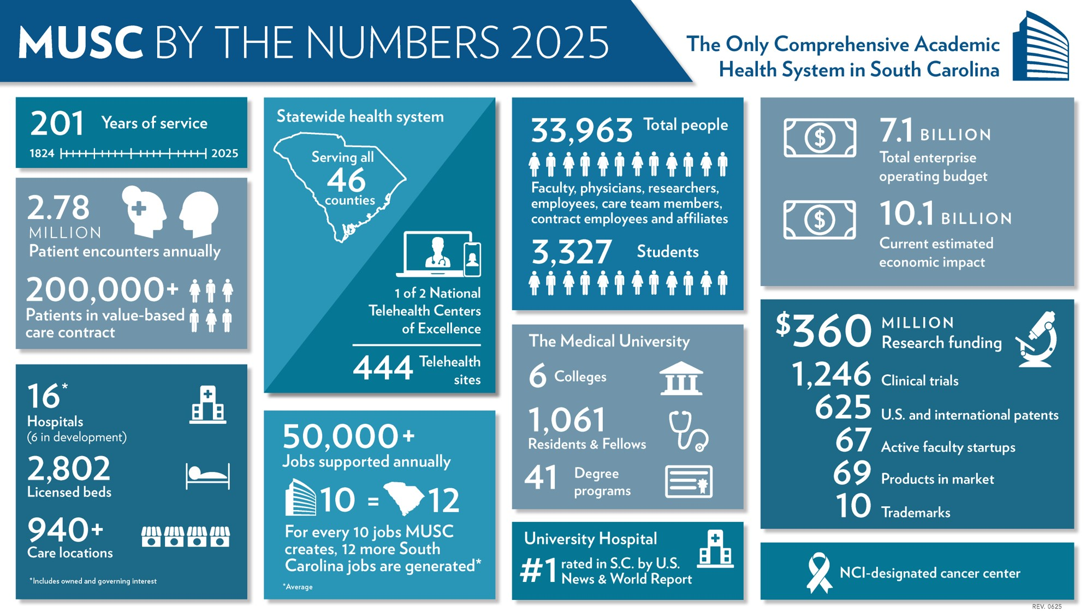
About MUSC
10,000+
Professional Staff

Slide 6
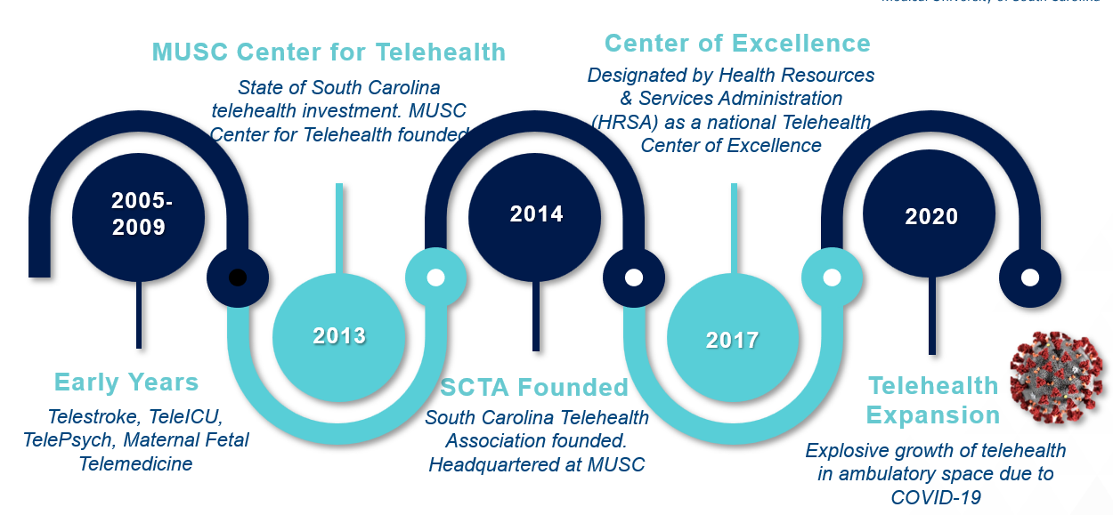
About Center for Telehealth
10,000+
Professional Staff

Slide 7
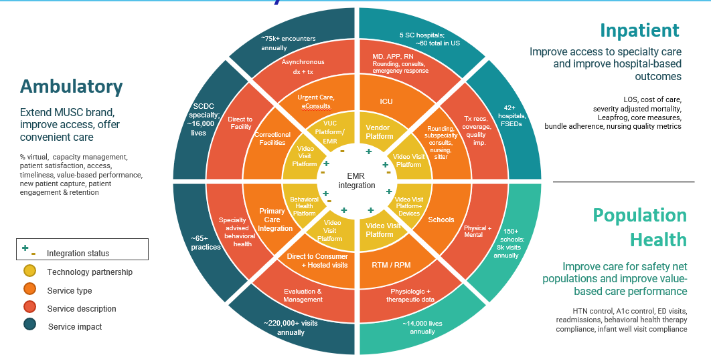
About Center for Telehealth
10,000+
Professional Staff

Slide 8
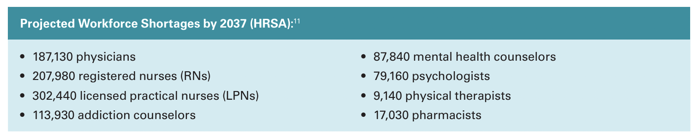
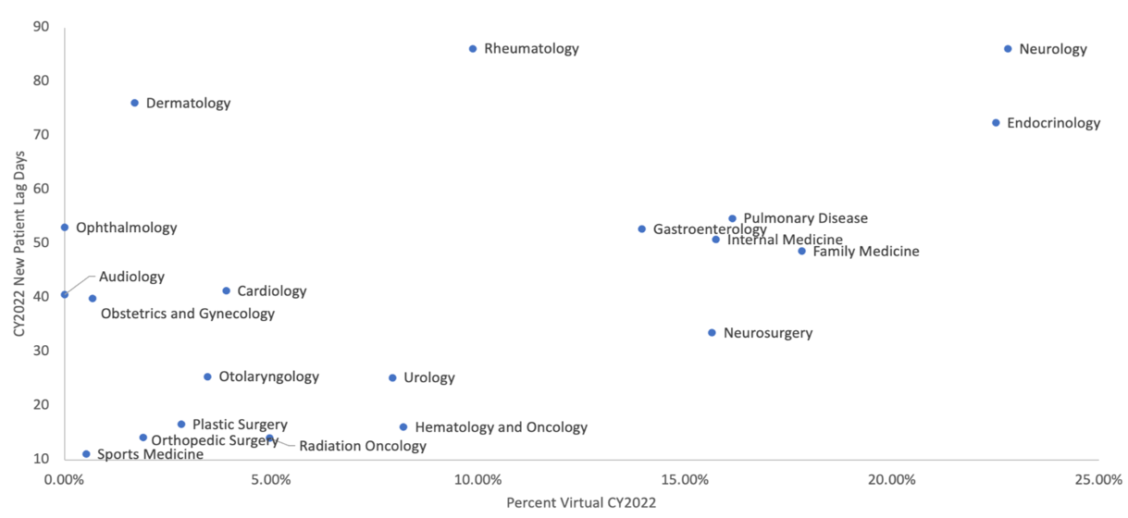
Solving Access Issues
Source: HRSA National Center for Health Workforce Analysis. (2025). Health workforce projections https://bhw.hrsa.gov/data-research/projecting-health-workforce-supply-demand
Selecting Specialties
High new patient appointment lag days
High telehealth utilization
Others on request

Slide 9
Implementation

Slide 10
Virtual Specialty Approach: Abundance of Need
Program Features
  Low friction, no barrier online scheduling with or without a referral
  Timely access as soon as same day for primary care and most specialties offered
  Fully staffed virtual ‘clinic’ with dedicated RNs, LPNs, and registration supporting pre-visit and post-visit experience, follow-ups, and ancillary service referrals
Goals
  Reduce wait times for specialty care.
  Increase access to care in rural and underserved areas.
  Successfully recruit specialists for our growing system and state needs.

Slide 11
Clinical Support Team
Pre-Visit
  Call Patient 2-3 days before
    Confirm appointment date
    Complete registration
    Review current medications and allergies
    Update medical/ surgical history
    Complete screenings for quality measures
    Specialty specific questionnaires/medical device downloads
  Day of appointment
    Assist patient with technology issues
Post-Visit
  Ensure lab and imaging orders are entered for patient preferred location
  Coordinate referrals
  Prior Authorizations
  Patient message support
  Schedule follow-up appointments
  Warm hand-off with in-person specialist for specific patient needs, as required.

Slide 12

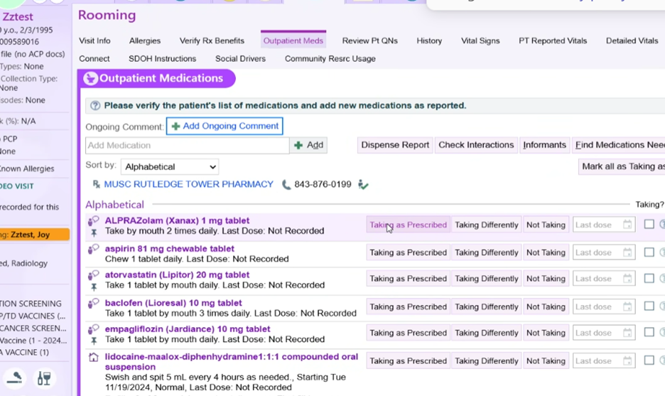
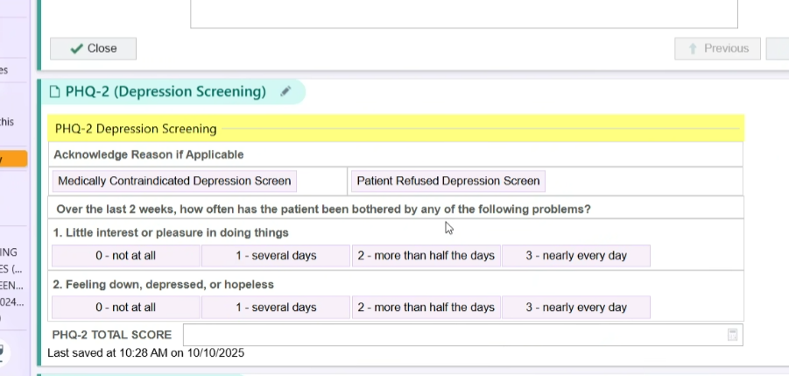
Clinical Support Team EHR Workflow

Slide 13
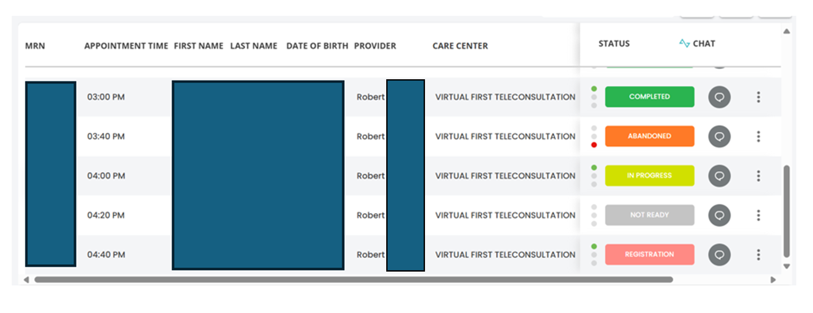
Clinical Support Team Video Visit Platform Dashboard

Slide 14

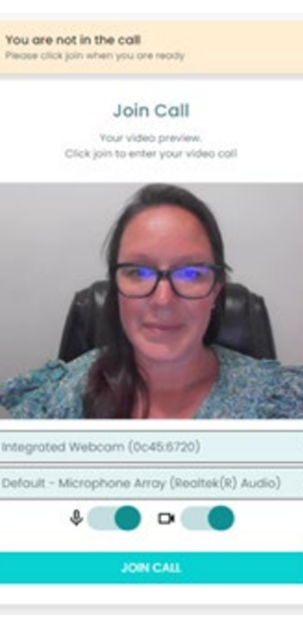
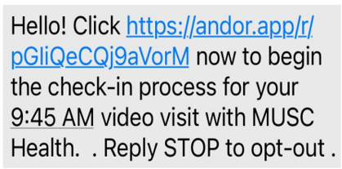
Virtual Waiting Room
Sign MUSC Consent- if not signed in the past year
Confirm you are in the state of South Carolina for the visit
Answer Yes/No if you have Medicare Coverage
Option to invite family member to join when the visit starts
Click “JOIN NOW”

Slide 15
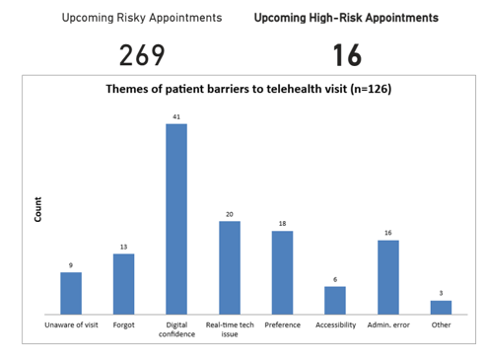
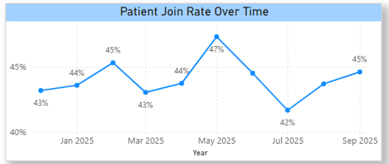
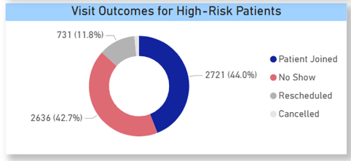
Digital Navigation Program 1.0
Identify patients at high risk for missing appointment
Risk score developed and initial results analyzed
Phone calls to 65+ y/o patients who had a no show and responses organized into themes
Goal is process optimization to better identify and support patients who will need human assistance.

Slide 16
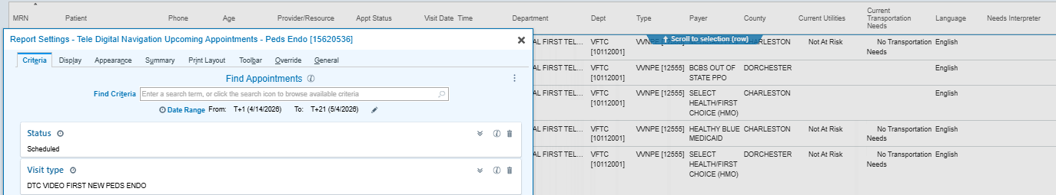
Digital Navigation Program 2.0
Identify patients at high risk for missing appointment
EHR report identifying upcoming new pediatric endocrinology appointments within the next 21 days
Provide resources to increase likelihood of a successful virtual visit

Slide 17
Monitoring Outcomes

Slide 18
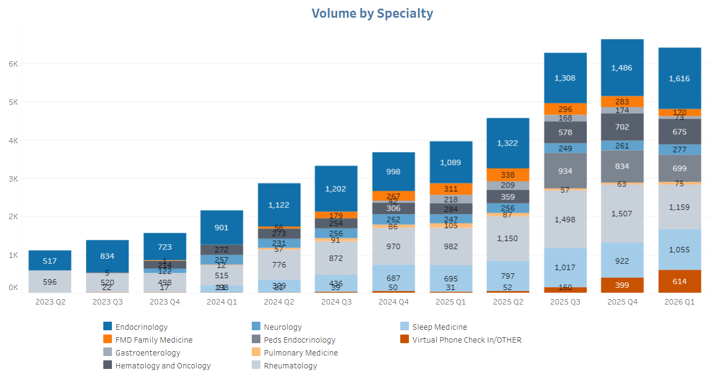
Growth

Slide 19
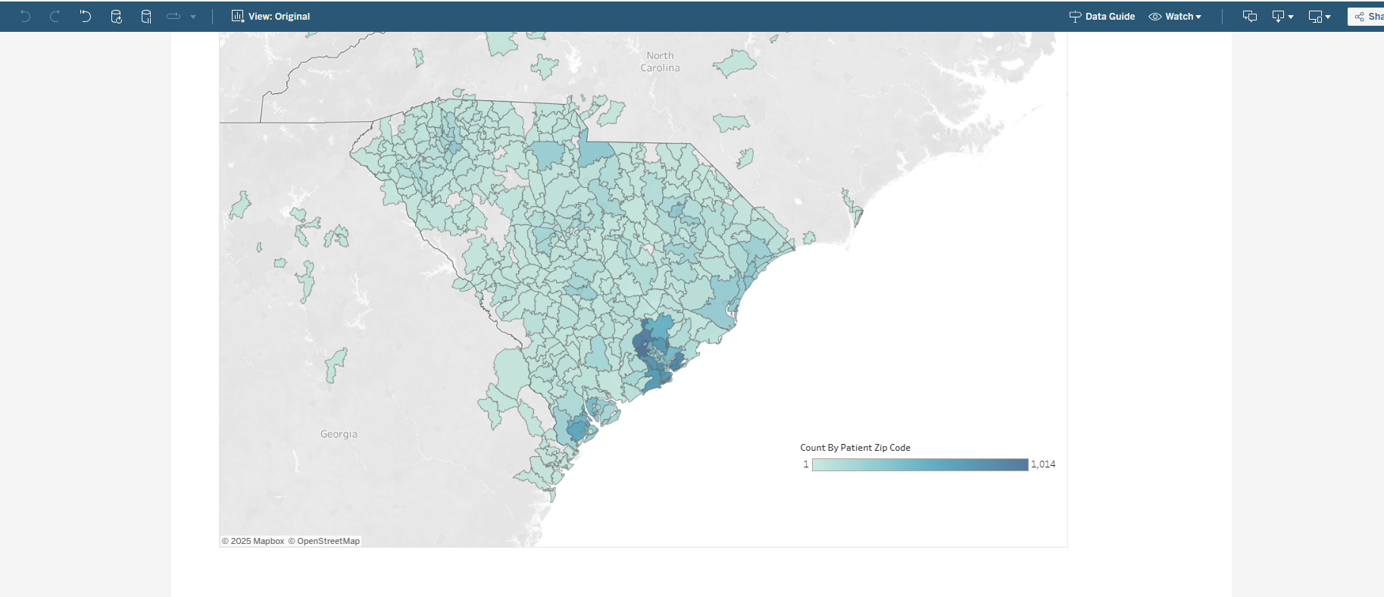
Statewide Reach
South Carolina has 41 out of 46 counties designated as Health Professional Shortage Areas (HPSAs), leading to delays in accessing in-person specialty care.
Average Wait times for in-person specialty visits could take 3-6 months.
Model supports access across rural areas evidenced by utilization across 95%+ of South Carolina Zip Codes.

Slide 20
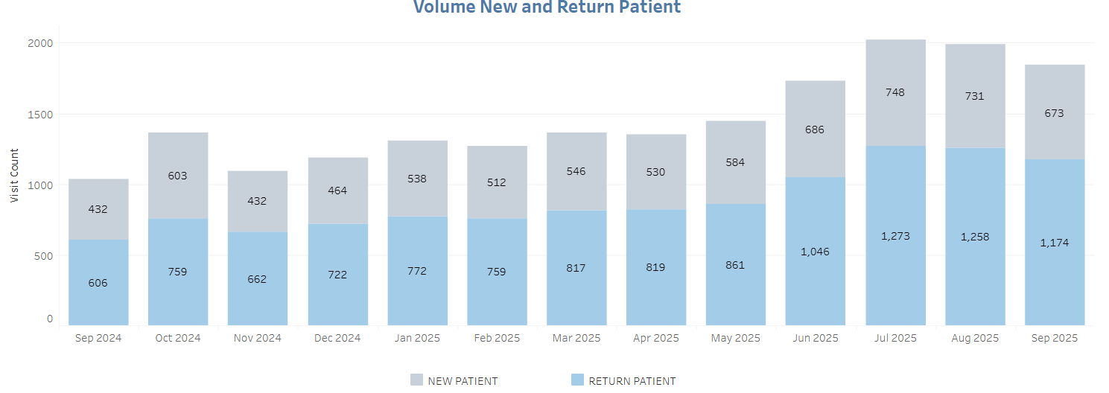
Maintaining Access

Slide 21
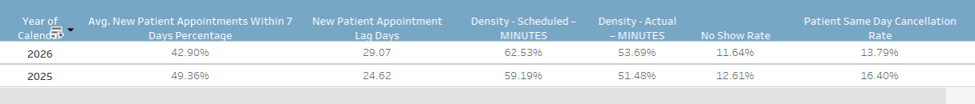
Capacity Management
Monitor by specialty and provider to evaluate
Hiring decisions
Technology and other workflow concerns
Scheduling template improvements

Slide 22
Patient Breakdown
Analysis of patient encounter data from Jan-June 2025
In-person for four In-person specialty practices
Virtual visits for virtual specialty providers
Comparison to better understand patient needs, utilization of services, and intensity of services.
 | Virtual Specialty Clinic | In-person clinics
Average Age | 51.1 years old | 58.5 years old
Female | 72.7% | 65.6%
New Patients | 39.9% | 26.4%
Established Patients | 59.8% | 64.4%
Average Scheduled Appointment Length | 29.2 minutes | 37.6 minutes
Same Day Cancellation Rate | 8.1% | 5.2%

Slide 23
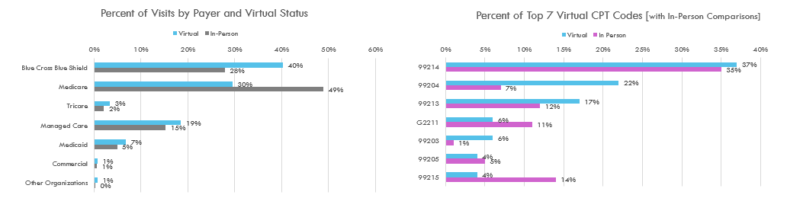
Patient Breakdown
Blue Cross Blue Shield was the most common payer for virtual (40%), while Medicare covered 49% of in-person patients.
Most common patient visits are for established patients of moderate complexity for both virtual and in-person (99214). In-person visits see higher % of established patients with high complexity (99215).
Aligned with the goal of improving access, virtual visits have a high percent of new patients (99203-99205).

Slide 24
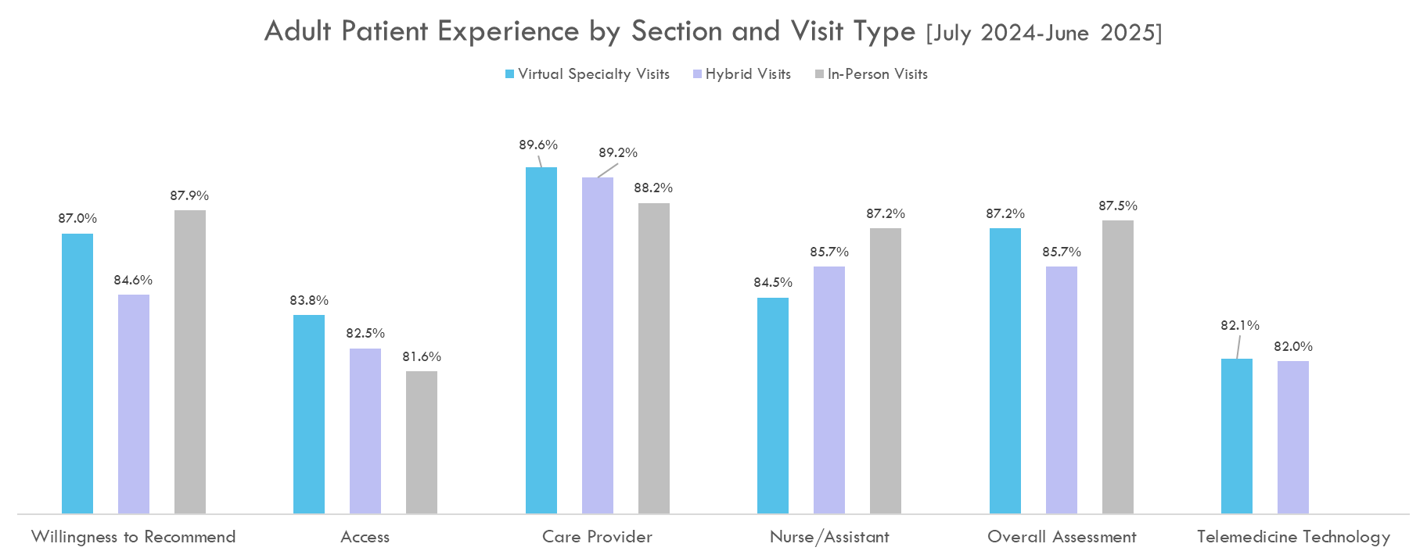

Patient Satisfaction

Slide 25
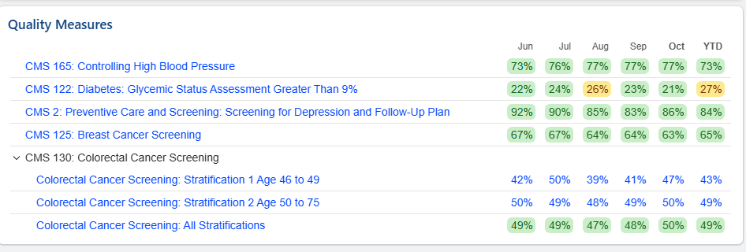
Impact on Value-Based Care
Maintaining the perspective of “All Patients, All Payors” to deliver on Medicare Shared Savings and other Quality Payment Programs.
Action Plan
Increase awareness
Improve standard work
Care coordination

Slide 26
Lessons Learned & Future Direction

Slide 27
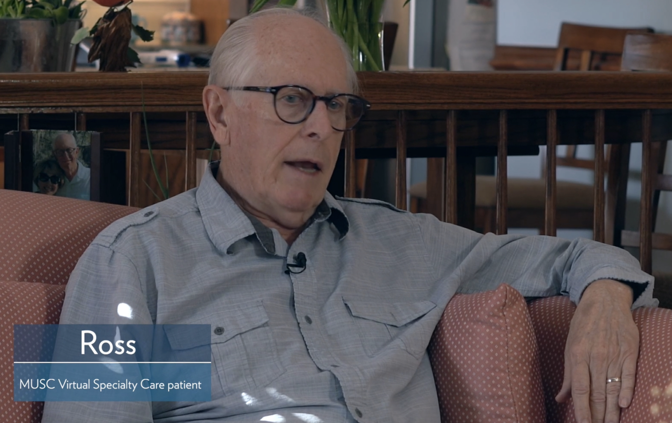

Lessons Learned
Provider onboarding
Staffing benchmarks
Regulatory barriers
Adoption and awareness
EMR integration, especially self-scheduling
Ancillary services in rural areas
Impact convenience has on visit loss
Patient appropriateness for virtual

Slide 28
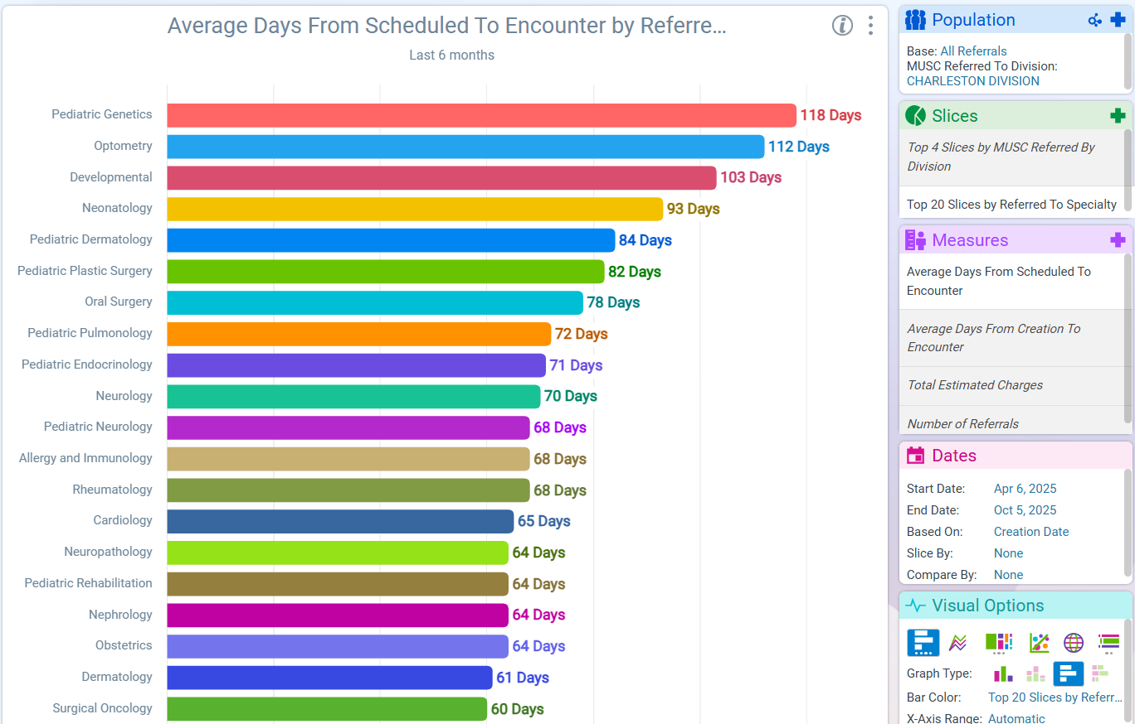
Future Direction
Endocrinology, Gastrointestinal, Benign Heme, and Pulmonology all off the top 20 list 2 years after going-live with Virtual Specialty
Continue to grow multi-specialty model
Grow specialty access to saturation, as referral patterns are changing
Continue to advance ancillary services to support specialty access across the state
  Example: Biopsy locations for dermatology, ultrasound for OBGyn
Adapt text message reminders by specialty and patient demographics to address same day cancellation and no-show rates

Slide 29

Thank You!
Questions?
Katie Kirchoff
Kirchoff@musc.edu

