Slide 1
Telepalliative Care Program Outcomes: Leveraging KPIs and Propensity Score Matching to Analyze Length of Stay
Christina McDaniel, DNP, MSN, RN
Kit N. Simpson, DrPH

Slide 2
Program Overview
MUSC Health Palliative Telehealth Program
Systemwide telepalliative care model within MUSC Health
Delivers specialty palliative care across diverse hospital settings
Focuses on improving care quality, efficiency, and goal-concordant decision-making

Slide 3
Why Telepalliative Care?
Addressing System and Access Challenges
Uneven access to specialty palliative care across regional hospitals
Growing population of patients with serious illness
Need for timely consultations early in hospitalization
Telehealth enables equitable, scalable specialty support

Slide 4
Program Structure
How the Model Works
3 palliative-trained Advanced Practice Providers (APPs)
Serve 14 Regional Health Network hospitals
MUSC Health hospitals
Affiliated system hospitals
Virtual integration with local care teams
Emphasis on early inpatient involvement

Slide 5
Clinical Focus
What Telepalliative Consults Address
Symptom management
Goals-of-care discussions
Advance care planning
Decision support for patients, families, and care teams
Alignment of treatment with patient values and preferences

Slide 6
Evaluation Approach
Measuring Impact Rigorously
Hospital length of stay
Timing of palliative consults
Care delivery patterns
Use of propensity score matching
Comparison of early palliative involvement vs. usual care

Slide 7
Impact Factors
What the data demonstrates
Impact of early telepalliative consultations on hospital length of stay
Impact on clinical care delivery
Influence of timely consults on hospitalization patterns
Use of evaluation methods to identify when palliative care makes the greatest difference
How to support goal-concordant care at scale

Slide 8
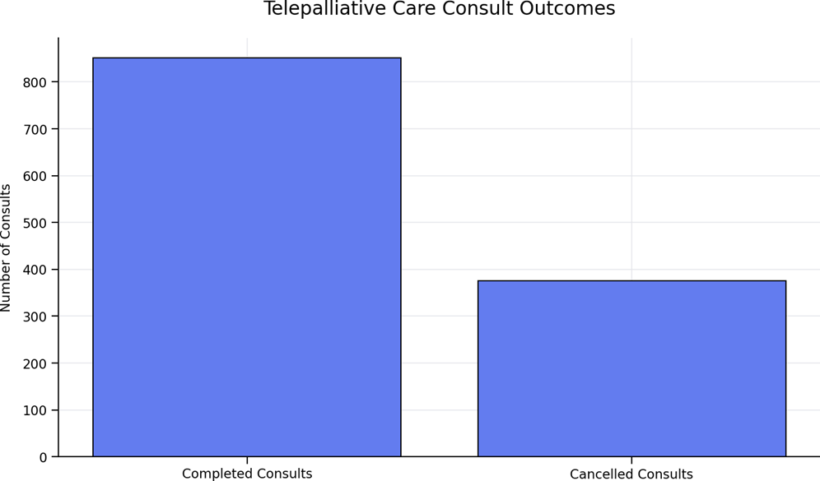
Consult Volume and Outcomes
Key Findings (Sept 2025-March 2026)
1,227 total consults ordered
851 consults completed (69%)
376 consults cancelled (31%)
Cancellations driven by clinical timing and care transitions:
Family not available
Patient death
Patient discharge
This data suggest that earlier telepalliative consultation—rather than unmet demand—may be a key opportunity to improve care delivery.

Slide 9
Qualitative Feedback: Patients & Providers
One‑Line Takeaway
Patients and providers consistently describe telepalliative care as compassionate, high‑value, and essential—while expressing strong demand for expanded availability and follow‑up.
Patient & Family Voices
“I am fully satisfied with the care that my Mom received, a great help to my family and myself.”
“The video was perfect solution for those of us out of town to be a part in discussion.”
“Feel very fortunate to have had the service of the palliative consult.”
Provider Voices
“Especially helpful in resolving provider and family conflict over appropriate care.”
“Important service for patient care given high acuity and complexity of patients with limited palliative services in the area.”
“Consistently been pleased with the added value and grateful for the extensive time spent.”
“An invaluable service. I wish they were available 7 days a week.”
“I wish we had follow up on patients and not only the option of new consults.”

Slide 10
Key Performance Indicators for PCC
Background: Use of timely and effective consultations for palliative care (CPC) may reduce patient suffering, decrease family distress, improve provider communication and reduce cost of futile intervention to hospitals and insurers.
Problem: CPCs are underused and often used too late even though Medicare and most other insurers cover CPCs (including telehealth consults) for people with serious or terminal conditions.
Hypothesis: Implementation of Telehealth Palliative Care programs will result in significant changes in code status, patient disposition, hospital readmissions, intensive care unit (ICU) utilization and transfer to another hospital facility for higher level of care.
Approach: We are using electronic medica records (EMR) data in a quasi-experimental design, combined with telehealth service data and key informant interviews, to assess the impacts of CPC telehealth programs in MUSC system hospitals.

Slide 11
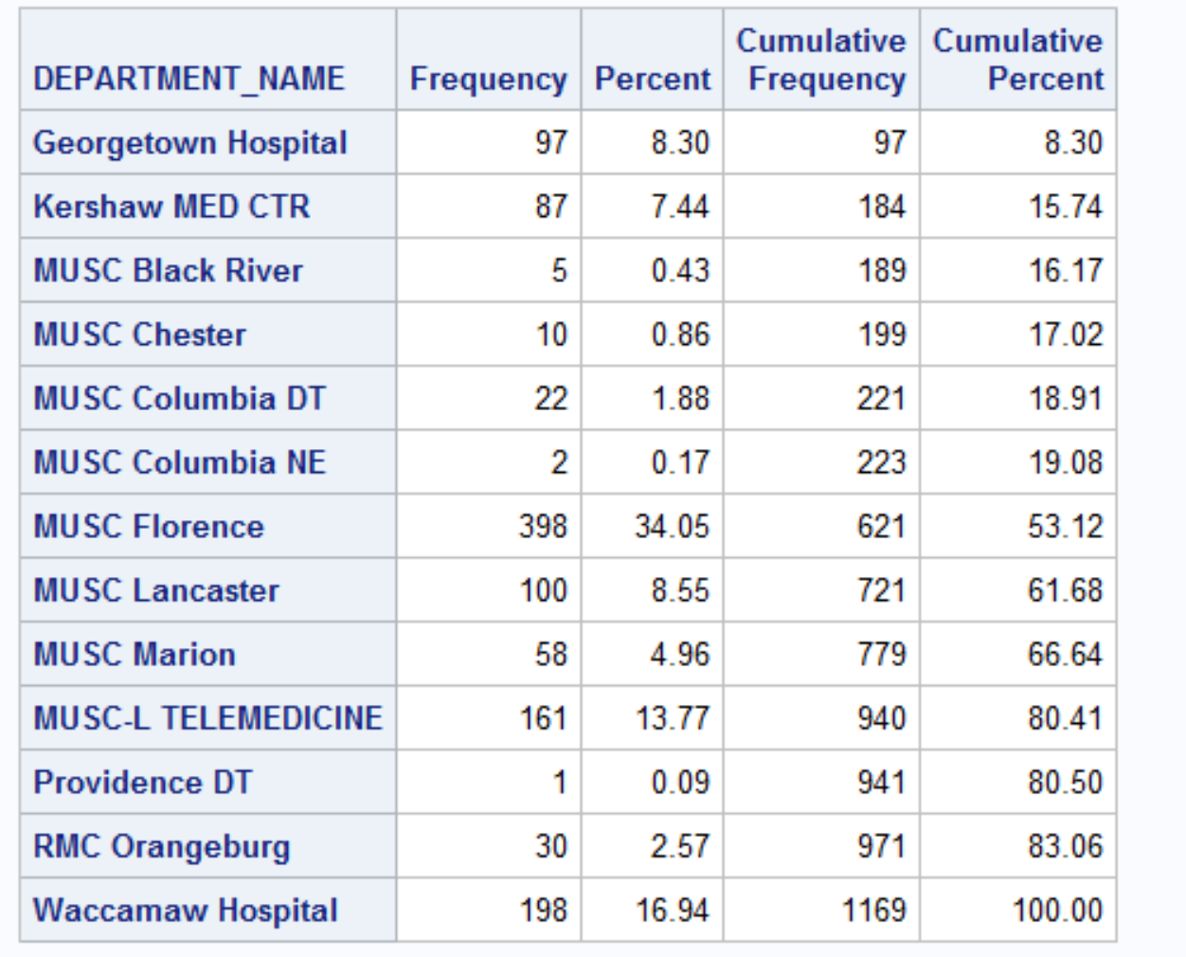
MUSC HRMC Unit

Slide 12
Results: Patient Demographics for MUSC TH PC Consults in 2024
Variable | N=1169 | Age Range
Age Mean (SD) | 73.6 (13.6) | 29-101
Female N (%) | 614 (52)
Married N (%) | 422 (36)
Race N (%)
White | 603 (52)
Black | 552 (47)
Other | 14 (1)
Insurer N (%):
Medicare | 837 (72)
Private | 156 (13)
Medicaid | 74 (6)
Other | 102 (9)

Slide 13
Suggested KPIs: MUSC Telehealth Palliative Care for 2024
Key Performance Indicator | Number | Mean (SD) | Definition
Days to Tele PC consult | 1211 | 9.0 (28) | All patient Days from admission to PC consult
Days to Tele PC consult (surviving hospital stay) | 1055 (87.1%) | 7.4 (11) | Only surviving patients
Days to Tele PC consult Discharged deceased | 156 (12.9%) | 19.7 (72) | Discharged expired
Days from TH consult to discharge | 1211 | 6.9 (13.6) | All Patients
LOS for Consult admission | 1211 | 15.9 (34) | All patients
Time from PC Consult to hospital readmission | 3672 | 102 (98) | Consult Date to Readmit Date
LOS for Readmission | 3644 | 4.0 (10.9) | Admit date to Discharge date

Slide 14
Subgroup Comparisons: PC Consult <= 3 days of Adm vs >3 days
40% (N=480) of patients had consult within 3 days of admissions
Of These 90% were discharged alive
Mean days to discharge from PC consult= 4.8 (SD 8.7)
Mean overall LOS = 6.9 (SD 8.7)
52.5% had a DH death record file within the observation time
60% of patents has PC consult => 4 days after admission
Of these 85% were discharges alive ( p=.0153)
Mean days to discharge from PC consult= 8.3 (SD 15.9) (p<.0001)
Mean overall LOS = 21.8 (SD 41.2) (<.0001)
62.2% had a DH death record file within the observation time (p=.0008)

Slide 15
Mean Cost per (Unmatched) Patient by PC-consult at <=3 Days of Admission Compared to Day 4 ore Later
 | Estimated Cost Consult at <=3 Days | Estimated Cost Consult at 4+Days | Cost Difference: Consult at 4+Days - Consult at <=3 Days | Statistic
Mean GenMed No ICU | $19,039 | $46,029 | $26,990 | P<.0001
Mean ICU and GenMed | $42,714 | $96,728 | $54,014 | P<.0001
Notes:
Unmatched patients. N=721.
Regression estimates controlling for age, race, married, veteran, and insurer.
ICU cost weights assigned to each admission base on 29% of charges
for patients in the GenMed service line using HRMC
Billing records for first 2 quarters of 2024. Daily cost wights were calculated
To reflect higher mean daily cost for admissions with shorter LOS

Slide 16
Propensity-Score Matched Patients
 | PC Consult <= 3 Days | PC Consult 4+ Days | Statistics
Age Mean (SD) | 76 .2 (12.8) | 75.7 (13.0) | P=.6407
Race N(%) |  |  | P=.2967
White | 146 (53) | 133 (48)
Black | 129 (46) | 144(52)
Other | 3 (1) | 1 (<1)
Insurance N(%) |  |  | P=.8020
Medicare | 216 (78) | 213 (77)
Private | 31 (11) | 36 (13)
Medicaid | 10 (4) | 12 (4)
Other | 21 (8) | 17 (6)
Married N(%) | 102 ( 37) | 106 (38) | P=.7259
Veteran N(%) | 33 (12) | 39 (12)( | P=.1000

Slide 17
Mean LOS, General Medicine Cost and ICU Cost for Matched Groups Controlling for Demographics
 | PC Consult <= 3 Days N=278 | PC Consult 4+ Days N=278 | Difference (B-A) | Statistic
Mean LOS {median} {95% CI) | 6.3 [4] ( 4.8 – 8.2) | 16.8 [7] (12.8 – 22.1) | 10.5 (8.0 – 13.9) | P<.0001
General Medicine Stay Mean Total Cost per Admission (95% CI) | $19,413 ($15,207 - $24,782) | $47,168 ($36,787 - $60,477) | $27,755 ($21,580 - $35,695) | p<.0001
Stay with ICU Mean Total 5ost per Admission (96% CI) | $42,305 ($33,351 - $53,665) | $96,491 ($75,760 - $122,896) | $54,186 ($42,409 - $69,231) | p<.0001
Note: Cost weights are estimated per day by LOS, based using pooled data on charges
for all MUSC Regional hospitals for 1st 2 quarters of
2024 assuming a 27% cost-to-charge ratio

Slide 18
Questions?

Slide 19
The Telehealth Centers of Excellence(COEs) develop resources for telehealth organizations, researchers, providers, and staff based on their experience, research, and innovation.
TelehealthCOE.org

