Slide 1
Estimating the Economic Benefit of Telehealth for Patients with Depression & Anxiety
February 25, 2026
Kit N Simpson, DrPH & Caitlin Koob, PhD

Slide 2
Funding Acknowledgment
This poster is supported by the Health Resources and Services Administration (HRSA) of the U.S. Department of Health and Human Services (HHS) as part of the National Telehealth Center of Excellence Award (U66RH31458) totaling $4,250,000 with 100 percent funded by HRSA/HHS. The contents are those of the author(s) and do not necessarily represent the official views of, nor an endorsement, by HRSA/HHS, or the U.S. Government.

Slide 3


Introductions
Kit N. Simpson, DrPH, MPH
Distinguished University Professor
Department of Healthcare Leadership &
Management
Medical University of South Carolina
Caitlin Koob, PhD
Research Associate
Department of Healthcare Leadership &
Management
Medical University of South Carolina

Slide 4
Number of Visits
Part 1: Quantitative Analyses
We identified 15,903,345 telehealth visits in the 2022 MarketScan Commercial insurance data set
Of these visits, 6.6 Million had a primary ICD-10 diagnosis code indicating a behavioral health condition based on the AHRQ Clinical Classifications software (CCSR) for ICD-10-CM diagnoses, v2025.1
We found 5,811,798 visits with a primary Dx of depression and anxiety provided to 236,395 unique patients
Males=68,851 (30%), Females 167,454 (70%)
The age, sex , diagnosis distributions and mean number of visits of for telehealth services are shown in Figure 1 and Table 1 and 2 below

Slide 5
Visits by Age Group, Sex and Diagnosis for First Telehealth Record
Part 1: Quantitative Analyses

Slide 6
Table 2: Mean (SD) Number of Telehealth Visits During 2022 by Age Group and Diagnosis
Part 1: Quantitative Analyses
 | Anxiety | Depression | Both
Age 0 to 17 | 9.0 (13.1) | 7.8 (10.9) | 41.7 (43.2)
Age 18 to 44 | 9.5 (14.1) | 8.1 (11.6) | 40.6 (41.1)
Age 45 to 64 | 7.9 (13.4) | 7.9 (12.1) | 36.2 (38.3)
Age 65+ | 5.2 (8.7) | 4.6 (5.8) | 29.1 (32.0)
Overall | 9.0 (13.9) | 8.0 (11.7) | 39.7 (40.8)

Slide 7
MarketScan Service Category Codes for TH Visits:
Part 1: Quantitative Analyses
Service Category Code for TH Visits | N | %
101 - Office visits, new patient | 4,614 | 2%
104 – Office visits, established patient | 69,372 | 29%
123 - Telemedicine Inter-Professional consult | 100 | <1%
124 – Psychiatric diagnostic services | 31,061 | 13%
135 – Psychotherapy, individual | 115,789 | 49%
136 – Psychotherapy, family | 2,332 | 1%
139 – Therapeutic psychiatric services | 1,981 | 1%

Slide 8
Types of Telehealth Visit by CPT codes
Part 1: Quantitative Analyses
Of the 236,194 visits, 99.4% were CPT codes in groups 9xxxx
Five code groups had 20,000 to 60,000 visits:
90791: Psychiatric diagnostic evaluation. N=21,770
90834: 45-minute face-to-face psychotherapy session. N=29,877
90837: Individual psychotherapy 53 minutes or longer. N=61,241
99213: Outpatient 20-29 Minutes evaluation and management. N=29,109
99214: Outpatient 30-39 Minutes evaluation and management. N=35,845
The remaining 0.6% of visits were HCPCS codes: G0xx, G2xx, G9xx, H0xx, H1xx, H2xx, T1xx, and S1xx and T9xx

Slide 9
Days from Pre- visit to 1st TH record (Mean, SD)
Part 1: Quantitative Analyses
Age Group | Anxiety | Depression | Both | Overall Mean (SD)
0 to 17 | 4.8 (8.1) | 5.1 (8.4) | 2.0 (3.4) | 3.4 (6.4)
18 to 44 | 5.6 (10.0) | 5.9 (10.2) | 2.2 (4.3) | 3.9 (7.8)
45 to 64 | 5.6 (9.9) | 5.7 (10.0) | 2.1 (3.6) | 4.0 (7.9)
65+ | 3.6 (4.2) | 3.7 (4.9) | 1.7 (2.5) | 2.8 (4.0)
Overall Mean (SD) | 5.5 ((.8) | 5.7 (9.9) | 2.2 (4.1) | 3.8 (7.7)

Slide 10
Reason for Pre-TH Visit by Primary Dx Code (Does not vary much by Age)
Part 1: Quantitative Analyses
2.9% Primary Dx of Anxiety
2.3% Primary Dx of Depression
57.5% Related Mental health, substance, signs or symptoms Dx
Mental/behavior/substance
Signs and symptoms
SDOH (Z codes)
Neurologic
37.3% Had seemingly unrelated diagnoses
respiratory; circulatory; urinary; muscular; infection; other

Slide 11
Main Points Identified to Date
Part 1: Quantitative Analyses
6.6 Million TH visits for Behavioral Health Dx in 2022
88% for of these TH visits with Primary Dx anxiety or depression
Visits generated by 236,395 patients under age 65
70% female 30% males most age 18-44
Mean TH visits per person: Anxiety 9, Depression 8; Both 40 visits

Slide 12
Estimating Economic Benefit of TH for Depression and Anxiety
Part 1: Quantitative Analyses
Time savings to patients and caregivers:
Travel time to appointments
Transportation time for care givers
Waiting time for care givers
Cost savings to providers:
Decrease in missed appointments or later reschedules
Ability to employ professionals living out of area
Decrease need for office space and parking

Slide 13
Estimated Savings for MS 2022 TH Cohort
Resource | Units | Number of events | Total Work Hours | US Mean Wage Hourly | Total Cost Savings
Child caregiver transport and wait | 1.6 hours | 656,504 | 1,050,406 | $31.91 | $33,518,468
5% Adult caregiver transport and wait | 1.6 hours | 257,764 | 412,422 | $31.91 | $13,160,399
95% Adult Patient self transport | 0.6 hours | 4,898,130 | 2,938,878 | $31.91 | $93,779,597
PATIENT SUBTOTAL |  |  |  |  | $140,458,464
Improved missed appt. from 1% to 0.5% | 0.75 | 290,589 | 21,794 | $30.60 | $666,904
Remote worker salary/space savings | 1% | 58,118 | 43,588 | $30.60 | $1,333,792
PROVIDER SUBTOTAL |  |  |  |  | $2,000,696
Time savings to patients and caregivers:
Travel time to appointments
Transportation time for care givers
Waiting time for care givers
Cost savings to providers:
Decrease in missed appointments or later reschedules
Ability to employ professionals living out of area
Decrease need for office space and parking

Slide 14
Part 2: Telehealth Utilization in SC & Patients’ Perspectives

Slide 15

Telehealth for Mental and Behavioral Health in SC
Part 2: Telehealth in SC & Patient Perspectives
All 46 SC counties are considered to have a healthcare provider shortage
Collaborative care management addresses mental & behavioral health in primary care
Uptake in rural communities remains challenging
Our telehealth-enabled Collaborative Care Management (CoCM) program was designed to improve access and quality of mental & behavioral health services
Read more about CoCM’s pilot implementation here
(Kruis et al., 2025).

Slide 16
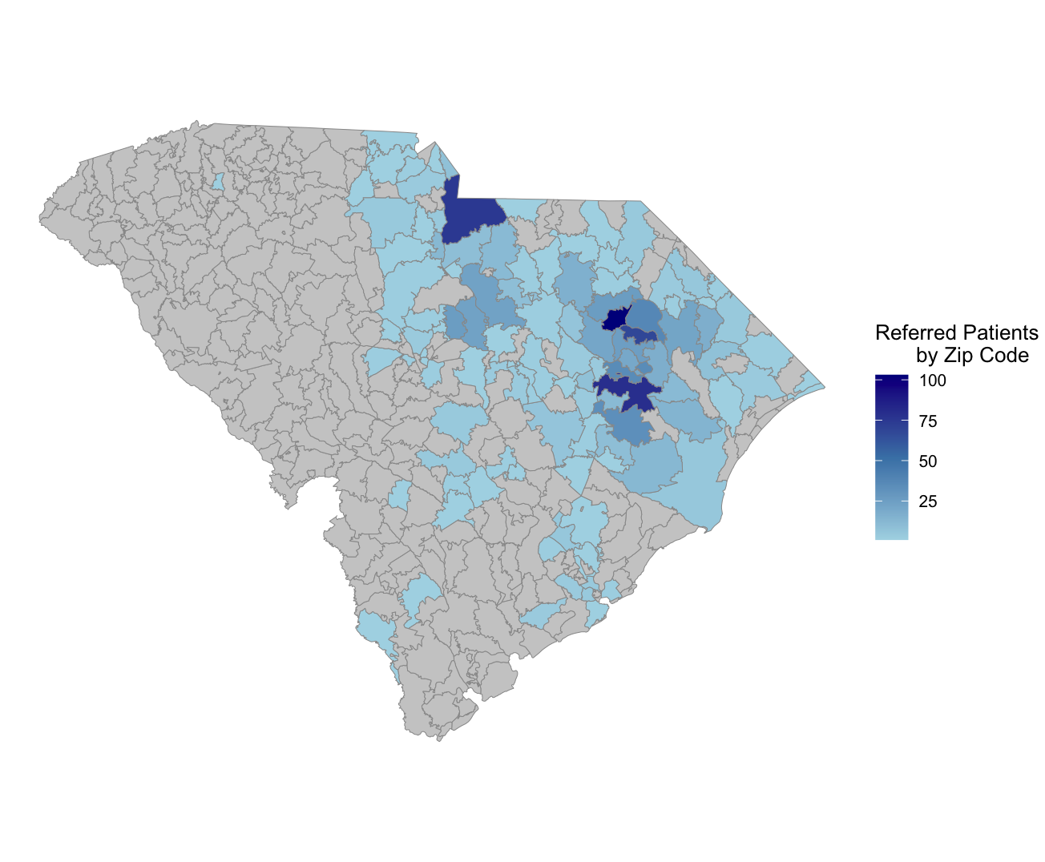
Part 2: Telehealth in SC & Patient Perspectives
Over the last year, CoCM has grown from serving 18 to 44 rural primary care clinics statewide
1,065 Patients were Referred to CoCM from 06/01/2023 – 06/30/2025 (Fig. 1)
608 patients referred ultimately enrolled into the program and completed an index assessment and intake visit with a behavioral health manager
Figure 1. Patients referred to CoCM by zip code from 06/01/2023 – 06/30/2025.

Slide 17
Mixed-Methods Evaluation
Part 2: Telehealth in SC & Patient Perspectives
Electronic health records (N=1,065 referred patients)
Patient-facing, web-based mental health application data (N = 608 patients)
Electronic surveys from patients who did and did not enroll in telehealth-based mental/behavioral health services (N=120)
In-depth interviews with patients who did and did not enroll in telehealth-based mental/behavioral health services (N = 13)

Slide 18
Patients’ Perspectives on Telehealth to Treat Their Depression & Anxiety
Part 2: Telehealth in SC & Patient Perspectives
The majority (60%) of enrollees reported improvements in their mental health after telehealth sessions
Over half of enrollees (58%) reported being “confident” or “very confident” that they could maintain their progress after telehealth therapy sessions
62% of enrollees reported they would recommend the telehealth program to others in need of mental or behavioral health support

Slide 19
Mixed-Methods Evaluation
Part 2: Telehealth in SC & Patient Perspectives
Electronic health records (N=1,065 referred patients)
Patient-facing, web-based mental health application data (N = 608 patients)
Electronic surveys from patients who did and did not enroll in telehealth-based mental/behavioral health services (N=120)
In-depth interviews with patients who did and did not enroll in telehealth-based mental/behavioral health services (N = 13)

Slide 20
Patient-Reported Benefit of Telehealth for Mental and Behavioral Health Services
Part 2: Telehealth in SC & Patient Perspectives
Perceived Benefits
Importance of Patient Provider Communication
Factors related to Long-Term Telehealth Use for Mental and Behavioral Health in South Carolina

Slide 21
Patients’ Perceived Benefit of Telehealth
Part 2: Telehealth in SC & Patient Perspectives
“I think it's a fantastic thing that you all are doing for our community and it could really help out a lot of people who, like I said, are afraid of the stigma that comes along with mental health issues.”
“It has completely turned my whole life around because the behavioral therapist was able to help me realize, "Hey, maybe you need to do this, maybe you need to do that”…sorted me out the right plan and the right track. Then I started realizing things and started getting better.”

Slide 22
Patients’ Perceived Benefit of Telehealth
Part 2: Telehealth in SC & Patient Perspectives
“I'm really shocked at the program in itself. I found a lot about myself and it's just really been an eye-opening experience truly, and if it wasn't for you guys, I would have never gotten the help I've always needed and get on the right medication and become stable and all those things. I really appreciate you guys.”
“It has improved my interpersonal relationships. Like I said, because of having a non-biased person. It's improved I guess my confidence really.”

Slide 23
Patients’ Perceptions of Patient-Provider Communication
Part 2: Telehealth in SC & Patient Perspectives
“I knew it was someone I could talk to. I didn't feel judged. She didn't know me on a personal level so it doesn't matter…I feel like I could openly talk to her because it was someone I had never met.”
“The thing I like the most about that appointment was she let me know that she wasn't there to judge me. She was there to listen and to get me the best help that I needed and the best care. And she made me feel like it was okay to speak with her.”

Slide 24
Patients’ Perceptions of Long-Term Telehealth Use for Mental and Behavioral Health
Part 2: Telehealth in SC & Patient Perspectives
“Since the beginning, number one, why I stayed, especially number one is that it's telehealth and it's just super convenient. They were able to adjust their own times where I was available.”
“I most definitely will 100% continue. I feel like I couldn't function if I didn't have the program at this point. It's been so helpful. And I know that if I get better, if things improved, my visits will probably get more duration in between, longer time between appointments, but it's okay as long as every three months or so I can still talk to somebody, I'll be okay.”

Slide 25
Patients’ Perceptions of Long-Term Telehealth Use for Mental and Behavioral Health
Part 2: Telehealth in SC & Patient Perspectives
“I had no problem. I think it's great. I think it's helpful.
I would probably do it the rest of my life if I can.”
“I knew that I could do it on the way home from school or at school, which is something also that I really liked, because I have a five-year-old, I have a husband, I have a dog, and then it’s just a quiet space for me. It was really easy for me to work around a schedule that I needed. They're so open, and they get so right on things. As soon as I call and I'm like, "Hey, I need to start talking to someone again," Within a week, we've got it set up, and we’re going.”

Slide 26
Key Takeaways
Telehealth may increase access to high-quality mental and behavioral health services
Telehealth services may also demonstrate cost savings for patients and health systems, compared to in-person mental and behavioral health services
Many patients report preferring telehealth services for mental and behavioral health needs, rather than in-person services

Slide 27
Questions? Please feel free to reach out at simpsonk@musc.edu or cak240@musc.edu.

Slide 28
The Telehealth Centers of Excellence(COEs) develop resources for telehealth organizations, researchers, providers, and staff based on their experience, research, and innovation.
TelehealthCOE.org

