Slide 1

Designing, developing, and evaluating digital mental health tools for adults who have experienced trauma
Olivia Metcalf, PhD
Centre for Digital Transformation of Health, University of Melbourne
Notes:
Add Deliver and Starr logo

Slide 2


Slide 3
The paradox of digital mental health
On the one hand-
      telehealth and other forms of digital mental health care surged during the pandemic
      we have 10,000+ mental health apps
      generative AI and machine learning-based digital mental health tools are increasing
      we have increasing demand for mental health treatment and workforce pressures
      176 RCTs of standalone mental health apps for depressive or anxiety symptoms
On the other hand-
      there is very low engagement in digital mental health apps (<5%)
      very little are integrated into clinical care
      we have very little evidence on the mechanisms of change
      the workforce is underprepared for digital mental health care
Notes:
Investigation of real-world objective data on user engagement with 93 popular mental health apps showed a median daily open rate of 4%, with around a 3% retention rate over a 30-day perio

Slide 4

Causes of sub-optimal outcomes
Lack of user-centric design
Poor usability
Concerns about privacy
Skepticism about benefits/usefulness
Limited digital literacy skills
Lack of personalization features

Slide 5
There is no standard development pathway for digital health tools.
Drug development
process
Digital health
innovation process
Discovery and development
Discovery and development
There is a gap in validating and evaluating digital health innovations.
Pre-clinical research
Animal testing, safety assessment
Clinical research
Phase I-IV clinical trials
Review by government
regulatory agency
Review by government
regulatory agency
Post-marketing safety
monitoring
Post-marketing safety
monitoring

Slide 6
When developing digital health tools, robust clinical trial evidence is not sufficient for effective implementation.

Slide 7
The problem
Problem anger is a common mental health issue in trauma-affected populations (31%; Varker et al., 2022)
Problem anger is highly prevalent in women—it is no less common than in men following military service, is more prevalent than in men after natural disasters and in adolescent populations, and occurs in 20% of new mothers
Patients with problem anger are difficult to engage in standard treatments
Problem anger interferes with standard PTSD treatment efficacy (Cowlishaw et al., 2021)

Slide 8
Would a digital mental health tool for problem anger after trauma be useful, acceptable, effective?

Slide 9

Ecological momentary assessment
Recruited 60 Australian veterans with problem anger and trauma exposure
Used ecological momentary assessment (EMA) 4 times per day for 10 days
Varker et al., 2021

Slide 10
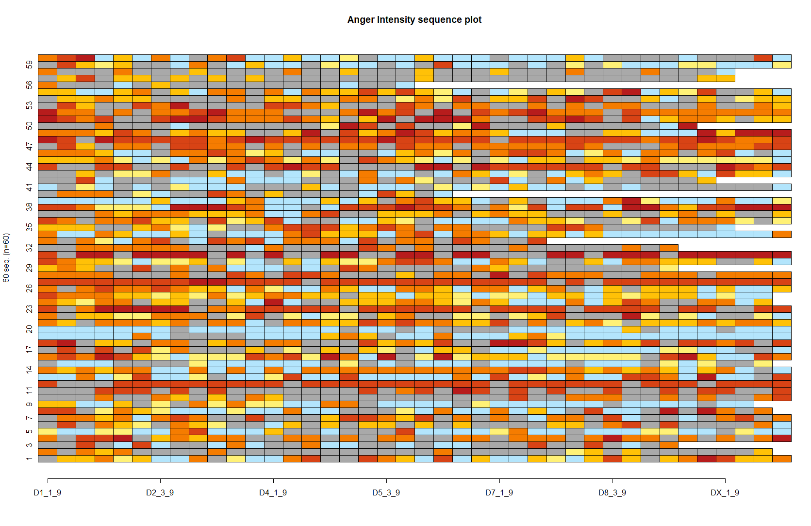
Using EMA to provide high resolution symptom data
Harjmand et al., 2023

Slide 11
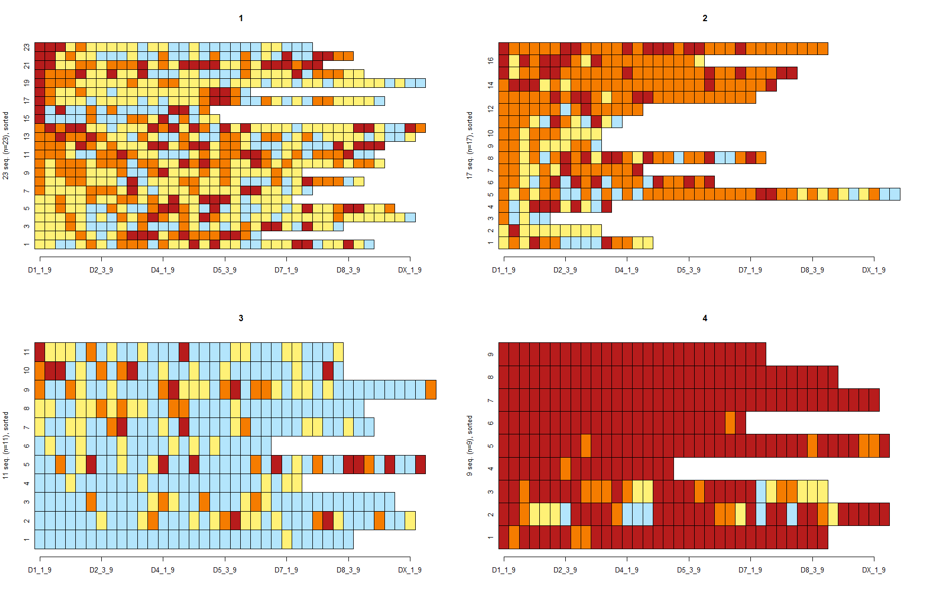
Using EMA to provide high resolution symptom data
Harjmand et al., 2023

Slide 12
Ecological momentary assessment
Highly feasible (<30% missing data) and effective in reducing anger symptoms (Varker et al., 2021)
Could be used as a novel assessment or treatment tool
The variability in anger experiences meant environmental or other factors were likely playing a role for some individuals
Varker et al., 2021

Slide 13
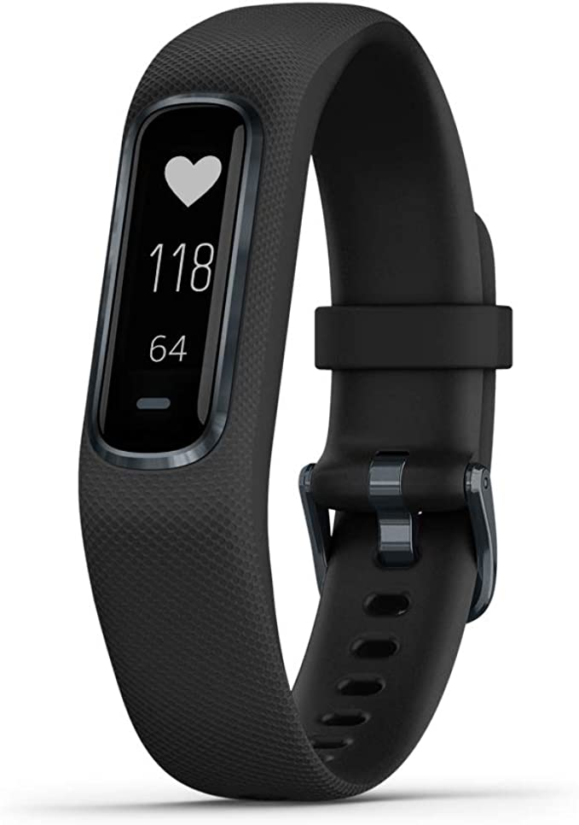
Digital phenotyping study
Added wearables to the EMA protocol and conducted study in community sample
Recruited 98 individuals with problem anger, high trauma exposure (4.5 PTEs), 80% women
App and wearable were rated as highly acceptable
      “Sometimes I would be more agitated than usual but because I wasn't paying attention to my body I wouldn't notice. The study helped me pay attention”
Metcalf et al., 2022

Slide 14
Digital phenotyping findings
Missing data for EMA was consistent with most samples in psychiatric populations ~27-32%
Missing data for the wearable was an additional ~30%
      Due to quality issues in data transfer between the wearable and the user’s smartphone
    Ten days of EMA plus wearable use significantly reduced anger (p= <.001; d= 0.88), anger rumination (p= 0.013; d= 0.27), and PTSD symptoms (p= 0.025; d = 0.26)
Metcalf et al., 2024

Slide 15
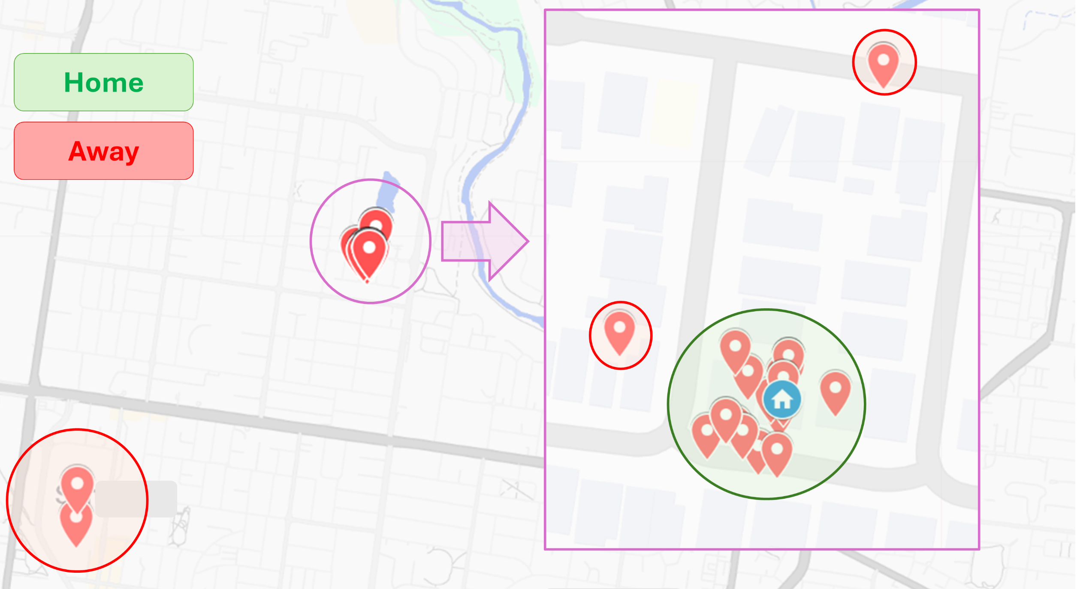
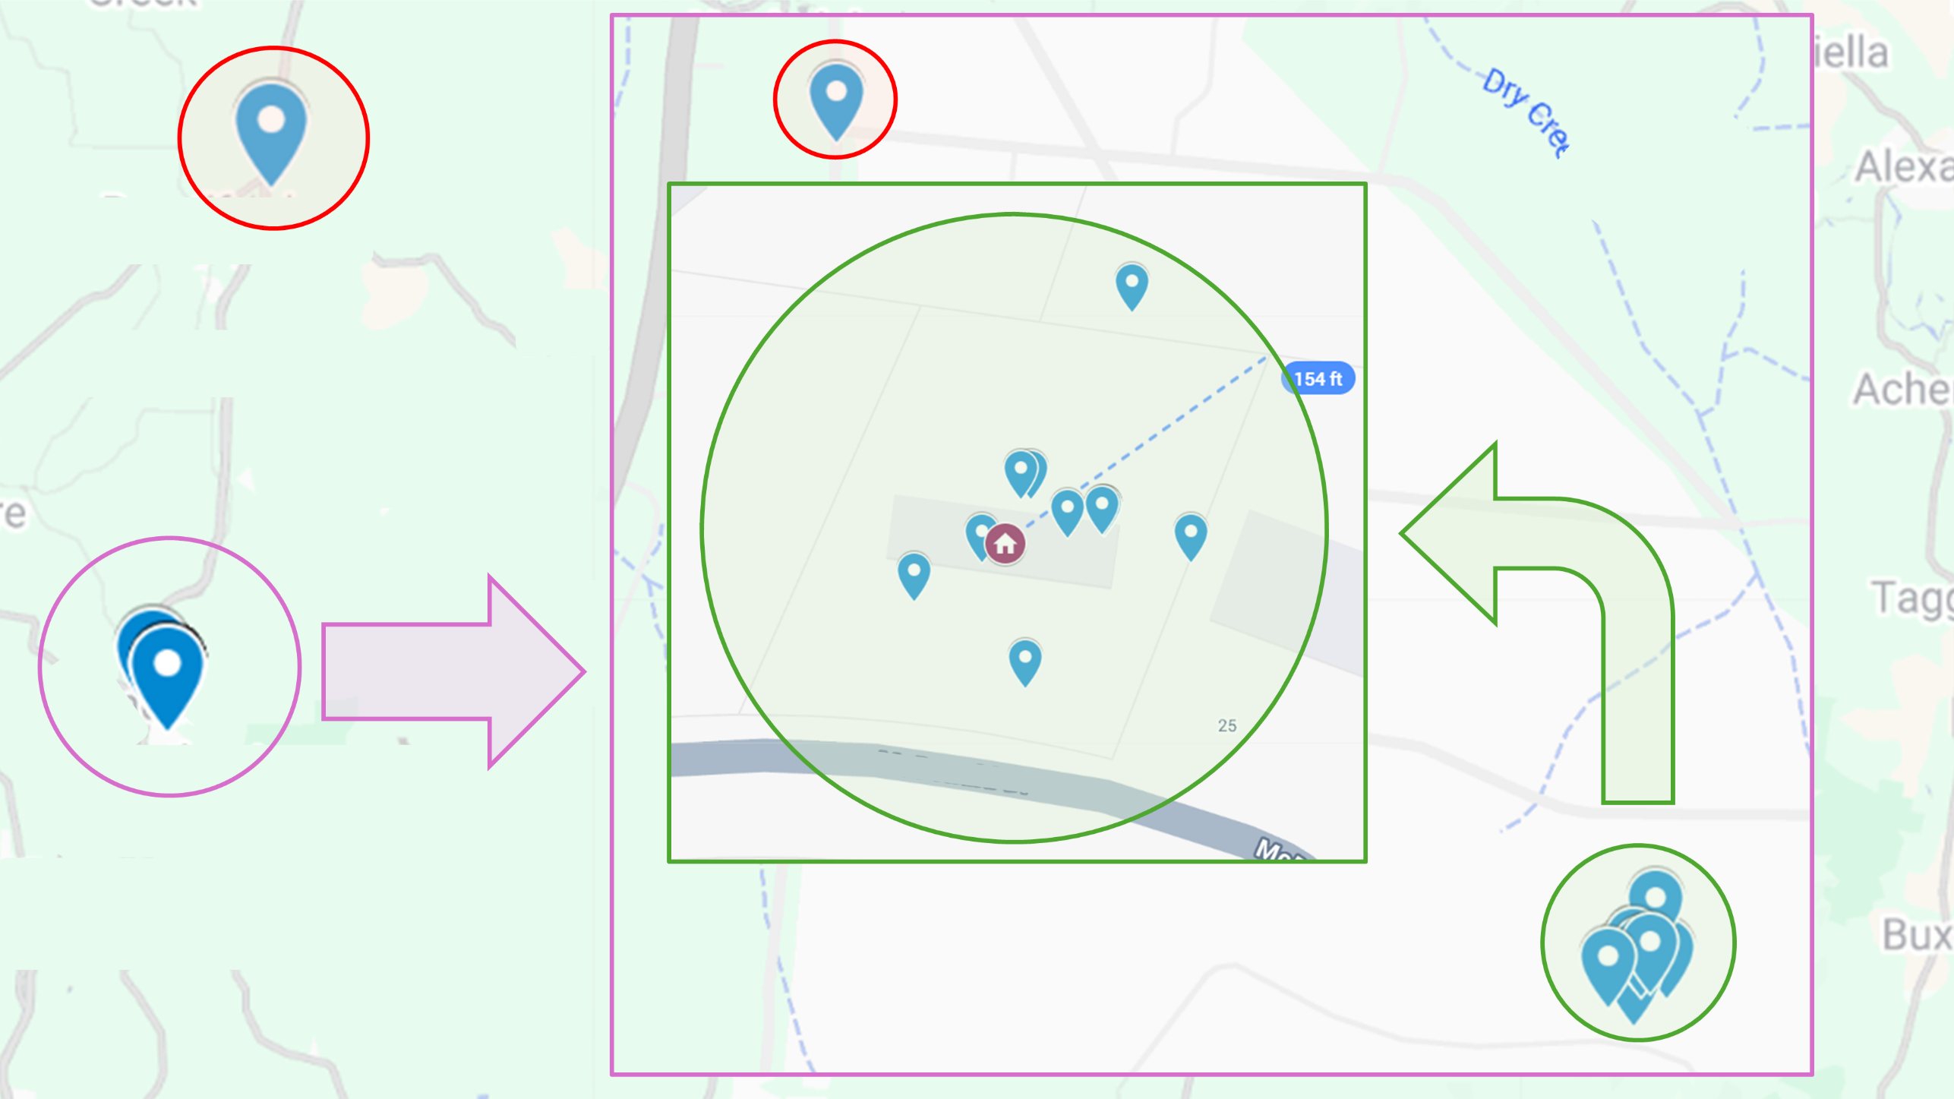
Using GPS location data to predict aggression
Does being at home vs away from home impact risk of perpetrating verbal and physical aggression?
How can we define home, for rural vs urban participants?
Henry, Modell, et al., 2025

Slide 16
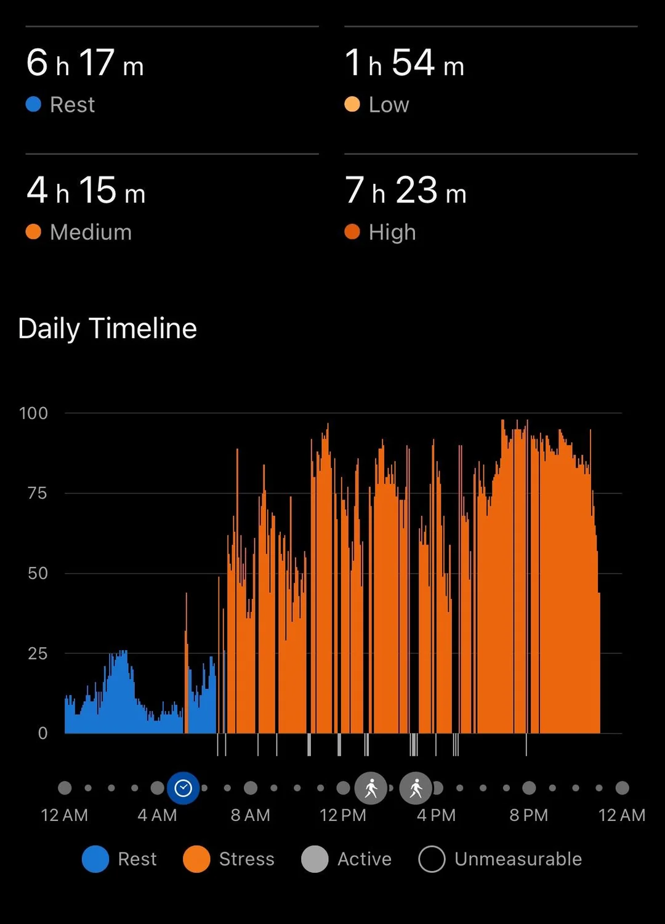
Using HRV-derived wearable data to predict high anger
84 participants had usable EMA and wearable data at the same time points (1190 observations)
165 observations (14%) were instances of high anger intensity
AUC ranged between 0.761-0.899, suggesting that the summary measures of the Garmin stress scores are predictive of anger intensity
Could be overly optimistic due to low frequency of high anger intensity
Real-world limitations around reliable data extraction from commercial devices remain challenging to the development of subsequent digital interventions.
Metcalf et al., 2025

Slide 17
Clinical AI: the model is not the product.
AI/ML quality discourse has often
emphasized technical challenges.
Dataset
quality
issues
Inappropriate
algorithms/
optimisations
Inherent
performance
limitations
Huckvale, 2025

Slide 18
Technical-clinical
INTERFACE CHALLENGES
CLINICAL CONTEXT
CHALLENGES
WIDER CONTEXT
CHALLENGES
Poor coherence/
not solving a real
(agreed) problem
Organisational
strategy
misalignment
Irrelevant
comparators
Lagging
regulation and
governance
frameworks
Dataset
quality
issues
Unreliable
ground truth
Poor cognitive
engagement
(buy-in) of users
Digital
maturity
constraints
Inappropriate
algorithms/
optimisations
Clinically
irrelevant
performance
Unclear
cost and
reimbursement
models
Poor UX and usability of tools based on the underlying models.
Inherent
performance
limitations
Poor perceived
‘fit’ within
pathways
Unacceptable
biases
Poor perceived
‘fit’ within
workflows
Variable
innovation
capacity and
appetite
Miscommunication
and misunderstanding
User capacity and
digital literacy
challenges
Multi-organisation
gatekeeping and
coordination
requirements
Huckvale, 2025

Slide 19
Developing a just-in-time-adaptive intervention for problem anger after trauma
Had sufficient evidence that anger was underaddressed by clinicians and digital mental health apps currently
Wanted to address the known engagement problem with digital mental health
Incorporated the wearable based on the phenotyping study evidence is was valuable for participants, but excluded the ML algorithm
Wanted to evaluate the mechanisms of change

Slide 20

Our JITAI Shift
Co-designed with adults with lived experience of trauma and problem anger
Content includes
      Psychoeducation
      CBT-based skills that match the level of self-reported anger intensity
          no anger
          escalating
          out of control
          after an anger episode
Metcalf et al., 2025
Notes:
An ongoing MRT is investigating whether prompting users four times per day, for 30 days, to engage with the CBT-based components tailored to the in-the-moment anger state, as compared to no prompt, improves near-term anger intensity. Sample size of N = 65 was planned based on the primary aim comparison assuming 1:1 micro-randomization at each decision point.

Slide 21
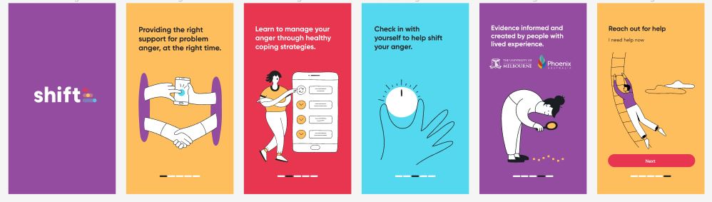

Slide 22

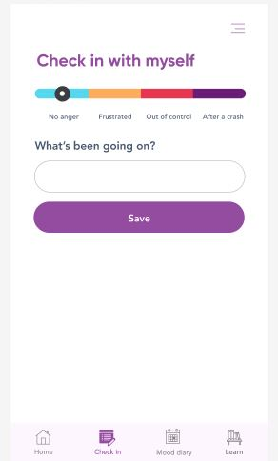
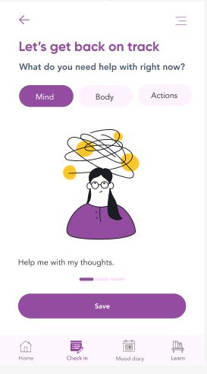
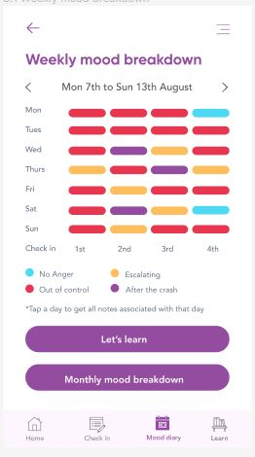

Slide 23

Micro randomised trial

Slide 24
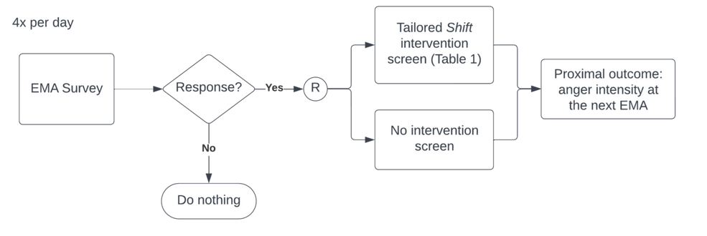
Shift’s micro-randomised trial
Recruited 66 adults with problem anger and trauma exposure from November 2024 - April 2025

Slide 25
Results
156 individuals completed screening
113 trauma-exposed adults with problem anger (Dimensions of Anger Reactions-5 [DAR-5]; ≥12) screened eligible
66 enrolled to participate (Mage= 38.2; 80% women, 17% men, 3% non-binary; 32% non-white; 20% living in rural and regional areas; 68% probable posttraumatic stress disorder)
Pre and post MRT, DAR-5 scores dropped 16.5 to 11.07 (95% CI [4.70, 6.79]), t(62) = 11.08, p < .001, d_{rm}= 1.62
Tianchen et al., 2025
Notes:
ust-in-time-adaptive interventions (JITAIs) are a new type of digital mental health tool that leverages contextual and environmental information to deliver the right intervention components at the right time. JITAIs have the potential to bridge inequity in mental health access by providing evidence-based support in an individual's environment. This study reports preliminary findings from an ongoing micro-randomized trial (MRT) testing a new JITAI for problem anger after trauma.
Method: CBT-based components to manage problem anger were co-designed with individuals with lived experience of trauma and anger, alongside mental health experts, and then developed into a JITAI smartphone app. An ongoing MRT is investigating whether prompting users four times per day, for 30 days, to engage with the CBT-based components tailored to the in-the-moment anger state, as compared to no prompt, improves near-term anger intensity. Sample size of N = 65 was planned based on the primary aim comparison assuming 1:1 micro-randomization at each decision point.
Results: To date, 103 individuals completed screening, with 53 trauma-exposed adults with problem anger (Dimensions of Anger Reactions-5 [DAR-5]; ≥12) screened eligible and 50 enrolling to participate (Mage= 38.2; 80% women, 18% men, 2% non-binary; 32% non-white; 20% living in rural and regional areas; 68% probable posttraumatic stress disorder). Thirty-two participants have completed the 30 days and preliminary results show a significant reduction in mean DAR-5 scores: 5.59 (95% CI [4.13, 7.05]), t(31) = 7.82, p < .001, drm= 1.38. Participant-rated System Usability Scores of the JITAI was high (82.9/100). Qualitative data showed participants reported that they felt the JITAI increased their self-awareness of their anger and triggers, provided practical tools for anger management, used language and information that was validating of their anger experiences, and had some ability to personalize to their needs. Suggestions for improvement included the need to address some technical issues, provide more personalization, offer more novel content, and expand the range of features to cater to diverse user needs and situations.

Slide 26
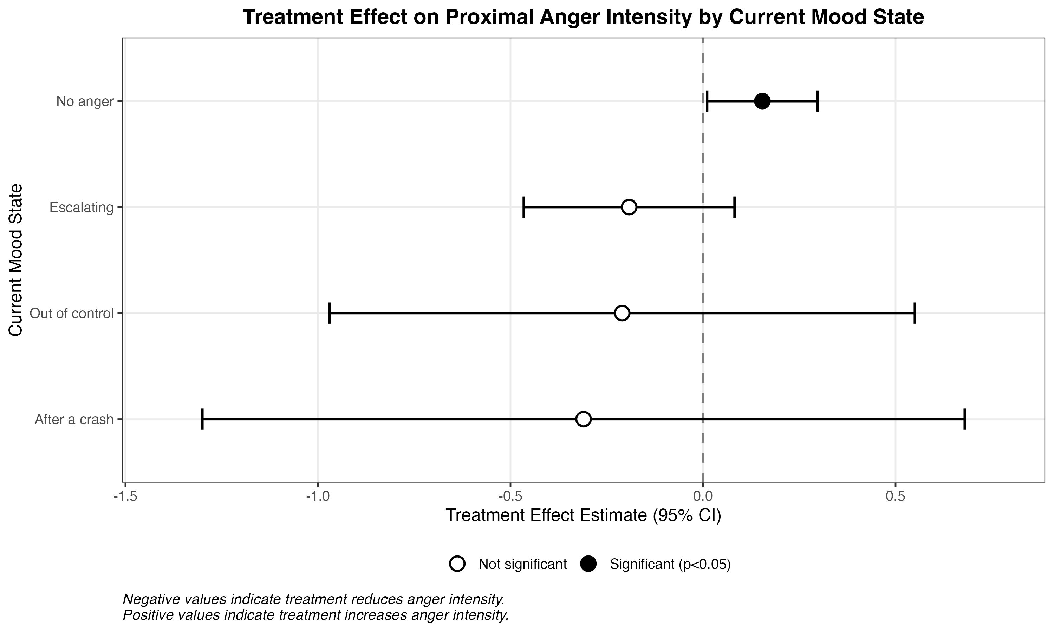
MRT results
4,022 decision points from 65 participants (mean 61.9 decision points per participant, SD= 28.6)
Treatment assignment was balanced, with 51.1% (n= 2,054) randomized to treatment and 48.9% (n= 1,968) to no treatment
Delivering an intervention (psychoeducation or progressive muscle relaxation) worsened anger (0.15 increase on a 1-10 scale)
Trending significant effect for delivering a CBT skill when anger is escalating
Notes:
When participants reported no anger, and received an intervention around psychoeducation or progressive muscle relaxation, the intervention had a statistically significant iatrogenic effect, with an estimated increase in proximal anger intensity of 0.154 points (on a 10 point scale) (95% CI: [0.011, 0.298], p=0.036)
When participants reported escalating anger and received a CBT skill, the point estimate for the effect in the escalating state (-0.192, p = 0.2) suggests a potential reduction in anger, though this did not reach statistical significance.
The “Out of control” (4.3% of observations) and “After a crash” (2.2% of observations) states were relatively rare in the data. While point estimates suggested potential beneficial effects (reductions of 0.21 and 0.31 points, respectively), the large standard errors (0.43 and 0.57) and wide confidence intervals reflect inadequate statistical power to detect effects in these subgroups.

Slide 27
Learnings about problem anger
JITAIs may particularly useful for underaddressed mental health issues
Participatory research, such as co-designing the EMA study protocol and the JITAI, is critically important to engagement and outcomes
      One early focus group revealed that some content, without a therapeutic relationship, was distressing
      We need to test our assumptions
Research teams must make difficult decisions between developing a minimally viable prototype to answer research questions, and a commercial product to increase engagement
Notes:
Conduct a RCT
Decide on whether telephone coaching would support engagement
Understand how a 30 day JITAI would augment traditional treatment

Slide 28
How can we address the challenges with successful implementation of digital mental health tools?

Slide 29
There is no standard development pathway for digital health.
Drug development
process
Digital health
innovation process
Discovery and development
Discovery and development
There is a gap in validating and evaluating digital health innovations.
Pre-clinical research
Animal testing, safety assessment
Clinical research
Phase I-IV clinical trials
Review by government
regulatory agency
Review by government
regulatory agency
Post-marketing safety
monitoring
Post-marketing safety
monitoring

Slide 30


Who are the users? Who are the stakeholders?
How can the usability, acceptability and safety of this innovation be optimised (for realistic clinical scenarios)?
How and where can clinical information generated by this innovation best be used?
What training, implementation and/or change processes are required?
What is the state of evidence for this innovation area?
What would a model of care built around this innovation look like?
Exploration
Design and prototyping
Development and Validation
Evaluation
What is a feasible payment model for this innovation?
What is needed to promote engagement and sustained, meaningful use?
What outcomes evidence is needed by payers and for compliance?
What regulatory frameworks will it need to operate within?
How can automated digital/behavioural data collection enable outcomes/experience measurement?
Notes:
The Validitron is built around the observation that, regardless of where you are at in the development lifecycle, at each stage there are probably things you should prioritise if your goal is implementation into healthcare contexts.
Things like: Who will pay for this innovation and via what mechanism? … all the way down to ... Does this data wrangling system need to handle partially compliant data?
And if you look across existing digital health research-led frameworks, such as the CEHRES Roadmap, ELICIT, etc., I think you see that: There are common themes and common questions that have been identified for implementation success.
So the Validitron is partly a set of research methods and tools: asking the right questions at the right project stage. (And that’s often earlier than you’d think.)

Slide 31
Simulation-based research in digital health
Enhanced
usability testing
Greater fidelity to
task and workflow
context.
Experiential learning
and cueing
De-biased feedback to support design and assessment of acceptability and
workflow compatibility.
Simulation-primed
qualitative inquiry
Exploration of
sensitive topics
Wong et al., 2017
Simulation-based evaluation
Guo et al., 2020
Pragmatic alternative to use of healthcare facilities for validation/evaluation.
Methodological agenda: scaled abstraction, distributed simulation, virtual vs physical simulation.

Slide 32



Slide 33
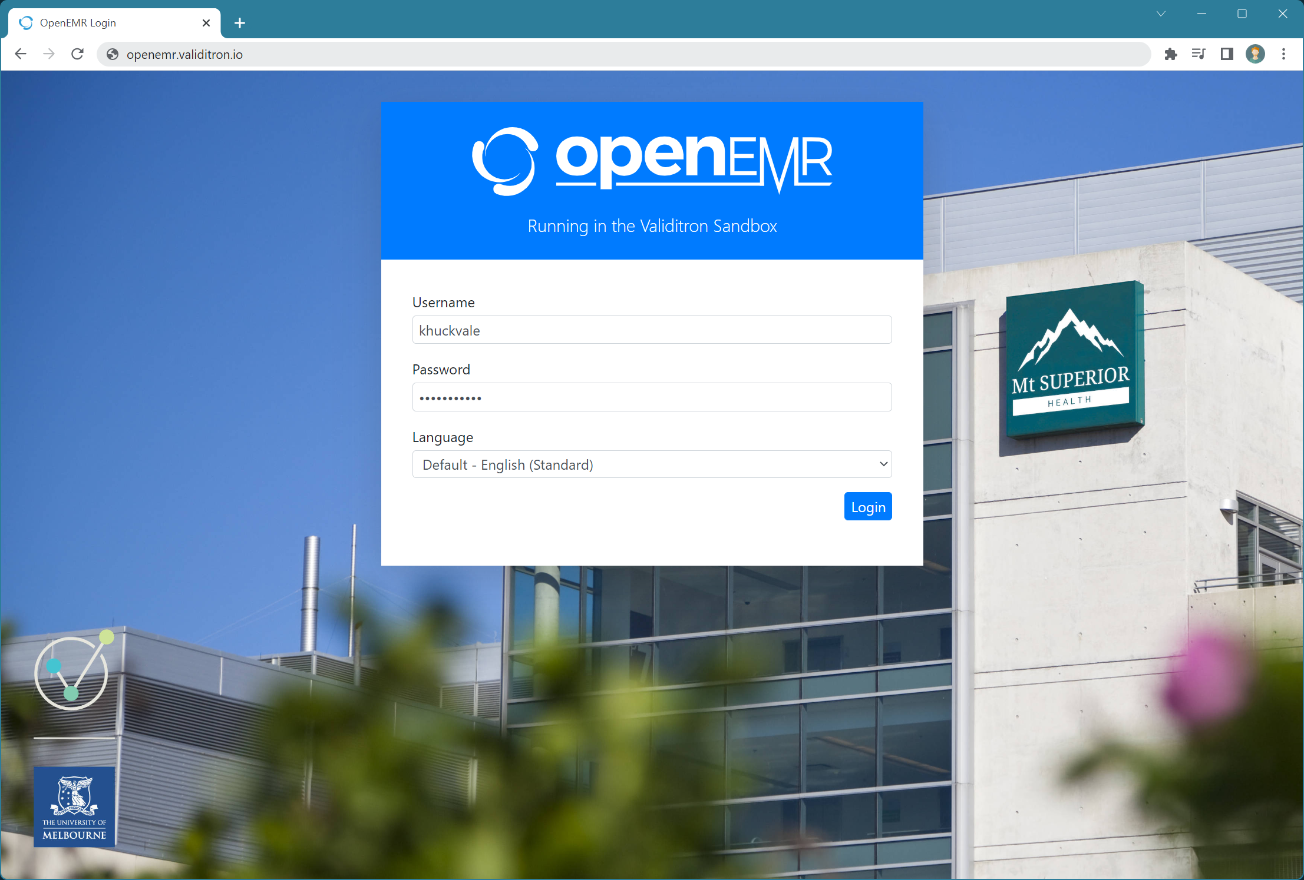
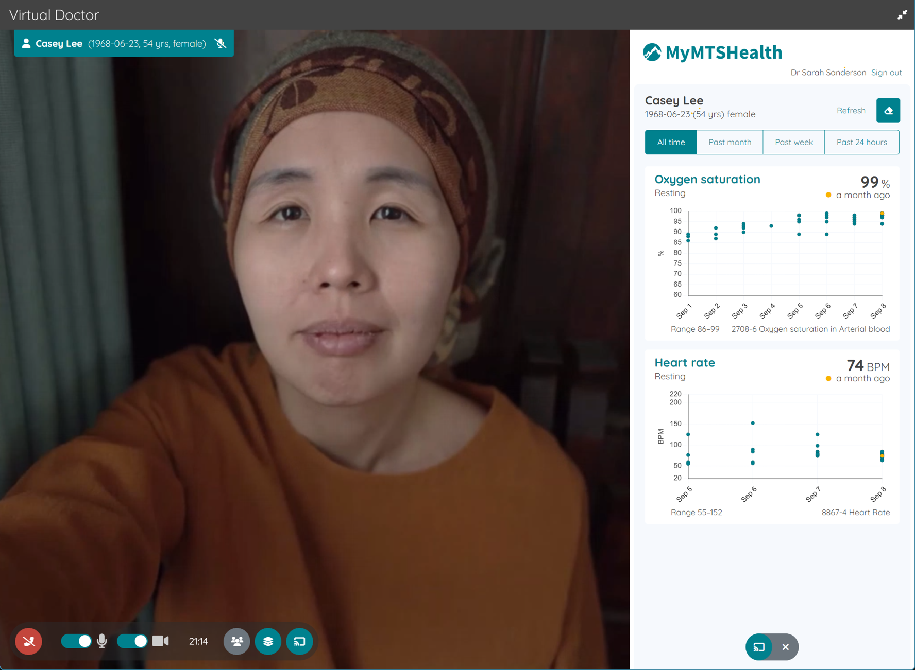

Slide 34
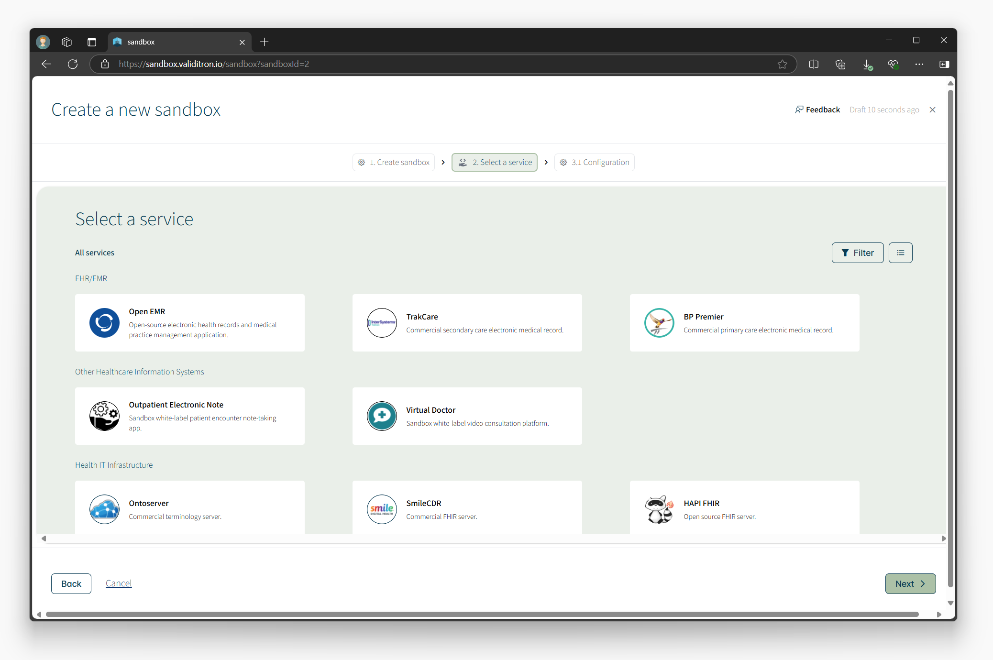
Validitron Sandbox

Slide 35




PROJECT CASE STUDY
Improving patient experience of telehealth with a consultation summary tool
KEY INSIGHT
Simulation showed that clinician time increased when using a tool designed to improve efficiency.
IMPACT
Paradoxical workflow impacts were detected.
Produced a range of implementation considerations to ensure uptake and equity.
MOTIVATING PROBLEM
Patients leave telehealth consultations without a summary of what has, and will happen.
VALIDITRON APPROACH
Co-design​
Environmental scanning​
Experiential simulation study
CHIEF INVESTIGATOR
A/Prof Rashina Hoda
DEPARTMENT OF SOFTWARE SYSTEMS AND CYBERSECURITY
MONASH UNIVERSITY
KEY PARTNERS

Slide 36
Learnings for developing digital mental health tools
Digital health solutions are not always the best solution, and more complex technology is not always superior
The first port of call must be consultation with the stakeholders
      Taking evidence-based treatments delivered face to face and converting them digital without consultation will result in at best sub-optimal uptake, and at worst unintended consequences, or harmful outcomes.
    Participatory research can be useful to design a data intensive study protocol
    Clinical simulation fills a vital gap between prototyping and further evidence generation/implementation
    A multidisciplinary team is essential to success (biostatisticians, UX/software experts, consumers, clinical psychologists, and digital health researchers)

Slide 37
Learnings for implementation
AIML approaches in mental health have significant hope but their feasibility in real world usage is challenging
Privacy of the data is a serious risk and concern
      Some had concerns that their physiological data would reveal embarrassing or personal things “Can it tell when Im having sex?” “The GPS can detect where I work and I don’t want my employer knowing I have anger problems”
      Some had serious legal concerns “my ex would use this data to remove access to my children”
    We need to better integrate into clinical care, and give mental health professionals the informatics expertise needed to understand how to best use data

