Slide 1
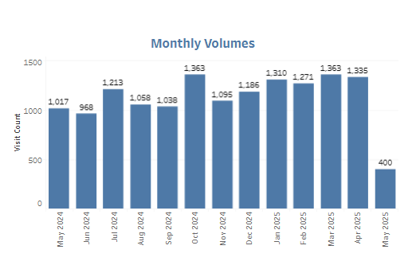
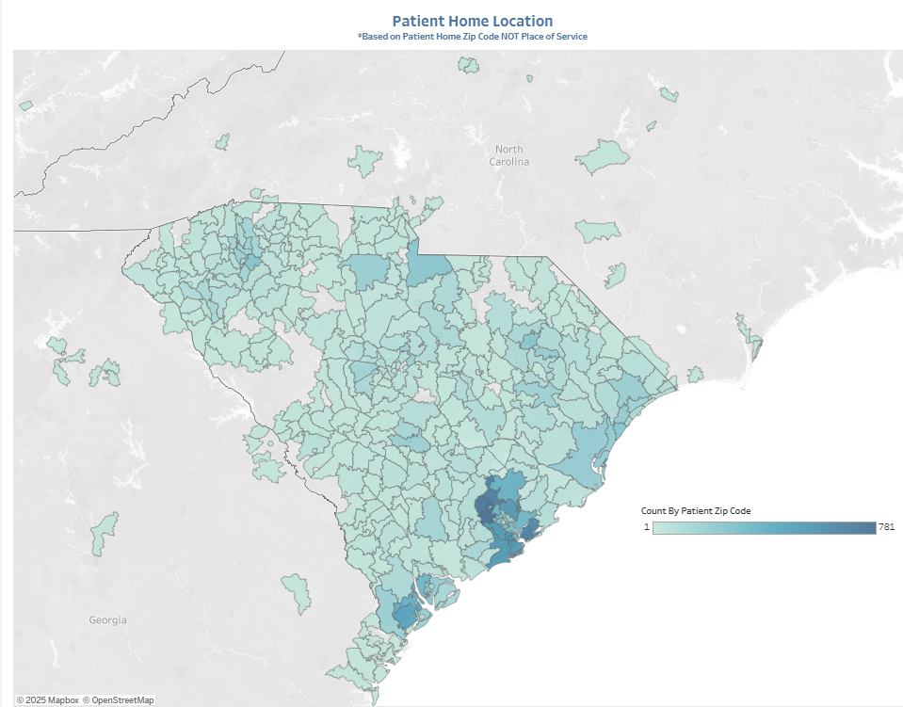
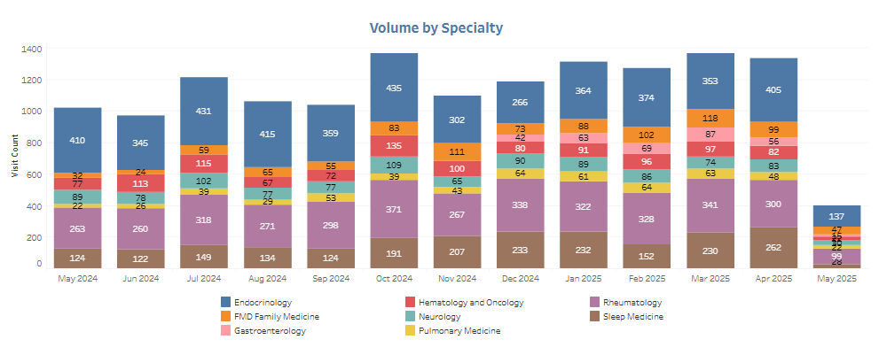
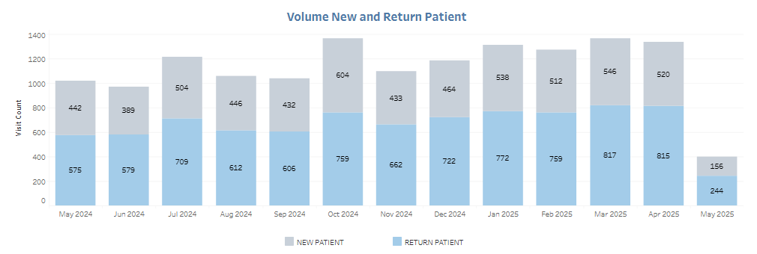
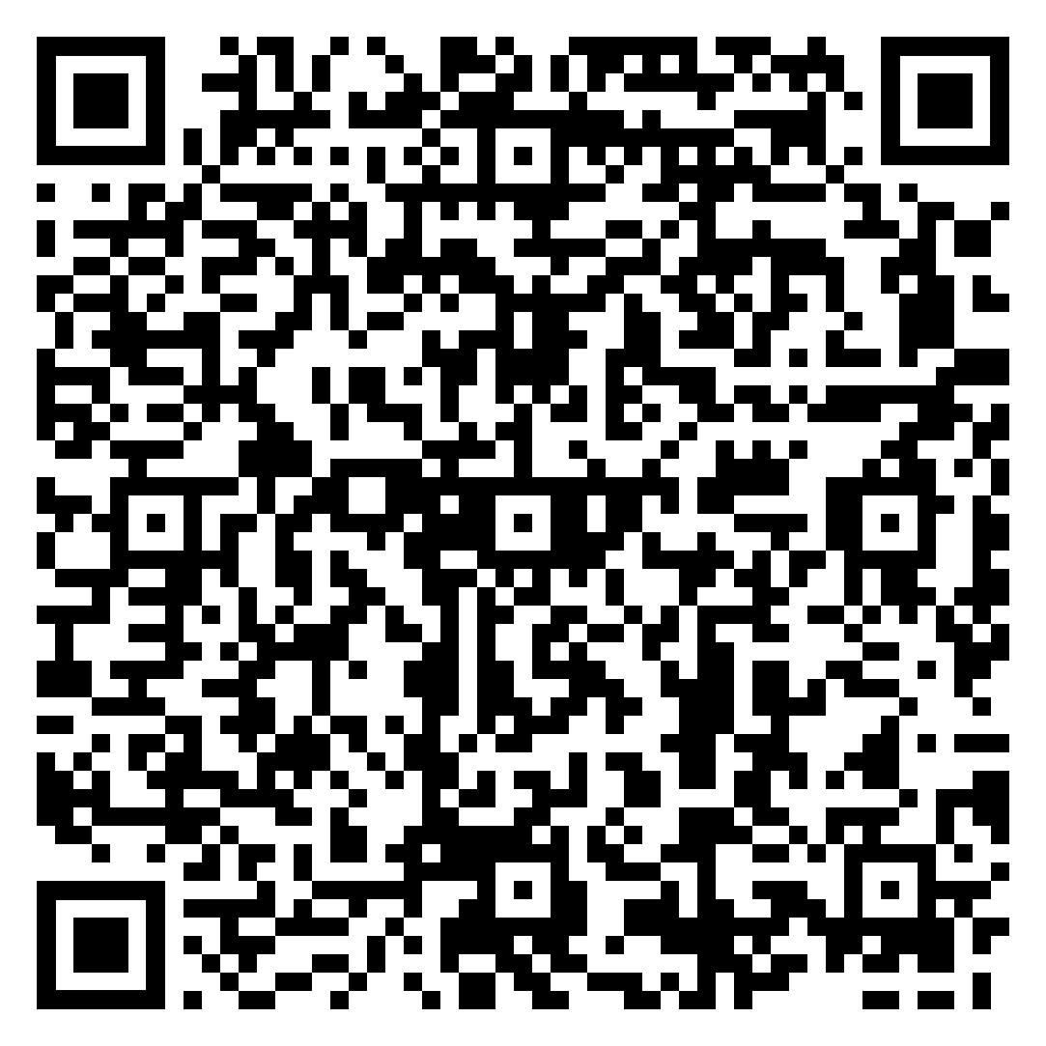
Utilizing RE-AIM to evaluate a virtual specialty care program
from development through implementation and expansion
Caitlin Koob, PhD^{1,2}, Jillian Harvey, PhD^{1,2}, Cortney Belton, MBA², Emily Warr, MSN²,
Peter Gardella, MBA², James McElligott, MD², & Dee Ford, MD²
¹Department of Healthcare Leadership and Management, Medical University of South Carolina, Charleston, SC;
²Center for Telehealth, Medical University of South Carolina, Charleston, SC
BACKGROUND: All 46 SC counties are considered to have a healthcare provider shortage, exacerbating challenges for patients who require specialty care. Traditional, in-person specialty care averages a 3- to 6-month wait time for new patients, which may contribute to poor health outcomes. To address this, the Virtual Specialty Care Program was developed to increase access to high-demand specialty care services and offer a 100% virtual alternative to in-person care. These “no barrier” specialty services are offered statewide, with or without a physician referral. In addition, the Virtual Specialty program coordinates referrals for in-person lab work, imaging, and pharmaceuticals based on the patient’s residential location.
STUDY DESIGN: RE-AIM guides real-time evaluation, incorporating multiple data sources and tracking process and outcome measures to inform program quality improvement and data-driven decision-making. Data sources, including program tracking data, REDCap, electronic health records, and qualitative data from patients, were triangulated to understand program utilization across specialties and patient satisfaction. Quantitative data are analyzed using descriptive statistics, and qualitative content analysis is utilized to identify themes.
SETTING: Virtual Specialty Practices, or ‘virtual clinics,’ are fully staffed with specialized physicians, registered nurses, and registration staff to support patients through pre- and post-visit experience, follow-ups, and ancillary service referrals. Using historical health system data, Virtual Specialties were identified through the intersection of high-demand and historical amenability to virtual services systemwide.
FINDINGS
Reach: 22,338 Virtual Specialty visits occurred among 9,676 patients from 12/2022-05/2025.
Effectiveness:
All specialties have reduced their wait times for new patients to <8 days
Patient experience ratings are consistently higher for the 100% virtual practice compared to hybrid care
Patients report immediate impacts for increased access to specialty care services, and the ability to initiate treatments faster than they would have with the first-available in-person visit
Patients in ‘virtual clinics’ reside across SC and beyond, saving patients’ considerable time and costs required to travel for medical care
Adoption: Endocrinology is consistently the highest volume service each month, followed by Rheumatology
Implementation: Virtual Specialty Programs underwent a four-phase implementation process
Maintenance: To date, the average monthly no-show rates among Virtual Specialty patients are 9-11%. A majority of visits (58%) were comprised of returning patients, indicating their satisfaction with virtual services.
IMPLICATIONS FOR POLICY & PRACTICE
To date, this Virtual Specialty program has increased access to care across SC, improved patient satisfaction, and reduced no-show rates relative to national benchmarks
Virtual Specialty Practices increased access to care, while simultaneously improving patient satisfaction and adherence to scheduled visits
Policy efforts needed to sustain reimbursement of virtual specialty services
Figure 1. Monthly volumes, 05/2024-05/2025.
Figure 2. Reach by patient zip code.
Figure 3. Monthly volumes by specialty.
Figure 4. Monthly volumes of new vs. returning patients.
This presentation was made possible by the Health Resources and Services Administration (HRSA) of the US Department of Health and Human Services (HHS) as part of the National Telehealth Center of Excellence Award (U66RH31458). The contents are those of the author(s) and do not necessarily represent the official views of, nor an endorsement, by HRSA, HHS or the US Government.
Questions? Please reach out to Caitlin Koob at cak240@musc.edu.
Notes:
Notes:
In Powerpoint, click View > Guides
Keep text within gutter guides.
Author list: Don’t split names onto two lines (e.g., “Jimmy [break] Smith”). If that happens, use a new line, unless you need the space. Bold the first names of anybody who’s presenting in person.
Intro/methods/result: Do not drop below font size 28, but if you have extra space, jack up the font size until the space is full.
Do not use color in the sidebars except in graphs/figures. It’ll pull attention from the center and slow interpretation for passersby.

