Slide 1
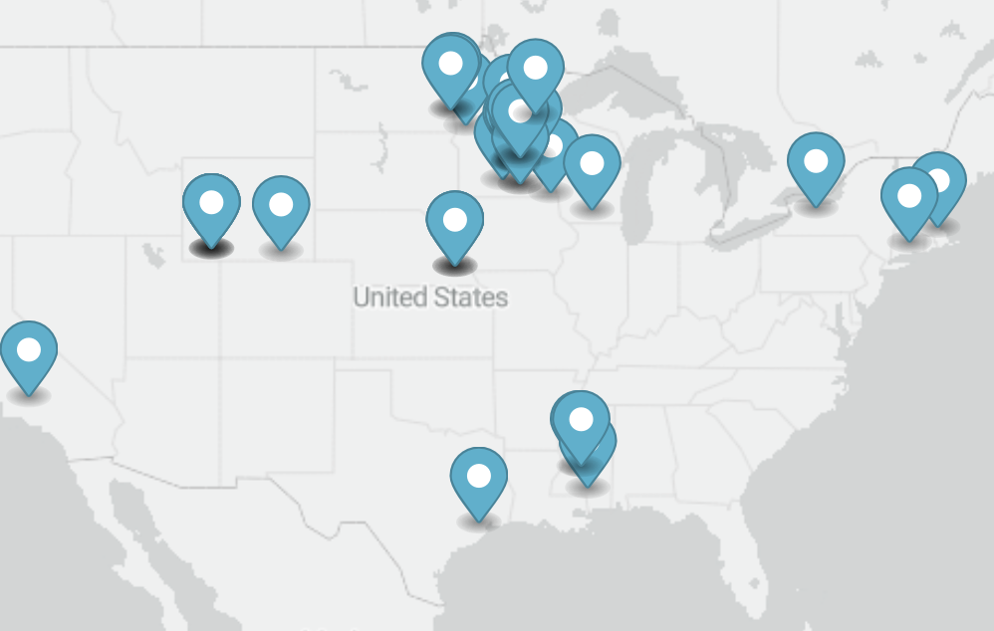
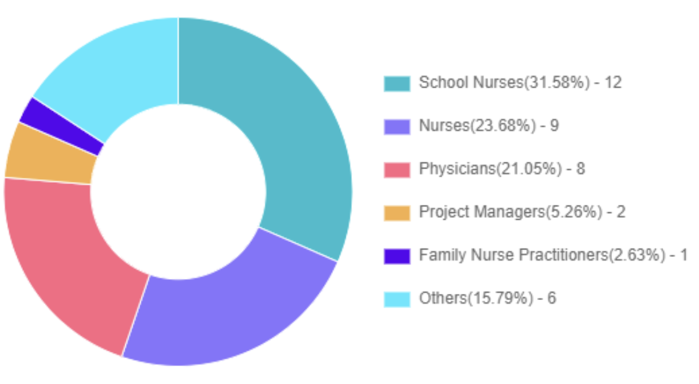
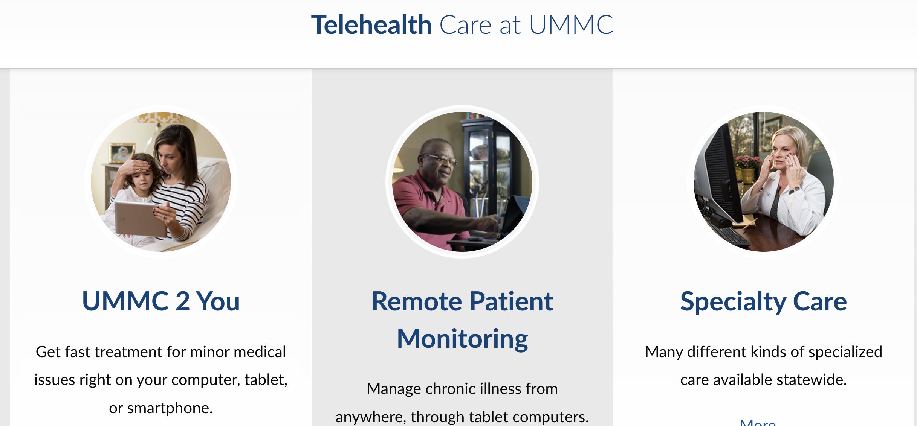
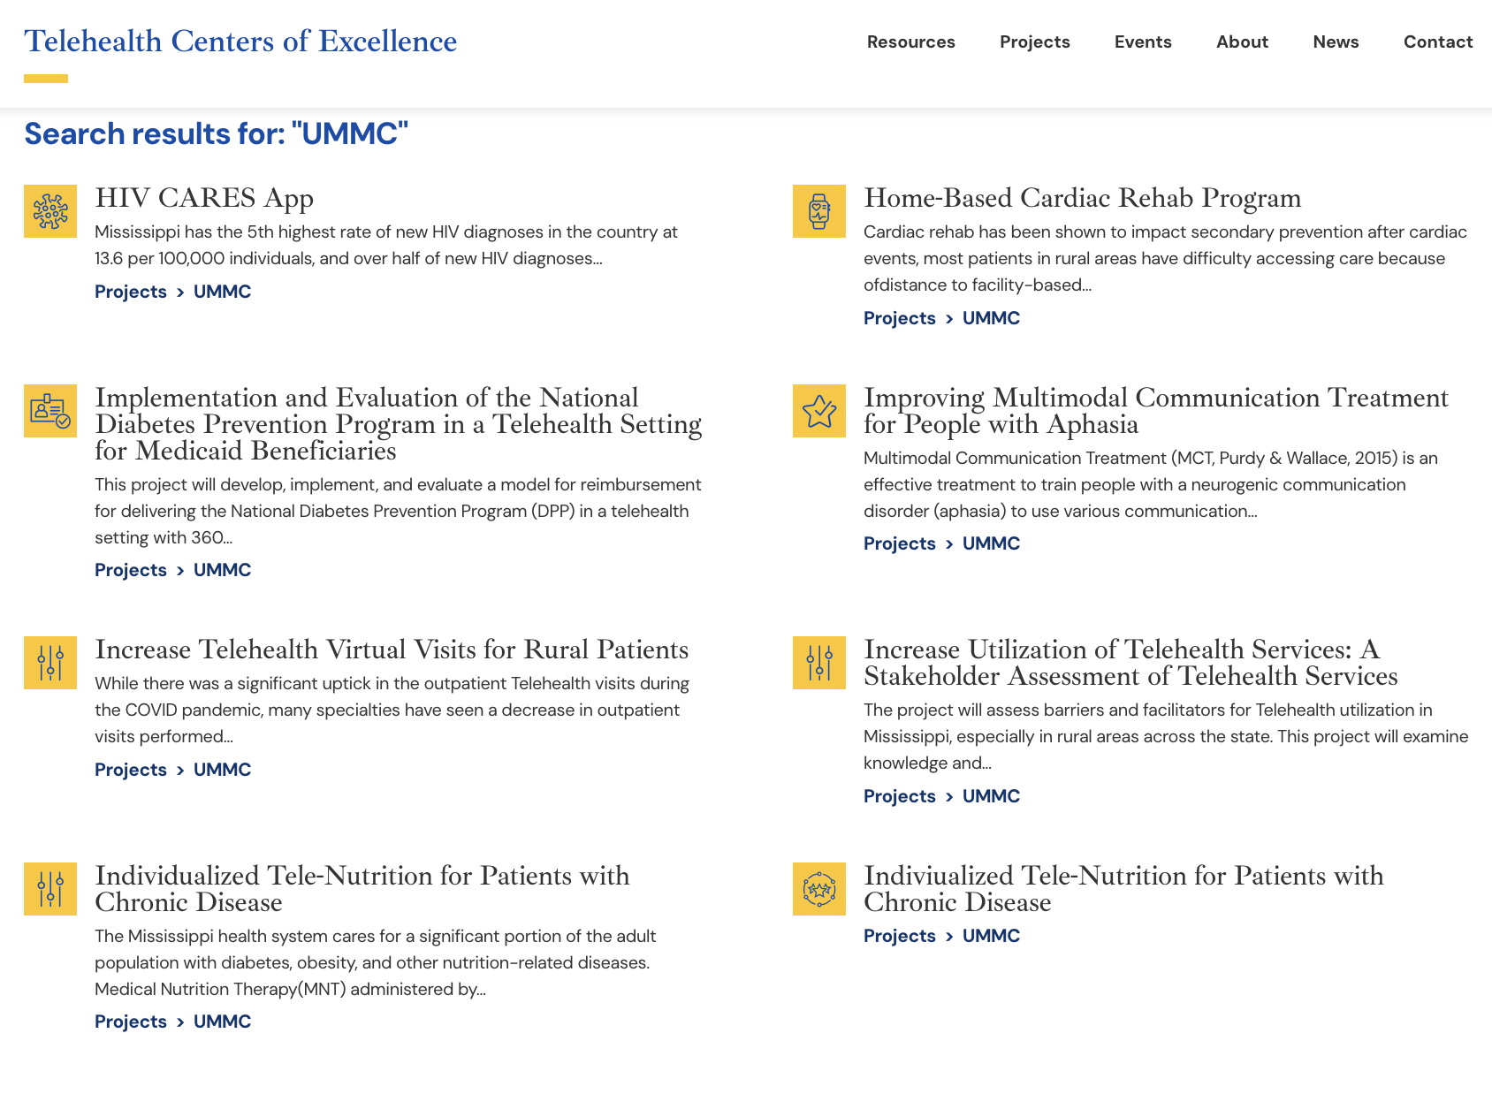
Pediatric Dermatology for the Upper Midwest ECHO
Brailyn Weber, BS³; DeAngela Ivory, MPH¹, Sarah Asch, MD²
University of Mississippi Medical Center, Center of Telehealth Excellence, Jackson, Mississippi¹
Hometown Pediatric Dermatology, PLLC, Minnesota²
University of North Dakota School of Medicine, Fargo, North Dakota³
ORGANIZATIONAL OVERVIEW
HIGHLIGHTS TO DATE
CONTACT INFORMATION
The University of Mississippi Medical Center (UMMC) is a HRSA Telehealth Center of Excellence championing many telehealth projects, large and small, with numerous ECHO projects. They serve as the Hub, provide project management, CME hosting and administrative support.
Hometown Pediatric Dermatology (Dr. Sarah Asch) is a solo pediatric dermatology direct care practice aimed at serving the rural Upper Midwest, and she is serving as the physician lead for this ECHO.
Attendee Locations
Attendee Profession Distribution
Sarah Asch, MD.
asch@hometownpediatricdermatology.com
612-234-2331 (office)
www.hometownpediatricdermatology.com
DeAngela Ivory – Project Manager, UMMC
divory@umc.edu
Find our Project ECHO at: https://telehealthcoe.org/project/2111/
OTHER TELEHEALTH SERVICES
UMMC has various telehealth services
Numerous Telehealth Center of Excellence Projects: https://telehealthcoe.org/
Most common to hear about ECHO through email list serve
Most physicians are in independent practice and have attended a past ECHO
School nurses most likely to state that they learned something new
PEDIATRIC DERMATOLOGY ECHO
Many Upper Midwest states have 0-3 pediatric dermatologists.
Unique aspects of this ECHO:
Focused solely on pediatric dermatology: Pediatric care differs from adults in access, challenges and clinical questions
Lead by a pediatric dermatologist in private practice: Involving experts outside academic centers with aligned goals
Partnering with a rural medical student from the targeted states as its recorder: Building rural specialty clinician pipeline in areas without home dermatology training programs
Focus of QI on retention of information from ECHO with a quiz format: Evaluate this ECHO structure on retention of learning as opposed to satisfaction by attendees
High attendance by School Nurses: New impetus to explore where rural children contact medical providers vs. adult experience
School Nurse Quote: “After attending a session on eczema, I mentioned dupilumab to the family of one of my students who has been struggling with eczema. She has clearer skin than she has had in years and her confidence has gone through the roof!”
This (publication/presentation was made possible by the Health Resources and Services Administration (HRSA) of the US Department of Health and Human Services (HHS) as part of the National Telehealth Centers of Excellence Award (U66RH31459). The contents are those of the author(s) and do not necessarily represent the official views of nor an endorsement by the HRSA, HHS or the US Government.
FUTURE AND ON-GOING DIRECTIONS
Further data collection & analysis of participant retention of information after they attend an ECHO session
Expanding access to ECHO sessions to relevant audiences; if you have a cohort that would be interested in attending an ECHO session, provide us with your contact information!
Notes:
Feel free to adjust the sizes of the frames/titles to meet the needs of your presentation. Do not use a font size smaller than 24. Please do not move the “splash session” logo.

