Slide 1
The Application of Extended Reality (XR) to Performance and Rehabilitation
Jennifer C. Reneker, PT, PhD
Associate Professor, Assistant Dean of Scholarly Innovation University of Mississippi Medical Center
Sports Biometrics Conference 2022

Slide 2
Conflict of Interest/ Disclaimer
Jennifer C. Reneker, PT, PhD is an intellectual property holder with 2 patents pending, which are related to this presentation.
Jennifer C. Reneker, PT, PhD is the founder/owner of ALTER VIST, LLC.
This project was supported by the Office for the Advancement of Telehealth (OAT), Health Resources and Services Administration (HRSA), U.S. Department of Health and Human Services (HHS) under cooperative agreement award no. 2 U66RH31459‐04‐00. The information, conclusions, and opinions expressed are those of the authors and no endorsement by OAT, HRSA, or HHS is intended or should be inferred.

Slide 3
Agenda
A little epidemiology
Focus on Why – landscape in Mississippi
Necessities being addressed
Prevention/Performance
Rehabilitation
Detection of Impairment
Results to date

Slide 4
A little Epidemiology
Sports Concussion

Slide 5
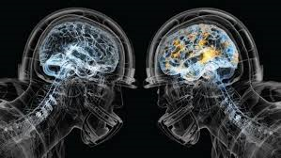
Epidemiology of Neurotrauma in Sport, Focus on Concussion
1.6 – 3.8 million = total number of traumatic brain injuries, including concussions, occurring in sports annually.
Langlois et al., 2006
1.1 – 1.9 million = sports- and recreation-related concussions annually in youth (<18 years old)
Bryan et. al., 2016
Highest rate of Sports-Related Concussion (SRC) in American football
IOM, 2013; Hendrickson, 2012
2.5 per 1000 exposures in college football
IOM, 2013
Notes:
Vast underestimation because many don’t seek care, and because they don’t seek care, they are not captured by surveillance

Slide 6
Concussion is a Neurotrauma
Functional rather structural – it alters how the brain works does not alter the anatomy
Most frequently occurs by being kicked or struck in the head or elsewhere on the body
Selassie et al., 2013
Associated with any contact sport
American football has the greatest number of TBI’s – it also has the greatest number of participants
Daneshvar, 2011
May or may not involve a loss of consciousness
Loss of consciousness does not necessarily predict longer recovery
McCrory 2017

Slide 7
Focus on Why – landscape in Mississippi
How did I get here?

Slide 8
Sports and Concussion in Mississippi
Poorest state in the US – While this is often attributed to the Mississippi Delta, the truth is even without the Delta, MS is still the poorest state in the US
Worst health outcomes – look up almost any CDC vital statistic (i.e. birth mortality, obesity, stroke prevalence, heart disease)
Mississippians are proud of their sports culture and Mississippi athletes excel to the highest levels of sports participation.
Within the state, baseline testing (prior to the beginning of the sports season) is not routinely implemented.
Of 325 schools, 82 have no ATC; None have a full time ATC in the MS Delta.
MS was the last state to implement a Youth Sports Concussion Law in 2014
No requirement to have a medical professional present at game events.
UMMC, the state’s only level 1 trauma center, does not have an organized concussion management program.

Slide 9
“Necessity is the Mother of Invention”
Plato

Slide 10
The necessity: Accessible Interventions
Rehabilitation is effective for attaining recovery from deficits associated with concussion
However, physical therapy examination and intervention are not routinely utilized for concussion management
Ranges between NO use to limited use of PT (only for slow recovery)
Patients who recover in the “expected timeframe” never receive an examination of to ensure recovery of physical and cognitive deficits
In Mississippi, specialist care for concussion management is extremely limited

Slide 11
The necessity: Prevent Subsequent injuries
Once returned to sport, athletes with a history of concussion are more likely to sustain a second concussion than non-previously concussed athletes
Reneker et al., 2019
Athletes and members of the military with history of a concussion have significantly increased risk of musculoskeletal injury compared to those with no previous concussion
Herman et al., 2017; Brooks et al., 2016; Reneker et al., 2019
Because of this, it has been suggested that ALL people who have a concussion should be examined and treated by a physical therapist
Kardouni et al., 2018; Reneker et al., 2019

Slide 12
The Invention: Virtual Immersive Sensorimotor Training (VIST)
Virtual Reality (VR) to deliver therapeutic intervention for impairments
VR exercises for prevention of injury in athletes at higher risk
VR training to increase proficiencies to enhance performance on the field
Useful in:
Concussion recovery
Secondary injury prevention
Long term impairment identification and treatment
Sports performance – super training
Other patient populations:
Geriatrics and fall prevention
Pediatrics

Slide 13
Feasibility
75 healthy collegiate soccer players enrolled
Participated in 8 training sessions
Low-tech PT interventions
4 VR activities training eye movement control and perception
Results
Significant improvements in nearly all clinical measures
Rate of injury trending down:
2017 – 2018 decreased by 27% (p=.180)
Reneker JC, et al.Phys Ther Sport. 2019 Nov;40:184-192. doi: 10.1016/j.ptsp.2019.09.012.

Slide 14
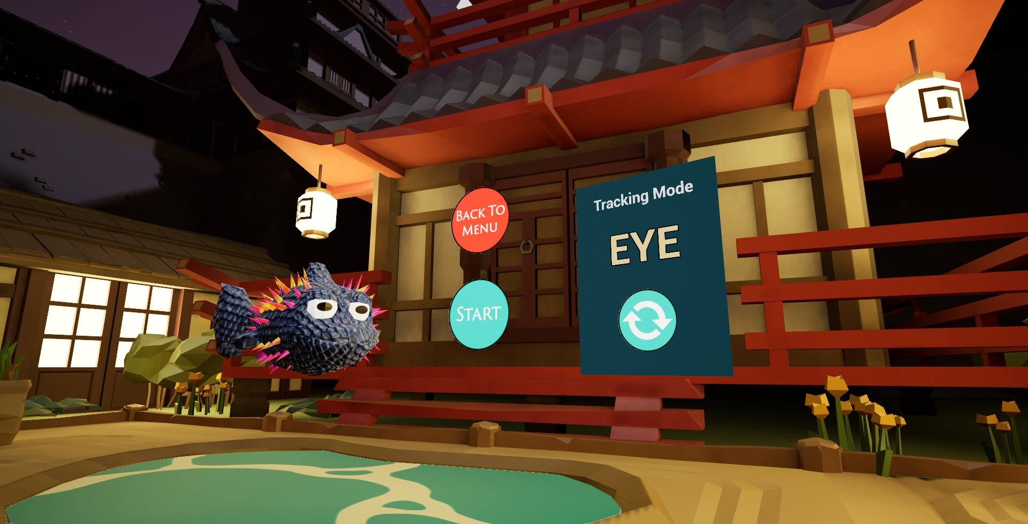
Smooth Pursuit

Slide 15
Saccades

Slide 16
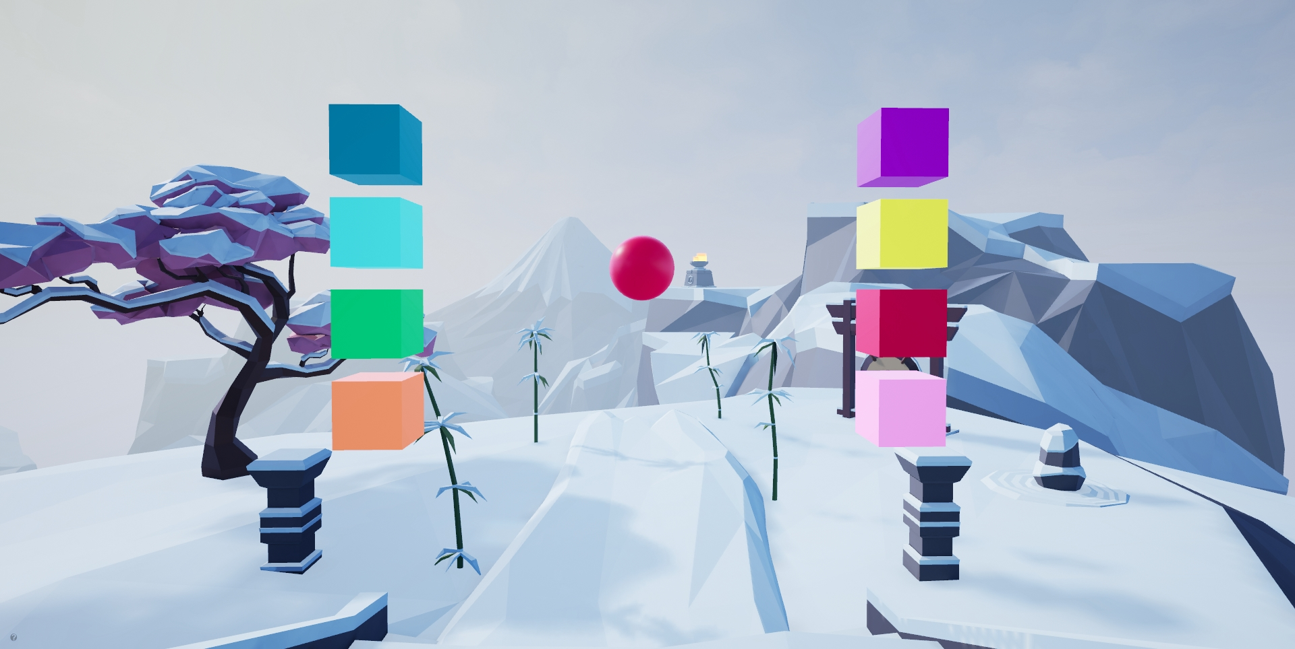
Peripheral Vision

Slide 17
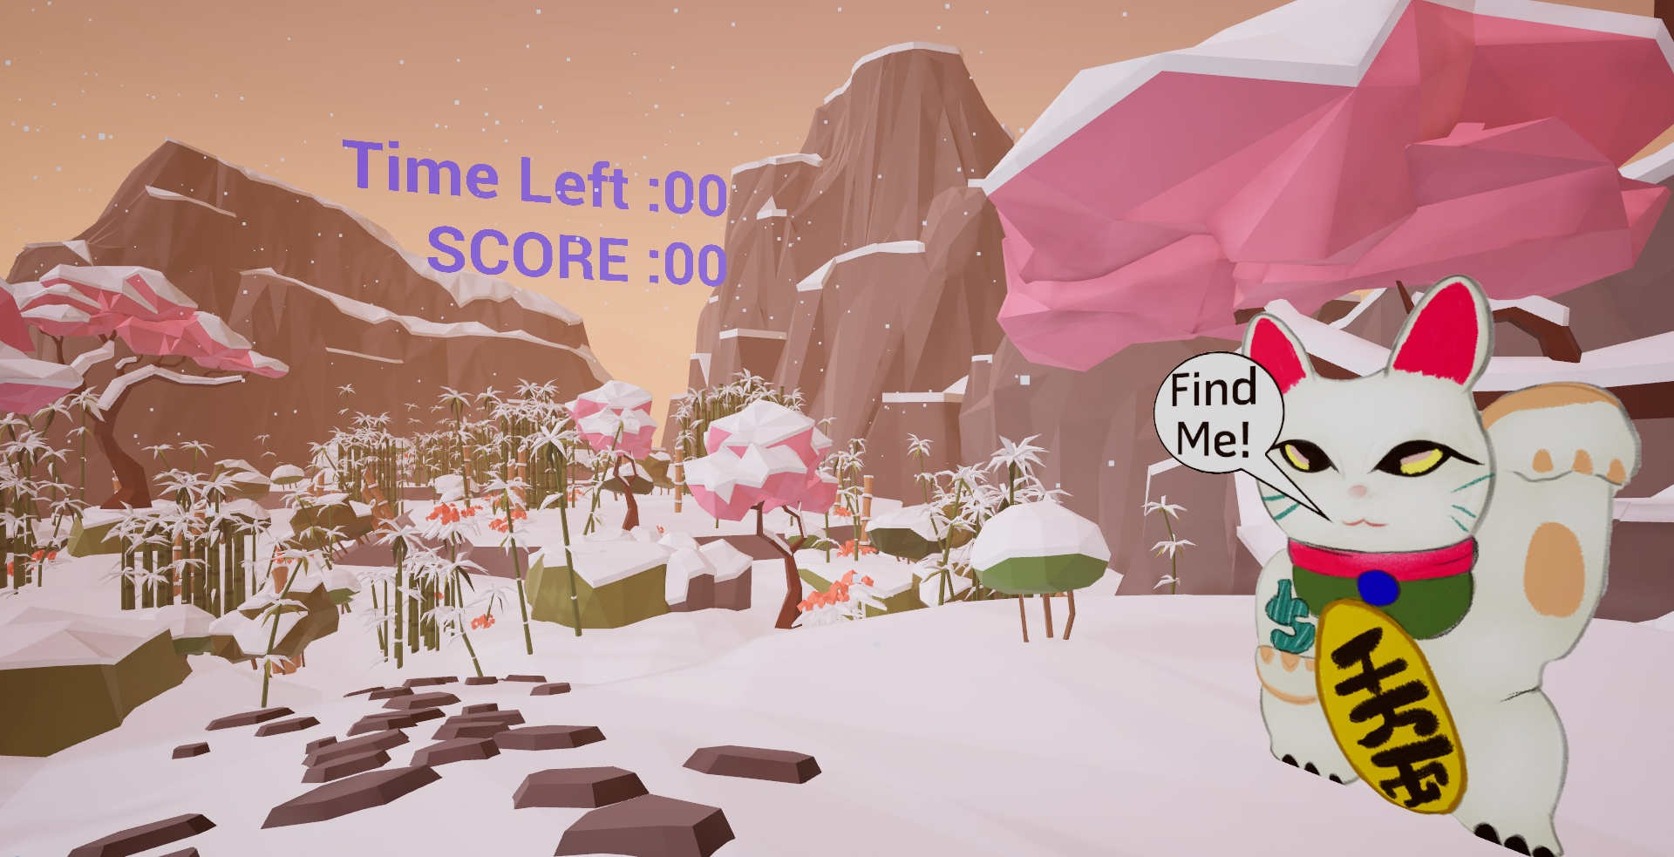
Functional eye movement and perception

Slide 18
Effectiveness
Enrolled soccer players from 2 universities
One was experimental (Mississippi College; n=78), one was control (Univ. of West Alabama; n=52)
Used VR training activities as primary intervention
Outcomes:
Training effect = change in performance on VR training activities
Near effects = clinical/ functional outcomes
Reneker JC, et al., Heliyon. 2020;6(7):e04527.

Slide 19
RESULTS
Tests | Coefficient Estimates (Std Err) | P-value
VR Scores
Sensorimotor Activities
Smooth Pursuits | 74.18 (14.5) | <.0001
Saccades | 95.78 (13.6) | <.0001
Near Point Convergence | 38.02 (14.7) | 0.005
Peripheral Vision | 43.98 (8.6) | <.0001
Cervical Proprioception | 41.93 (11.1) | <.0001
Cervical Neuromotor Control | 41.96 (10.7) | <.0001
Visual Figure | 127.73 (12.6) | <.0001
Clinical Outcomes
Cervical Neuromotor Control | 0.89 (0.2) | <.0001
Cervical Neuromotor Endurance | 8.63 (3.6) | 0.009
Total Balance Score | 6.04 (1.6) | 0.0001
Feet together | 6.89 (2.2) | 0.001
Tandem – Right | 7.18 (2.6) | 0.003
Tandem – Left | 4.65 (1.8) | 0.005
Single-leg – Right | 8.66 (3.1) | 0.003
Single-leg – Left | 9.72 (3.0) | 0.0007
Inspection Time | 1.90 (0.8) | 0.008
An interesting occurrence:
both the men and women’s soccer teams from the experimental school were regular season conference champions in 2019, which had never before happened for that school.
Reneker et al., 7/2020 Heliyon

Slide 20
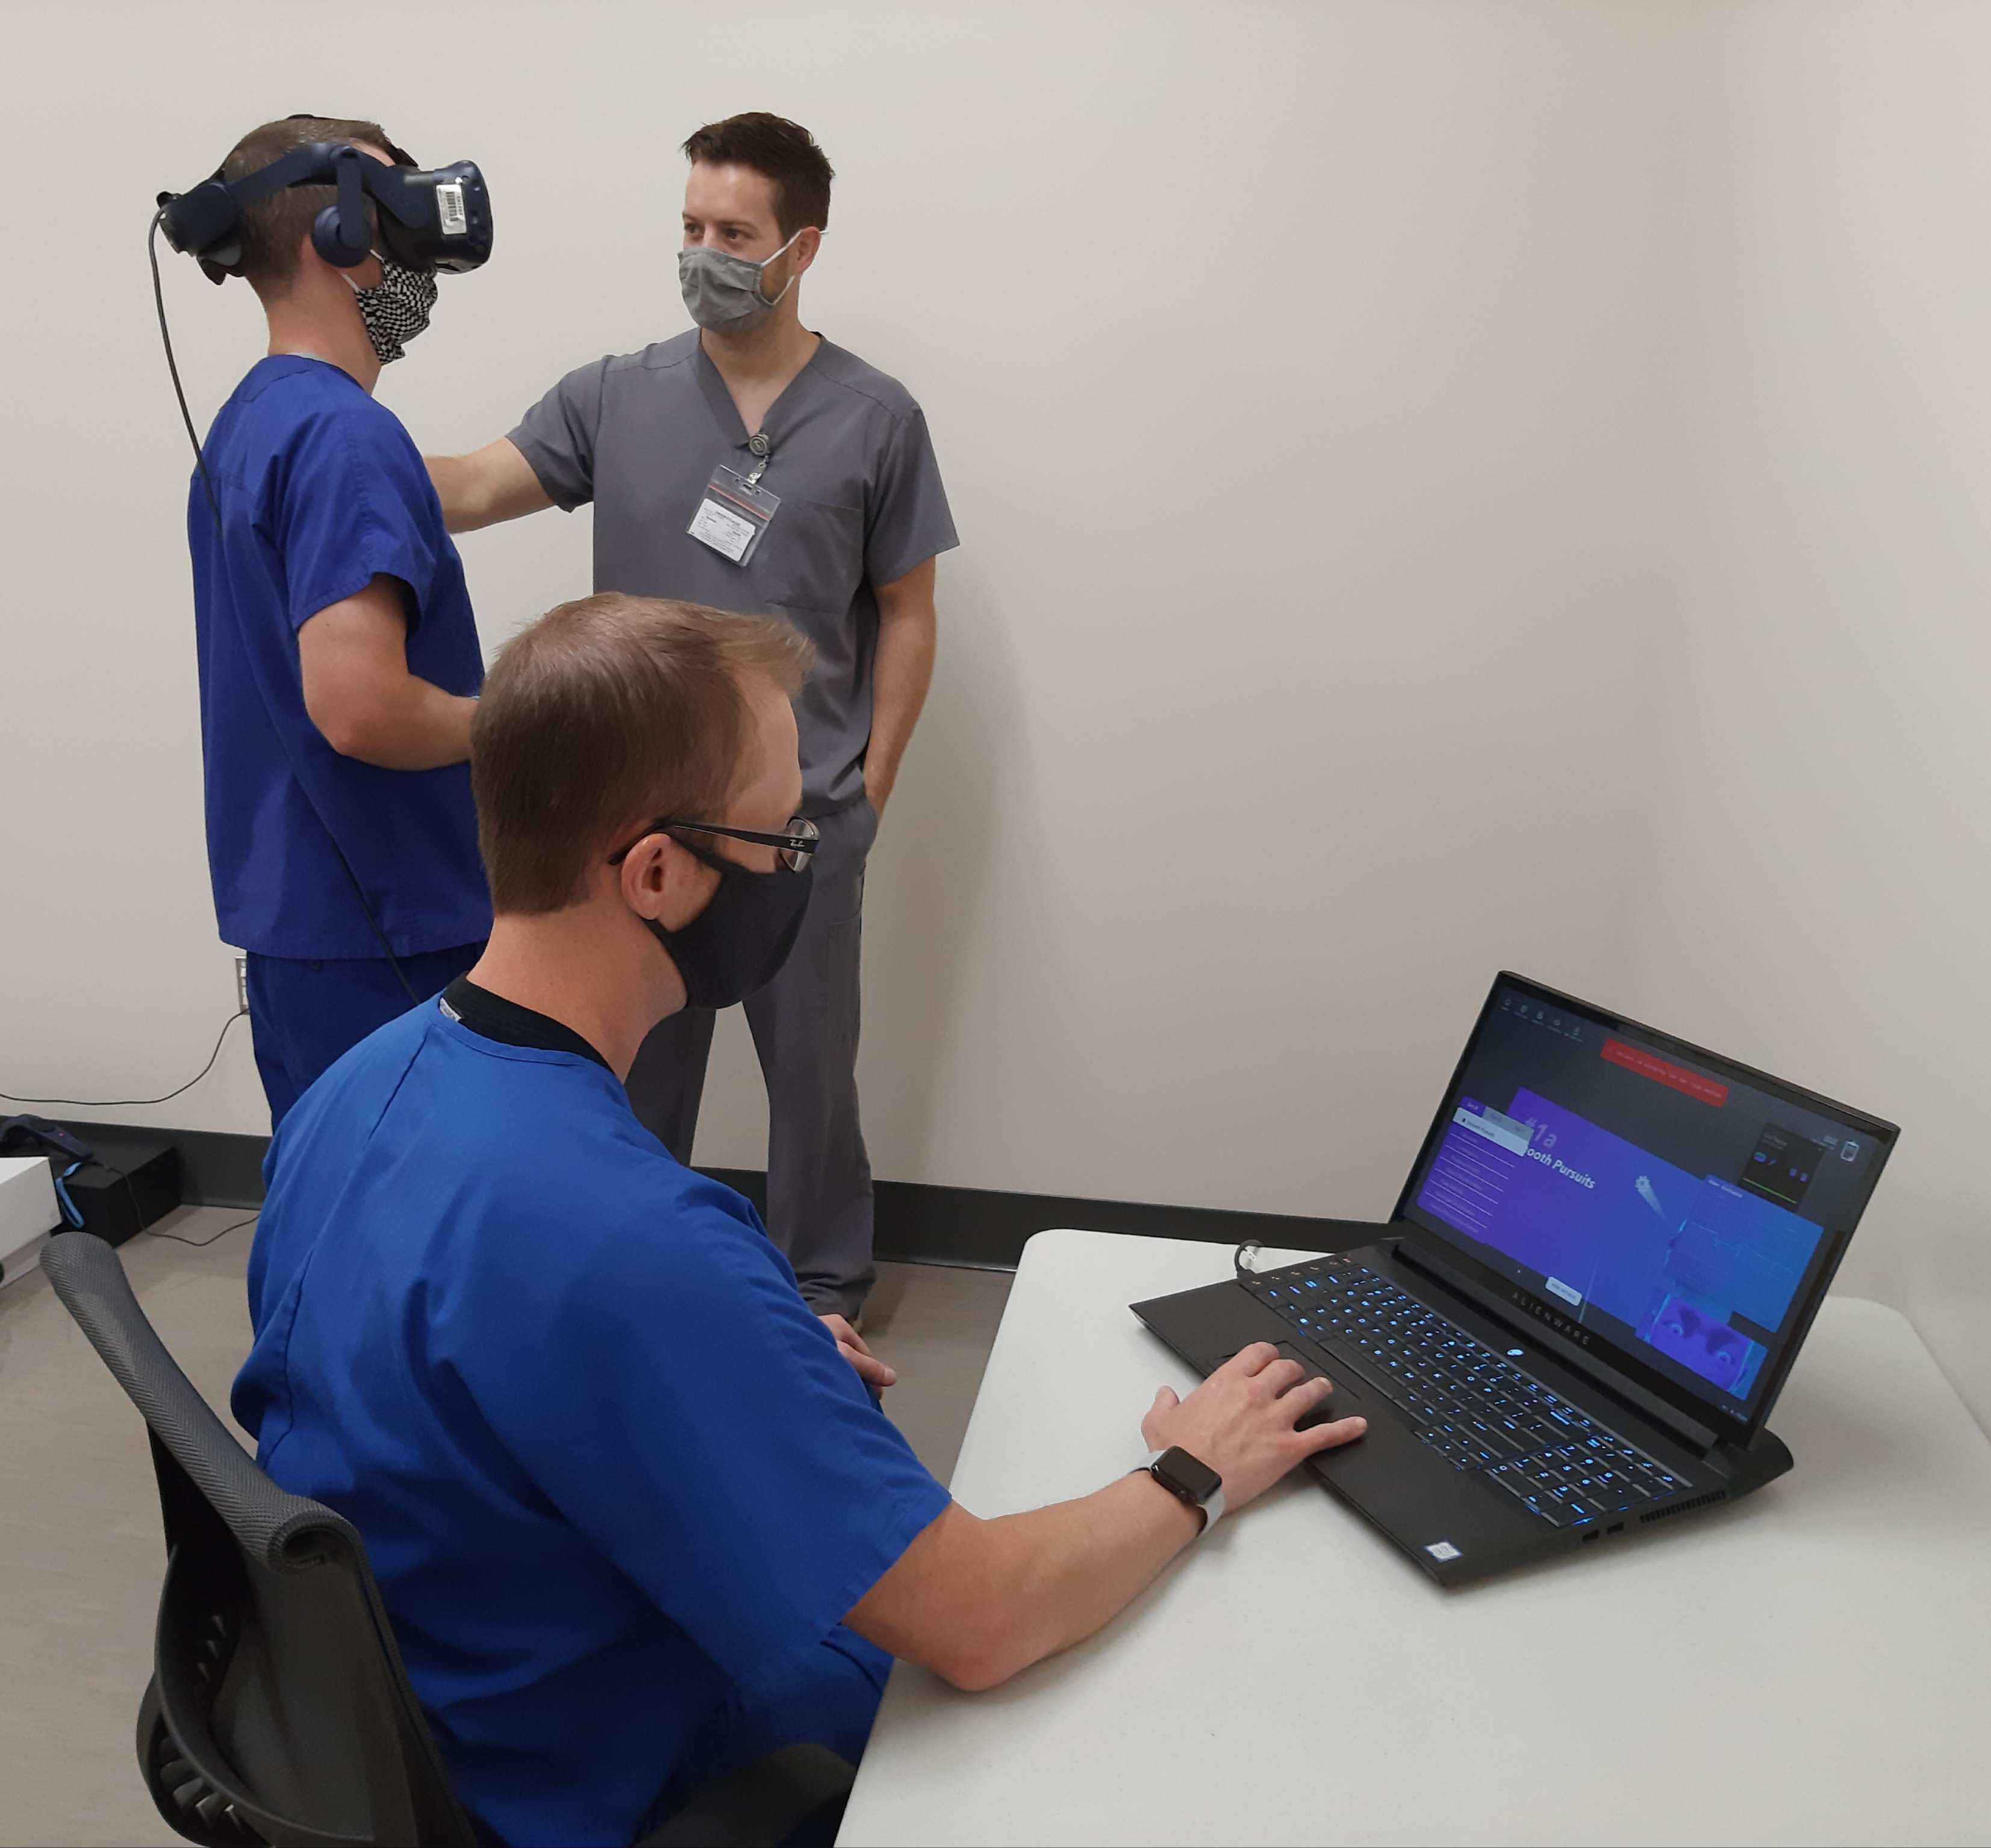
Rehabilitation after injury?
Next Step: Transition traditional physical therapy exercises into XR environments for Rehabilitation of impairments after an acute injury

Slide 21
What about detection of Impairment?
Ongoing work

Slide 22
The Necessity: rapid, point-of-care, standard test of concussion
Invisible injury
No gold-standard
Most examination/ diagnostic tests:
Are not standardized or objective
Require a baseline
Do not identify specific impairments to inform treatment
Were not created to interface in remote/rural environments – no Wi-Fi/ telehealth
Sensory-Motor control and Neurocognition are frequently injured after a concussion, but are not routinely examined because:
Nuance
Lack of specialists
Lack of quantifiable results

Slide 23
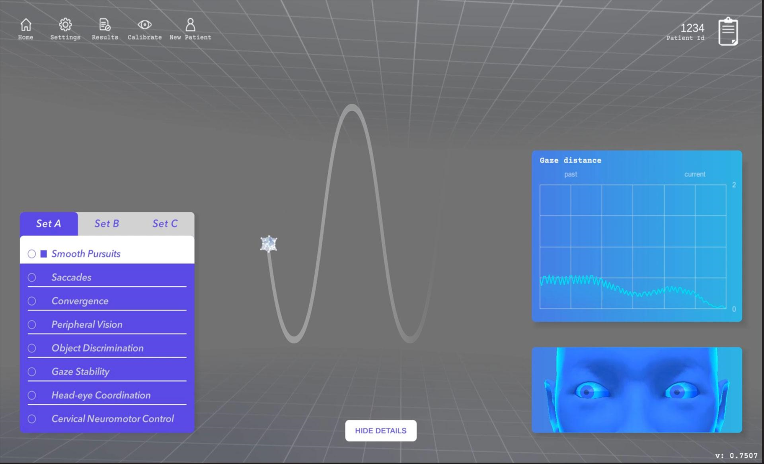
Solution: VIST Neuro-ID
Worked with a developer (Groove Jones) to develop translate clinical tests of sensorimotor control into VR.
VIST Neurological Impairment Detection

Slide 24
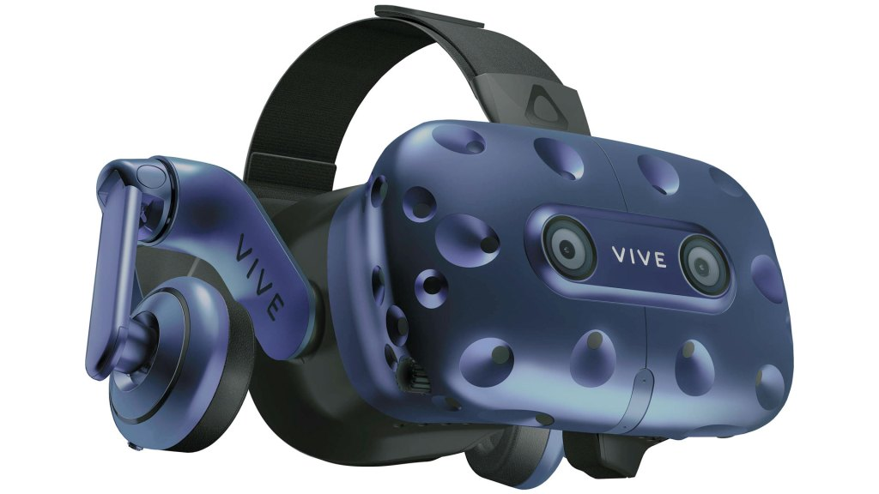
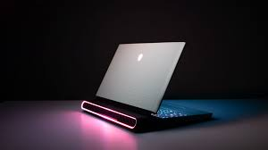
Method
8 tests with integrated sensory, cognitive, and motor control components
18 – 26 types of discrete sensor-based data, collected continuously
develop a machine learning classifier to detect neurological impairments
Statistical analysis of differences between groups
Enrolling participants 18 – 40 years of age
broadly defined as healthy
With a physician diagnosed acute concussion

Slide 25
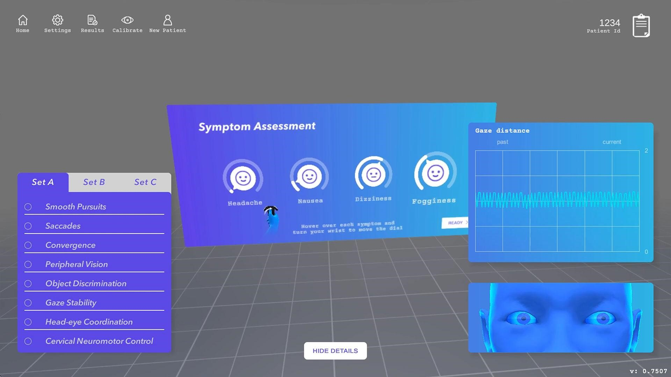

Slide 26
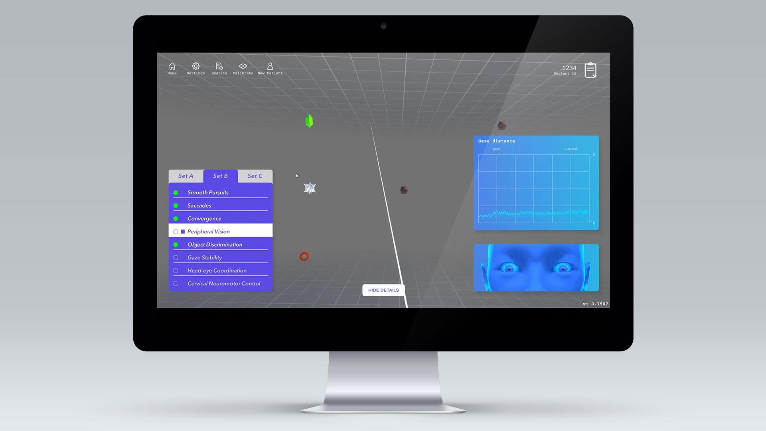

Slide 27
So far
The pandemic made data collection rather hard
We have collaborative partnerships with University of Mississippi, Mississippi State, Louisiana State University (DI), Mississippi College (DII), and Millsaps College (DIII) for data collection
to date we have enrolled:
705 healthy people
18 with an acute concussion

Slide 28
So far
We know that there are features that are distinguishable
statistical differences in performance
There is a wide range of performance abilities in the healthy population
Not all concussions present the same

Slide 29
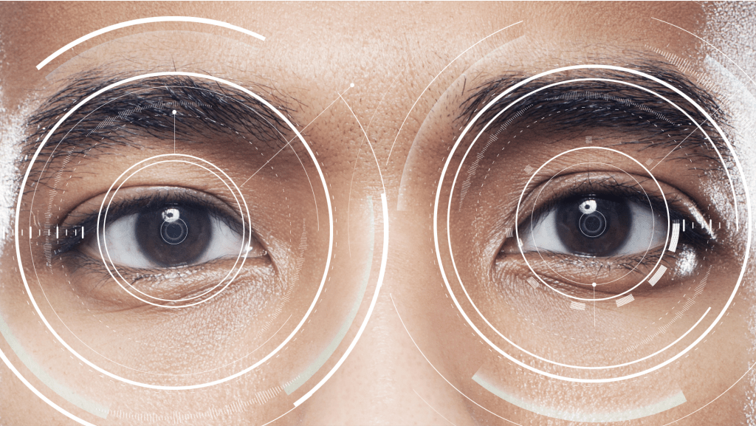
The Desired goal
A technology tool that:
does not require a baseline
identifies specific impairments to direct treatment
Quantifies deficits to measure change over time
Can be used in person or through telehealth

Slide 30
We believe
This will be useful:
in rural poor areas, like Mississippi
For far-forward diagnostics in military environments
To enhance objectivity in medical decision making
To drive more effective treatment methods
Beyond concussion, in other conditions which injure functional neural networks

Slide 31
Jennifer Reneker, PT, PhD
Jreneker@UMC.edu
www.linkedin.com/in/jennifer-reneker-pt-phd/

