Slide 1
Functional assessment and training of cognitive, sensory, and motor proficiencies using Virtual Reality
Jennifer C. Reneker, PT, PhD
Associate Professor, Assistant Dean of Scholarly Innovation University of Mississippi Medical Center
Athlete Engineering Conference 2022

Slide 2
Conflict of Interest/ Disclaimer
Jennifer C. Reneker, PT, PhD is an intellectual property holder with 2 patents pending, which are related to this presentation.
Jennifer C. Reneker, PT, PhD is the founder/owner of ALTER VIST, LLC.
This project was supported by the Office for the Advancement of Telehealth (OAT), Health Resources and Services Administration (HRSA), U.S. Department of Health and Human Services (HHS) under cooperative agreement award no. 2 U66RH31459‐04‐00. The information, conclusions, and opinions expressed are those of the authors and no endorsement by OAT, HRSA, or HHS is intended or should be inferred.

Slide 3
Agenda
Premise of this work
Necessities being addressed
Prevention/Performance
Rehabilitation
Detection of Impairment
Results to date

Slide 4
Sensory + Cognition + Motor = Sensorimotor control

Slide 5
Sensorimotor control
Sensory
Vision: Plan whole body movements in a feed-forward manner
Vestibular system: Detect angular and linear acceleration, provide feedback about movement and eliciting ocular and postural reflexes
Somatic system: Permit proprioceptive and kinesthetic awareness
Cognition
Integration and interpretation of sensory inputs
attention and executive function
Motor
enable intended actions
precise motor control
Notes:
Vast underestimation because many don’t seek care, and because they don’t seek care, they are not captured by surveillance

Slide 6
Is sensorimotor control important for Performance?
Yes!
Higher levels of sensorimotor control are observed as level of competition moves from youth to professional sports
Different people can have different proficiencies
Injuries (neurological and musculoskeletal), use of substances, stress, and other factors can impair sensorimotor control

Slide 7
Neurocognitive impact on Sensorimotor control
Ability | Application in Performance
Executive function – reasoned decision making | Which Play is best?
Attention – consistent focus | “Keep your eye on the ball/target”
Selective attention – deciding on what is important to focus | Which player is most important to watch?
Attentional Switching – cognitive flexibility | The game has unexpectedly changed, now what?
Processing speed – efficiency in interpretation of input and production of action | So much is going on and a decision must be made
Visuospatial abilities – relative position of self to environment | Time to contact/ evasive maneuvering/ perfectly executed steal

Slide 8
Measuring Cognition
Computer generated tasks utilizing visual stimuli to provoke goal directed eye movements are being increasingly used to screen and assess cognition, including executive function
Keller et al., Amyotroph Lateral Scler Frontotemporal Degener. 2018; Tao, et al., Neurol Sci. 2020; Asato et al., Epilepsia. 2011.
include oculomotor and visual perceptual tasks, such as smooth pursuit eye movements, pro-and anti-saccadic eye movements, fixation tasks, and visual search activities.
Tao, et al., Neurol Sci. 2020
Consistent link between oculomotor behaviors, neural mechanisms of brain function, and higher cognitive abilities.
Tao, et al., Neurol Sci. 2020; Wolf et al., Front Psychol 2018; Isbilir et al., Front Hum Neurosci., 2019; Amador et al., Neuropsychologia, 2006.

Slide 9
Immersive Virtual Reality (IVR)
Immersive virtual reality (IVR)
provides an unmatched modality with which to interact
Computer generated, 3-dimensional, controlled, and reproducible environment for visually based tasks
Enables the assessment of complex cognitive, behavioral, and motoric functions in a superior manner to traditional measures.
Santos et al., J Clin Transl Res. 2006
Outperforms computer-based video technology in investigations of visual perception
Vignais et al., Hum Mov Sci. 2015

Slide 10
“Necessity is the Mother of Invention”
Plato

Slide 11
Concussion is a Neurotrauma
Functional rather structural – it alters how the brain works does not alter the anatomy
Most frequently occurs by being kicked or struck in the head or elsewhere on the body
Selassie et al., 2013
Associated with any contact sport
American football has the greatest number of TBI’s – it also has the greatest number of participants
Daneshvar, 2011
May or may not involve a loss of consciousness
Loss of consciousness does not necessarily predict longer recovery
McCrory 2017

Slide 12
The necessity: Accessible Interventions
Rehabilitation is effective for attaining recovery from deficits associated with concussion
However, physical therapy examination and intervention are not routinely utilized for concussion management
Ranges between NO use to limited use of PT (only for slow recovery)
Patients who recover in the “expected timeframe” never receive an examination of to ensure recovery of physical and cognitive deficits
In Mississippi, specialist care for concussion management is extremely limited

Slide 13
The necessity: Prevent Subsequent injuries
Once returned to sport, athletes with a history of concussion are more 4.44 (95% CI 2.90, 6.79)times more likely to sustain a second concussion than non-previously concussed athletes
Reneker et al., 2019
Athletes and members of the military with history of a concussion have significantly increased risk of musculoskeletal injury compared to those with no previous concussion
Herman et al., 2017; Brooks et al., 2016; Reneker et al., 2019
Because of this, it has been suggested that ALL people who have a concussion should be examined and treated by a physical therapist
Kardouni et al., 2018; Reneker et al., 2019

Slide 14
The Invention: Virtual Immersive Sensorimotor Training (VIST)
Virtual Reality (VR) to deliver therapeutic intervention for impairments
VR exercises for prevention of injury in athletes at higher risk
VR training to increase proficiencies to enhance performance on the field
Useful in:
Concussion recovery
Secondary injury prevention
Long term impairment identification and treatment
Performance – super training

Slide 15
Feasibility Study: Increased sensorimotor control proficiency
Proof of Concept Research
75 healthy collegiate soccer players
8 training sessions; 4 VR activities training eye movement control and perception + low tech PT
Results: Significant improvements in sensorimotor control and 27% decrease in injury rate compared to 2017
Reneker JC, et al., Phys Ther Sport. 2019 Nov;40:184-192. doi: 10.1016/j.ptsp.2019.09.012.
Notes:
To test that, I have completed and published 2 studies on this topic

Slide 16
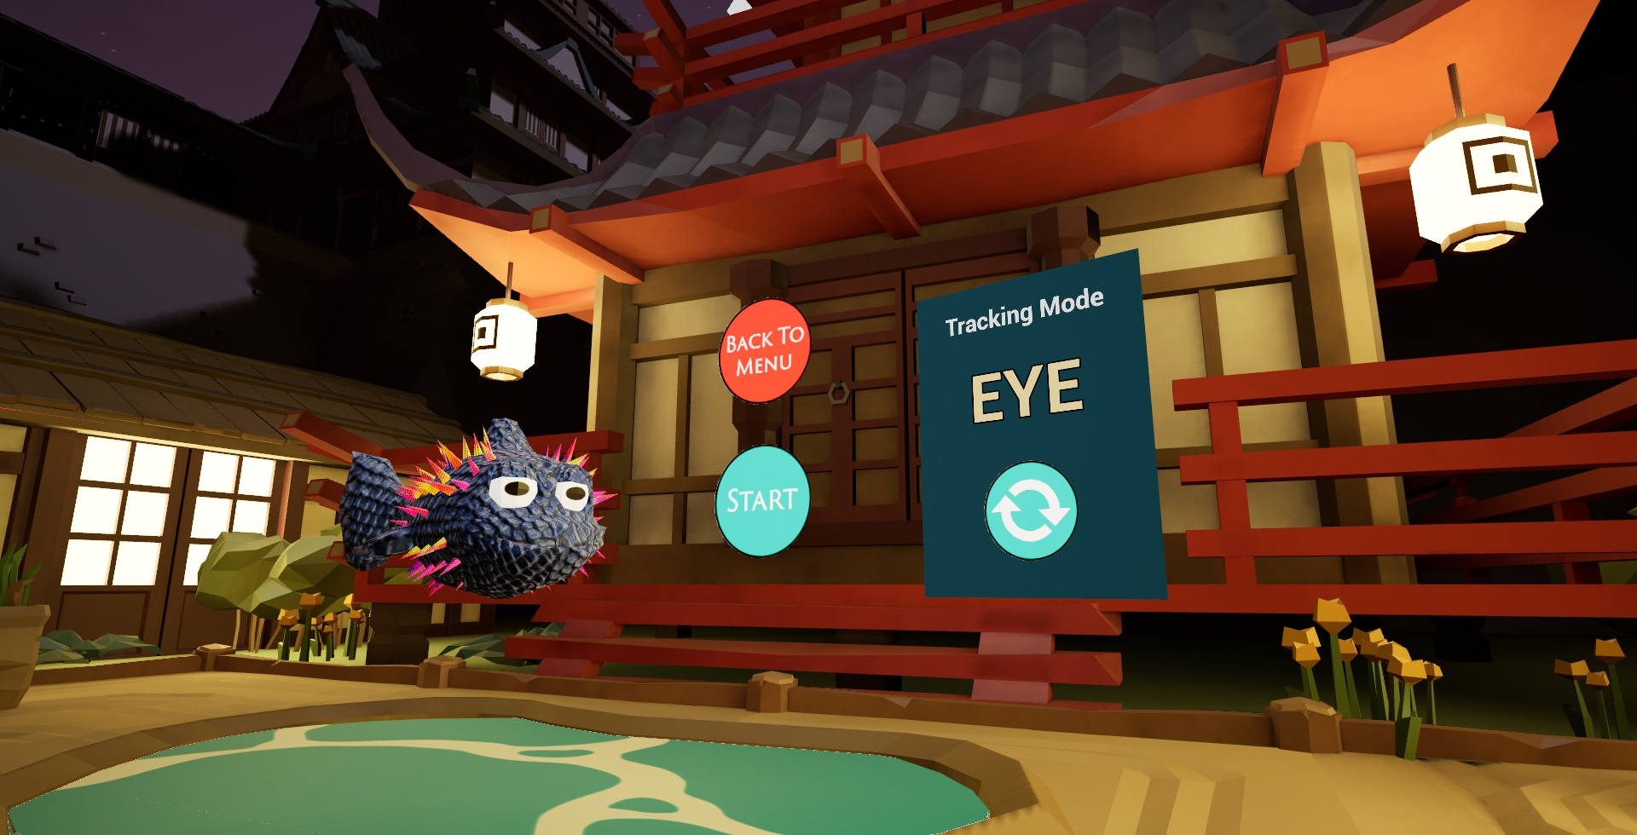
Smooth Pursuit

Slide 17
Saccades

Slide 18
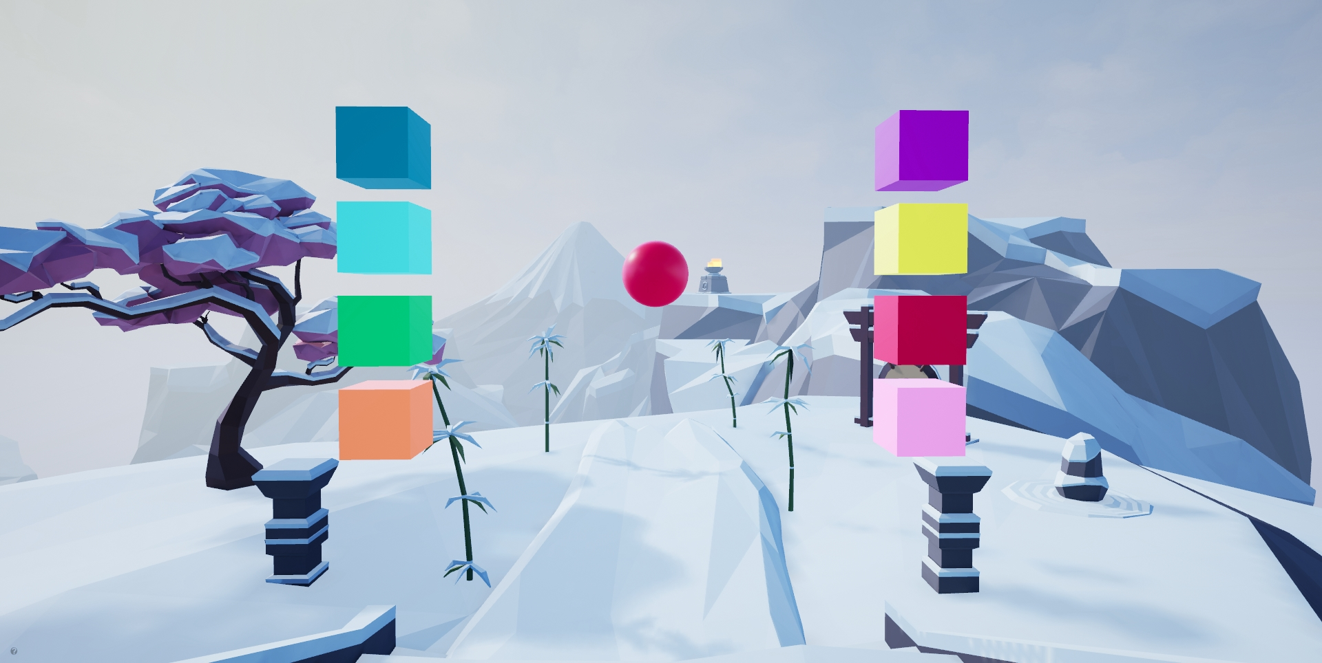
Peripheral Vision

Slide 19
Functional eye movement and perception

Slide 20
Effectiveness Study
Enrolled healthy soccer players from 2 universities
One was experimental (Mississippi College; n=78), one was control (Univ. of West Alabama; n=52)
Used VR training activities as primary intervention
Outcomes:
Training effect = change in performance on VR training activities
Near effects = clinical/ functional outcomes
Reneker JC, et al., Heliyon. 2020;6(7):e04527.

Slide 21
RESULTS
Tests | Coefficient Estimates (Std Err) | P-value
VR Scores
Sensorimotor Activities
Smooth Pursuits | 74.18 (14.5) | <.0001
Saccades | 95.78 (13.6) | <.0001
Near Point Convergence | 38.02 (14.7) | 0.005
Peripheral Vision | 43.98 (8.6) | <.0001
Cervical Proprioception | 41.93 (11.1) | <.0001
Cervical Neuromotor Control | 41.96 (10.7) | <.0001
Visual Figure | 127.73 (12.6) | <.0001
Clinical Outcomes
Cervical Neuromotor Control | 0.89 (0.2) | <.0001
Cervical Neuromotor Endurance | 8.63 (3.6) | 0.009
Total Balance Score | 6.04 (1.6) | 0.0001
Feet together | 6.89 (2.2) | 0.001
Tandem – Right | 7.18 (2.6) | 0.003
Tandem – Left | 4.65 (1.8) | 0.005
Single-leg – Right | 8.66 (3.1) | 0.003
Single-leg – Left | 9.72 (3.0) | 0.0007
Inspection Time | 1.90 (0.8) | 0.008
An interesting occurrence:
both the men and women’s soccer teams from the experimental school were regular season conference champions in 2019, which had never before happened for that school.
Reneker et al., 7/2020 Heliyon

Slide 22
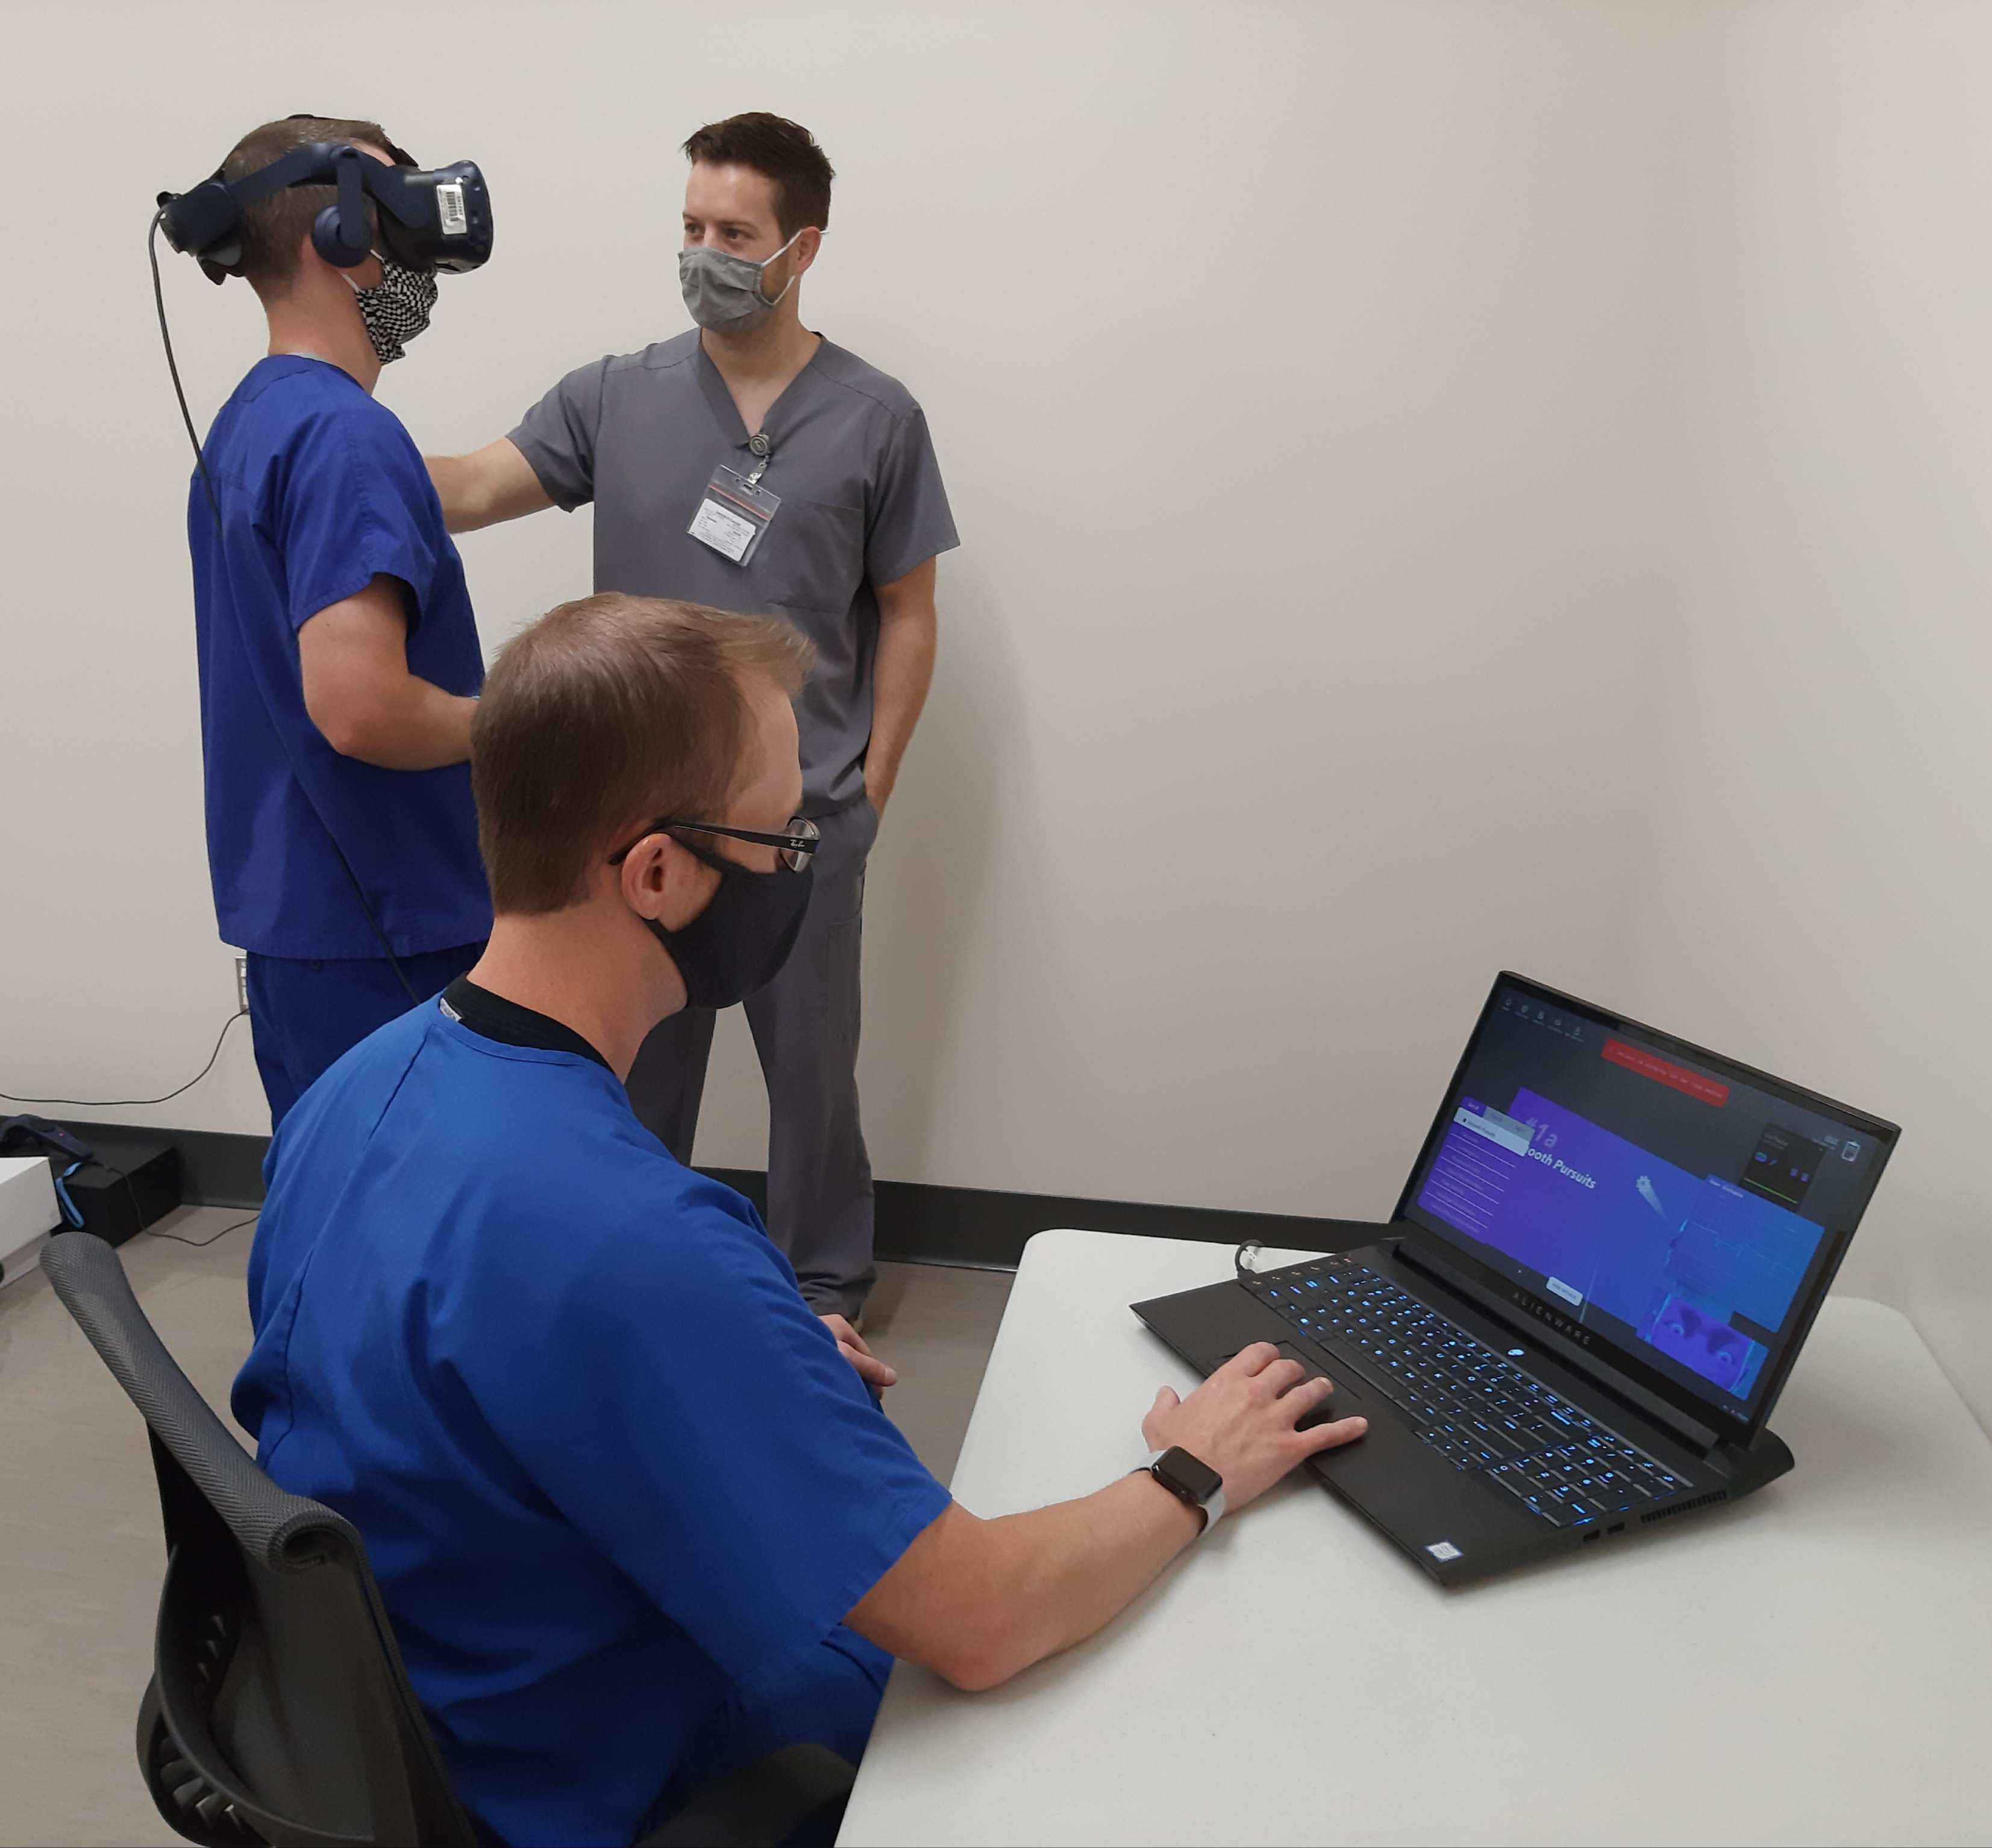
Rehabilitation after injury?
Next Steps: Transition traditional physical therapy exercises into XR environments for Rehabilitation of impairments after an acute injury

Slide 23
detection of Sensorimotor control Impairment
Ongoing work

Slide 24
The Necessity: rapid, point-of-care, standard test of concussion
Invisible injury
No gold-standard
Most examination/ diagnostic tests:
Are not standardized or objective
Require a baseline
Do not identify specific impairments to inform treatment
Were not created to interface in remote/rural environments – no Wi-Fi/ telehealth
Sensorimotor control and Neurocognition are frequently injured after a concussion, but are not routinely examined because:
Nuance
Lack of specialists
Lack of quantifiable results

Slide 25
Individuals diagnosed with concussion:
Visually guided movements requiring the integration of cognitive and motor processes are slowed
Fueger and Huddleston J clini and exp neuropsychology 2018
Specific deficits in processing speed, executive function, visuospatial abilities, and visual attention
Martue et al., J Head Trauma Rehab. 2010; Suh et al., Neurosci Lett. 2006; Alvarez et al., Optometry and vision science, 2012; Braham et al., Optometry and vision science, 2009; Colvin et al., Am J Sports Med., 2009

Slide 26
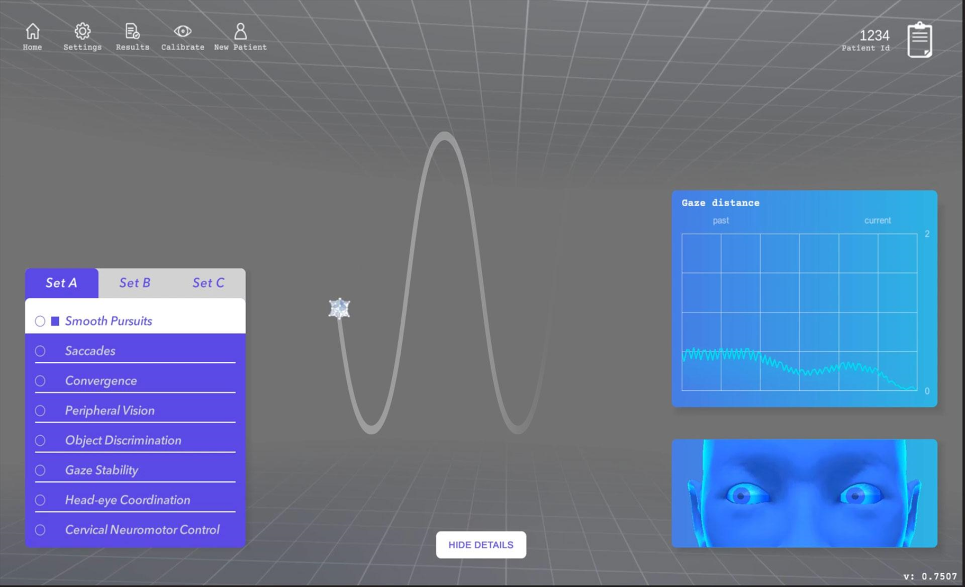
Solution: VIST Neuro-ID
Worked with a developer (Groove Jones) to develop translate clinical tests of sensorimotor control into VR.
VIST Neurological Impairment Detection

Slide 27
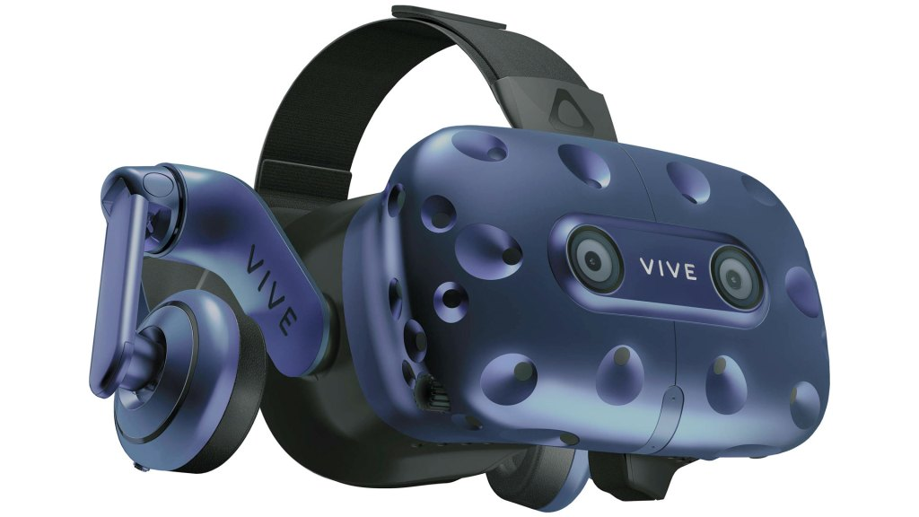
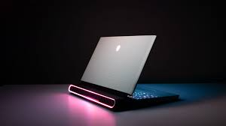
Method
8 tests with integrated sensory, cognitive, and motor control components
18 – 26 types of discrete sensor-based data, collected continuously
develop a machine learning classifier to detect neurological impairments
Statistical analysis of differences between groups
Enrolling participants 18 – 40 years of age
broadly defined as healthy
With a physician diagnosed acute concussion

Slide 28
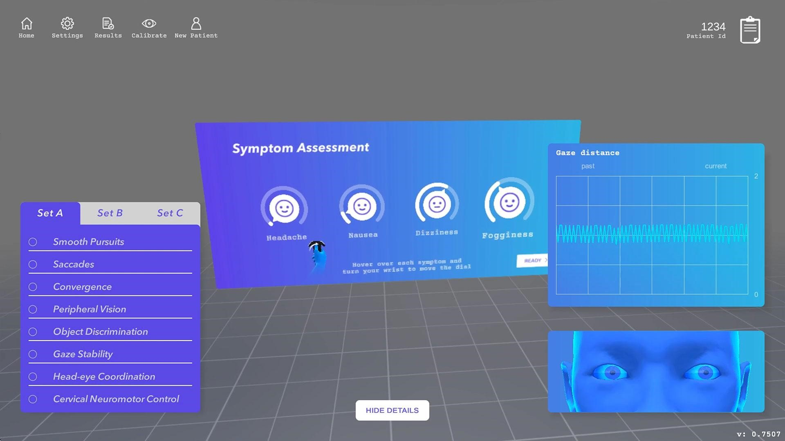

Slide 29
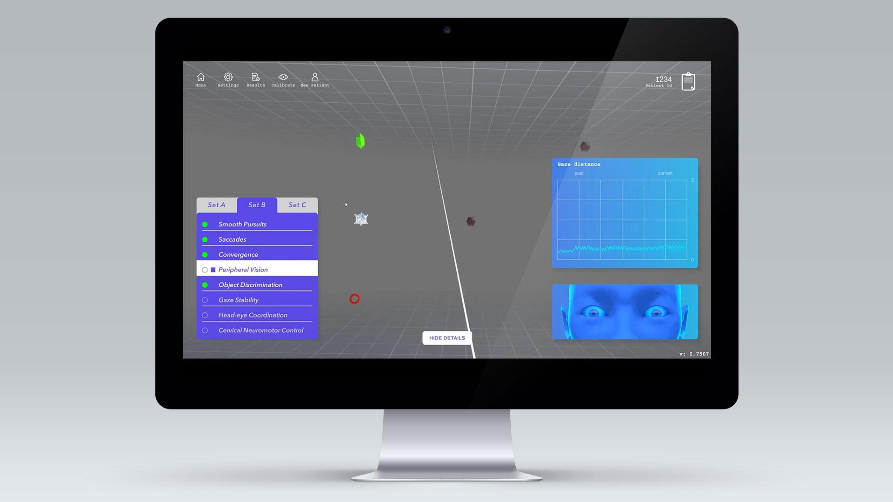

Slide 30
Enrollment So far
We have collaborative partnerships with University of Mississippi, Mississippi State, Louisiana State University (DI), Mississippi College (DII), and Millsaps College (DIII) for data collection
to date we have enrolled:
773 healthy people
19 with an acute concussion

Slide 31
General Results
We know that there are features that are distinguishable
statistical differences in performance
There is a wide range of performance abilities in the healthy population
Not all concussions present the same

Slide 32
Preliminary Results: Smooth Pursuit
Figure 2: Localization of acutely concussed (red), previously concussed (black), and participants with no history of concussion (blue) in a two feature space derived from gaze fixation in smooth pursuit. N=338 tests.
338 tests on acutely concussed (RED) and non-concussed participants, sub-classified as previously concussed (BLACK) or not (BLUE)
Use of Machine learning techniques with eye fixation data.
consistency of eye tracking in the test
Performance of tracking
Observe the separation of the acutely concussed individuals, indicating poorer performance and consistency
Decision tree classification in this space gives a sensitivity of 0.84 and a specificity of 0.61.

Slide 33
Figure 3: In the peripheral vision test, concussed subjects displayed decreased numbers of valid tests (i.e., eyes did not fixate on central object during choice) in the last quartile of testing (p<0.02). In all episode segments, concussed subjects required more time to make a choice, with significant differences in the third and fourth segments.
Peripheral Vision Test
Significant difference in the number of valid episodes in the furthest periphery (episodes 46-60; mean 14.81 vs. 12.77; p=0.02) for acute concussed
Significantly longer latency when cheating episodes were penalized, which became larger as the test progressed
peripheral vision perception is accurate, but the cortical processing time is delayed and requires use of “cheating” for correct responses at end ranges
Matched case-control analysis
Compared test performance on:
Number of valid episodes
Mean latency without cheating
Mean latency with cheating penalty
Evaluated across entire test and in quartiles

Slide 34
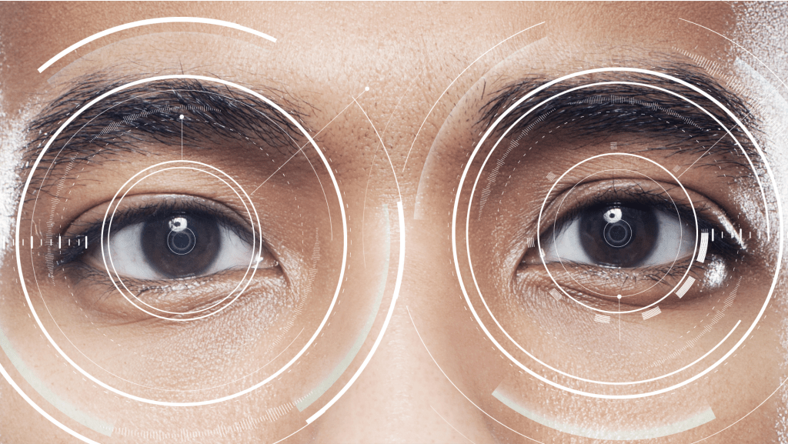
The Desired goal
A technology tool that:
does not require a baseline
identifies specific impairments to direct treatment
Quantifies deficits to measure change over time
Can be used in person or through telehealth

Slide 35
Vision for the future
This will be useful in non-injury states:
in rural poor areas, like Mississippi
For cognitive baselining in pilot training
To identify individuals at risk of injury
Geriatrics – dementia and falls
Athletes
Service Members
To drive more effective prevention methods
This will be useful in injury states:
in rural poor areas, like Mississippi
For far-forward diagnostics in military environments
To enhance objectivity in medical decision making
To drive more effective treatment methods
Beyond concussion, in other conditions which injure functional neural networks

Slide 36
Jennifer Reneker, PT, PhD
Jreneker@UMC.edu
www.linkedin.com/in/jennifer-reneker-pt-phd/

